Slide 1
Esther Pearson, Director
South West Coast Path Association

Slide 2
National Trail
One of 15 in England & Wales
Highest standard of public right of way
630 miles – Minehead to Poole
Follow the Acorn
Association – registered charity working with the Trail Partnership to Promote & Protect

Slide 3
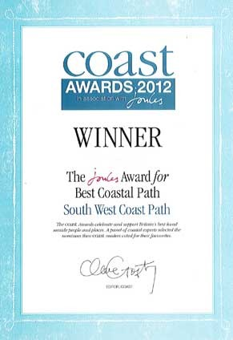
Notes:
Highly recognised
Coastal Path series
Dog award…

Slide 4
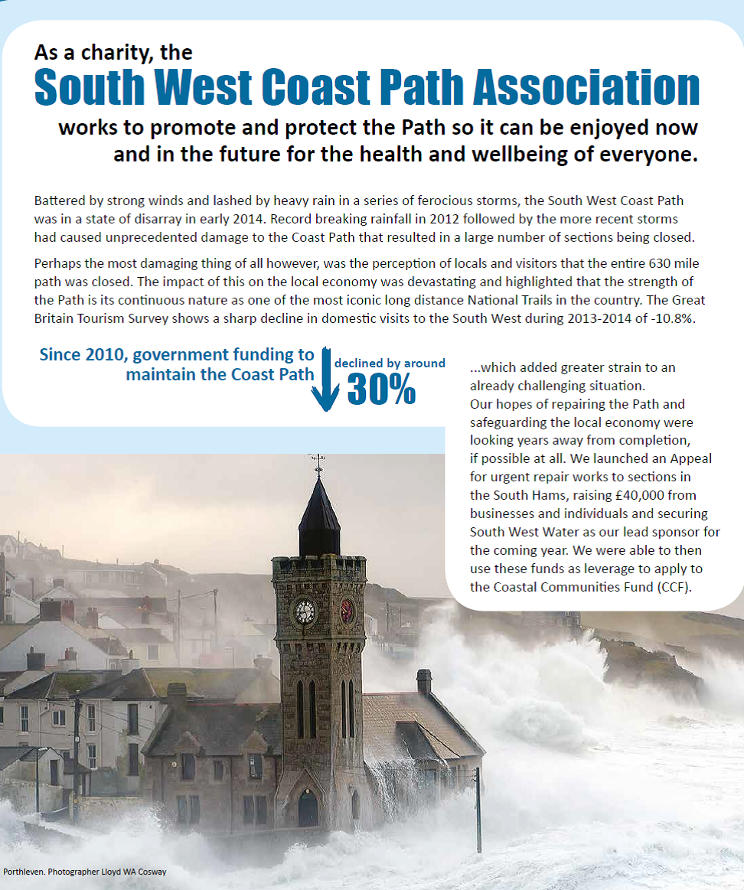
Cuts & crashing waves
2014 saw
9 million drop in revenue =
800 less jobs

Slide 5
Delivery
41 Capital repair projects
61 Information boards
Events 1,500 participants
Membership 6,500 & 500
Promotion reaching nearly 2 million

Slide 6
Impact
Reverse decline
Sustain jobs
Create jobs

Slide 7
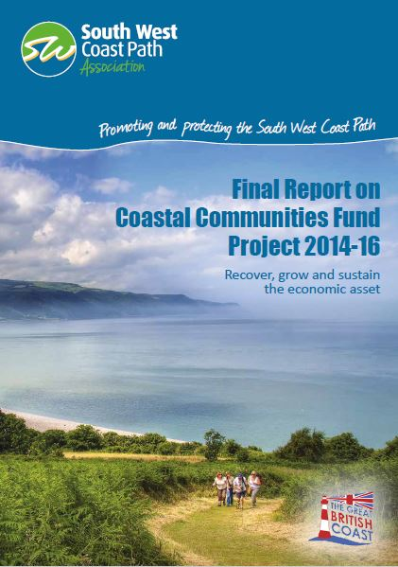
Celebrate success
Digital
Media
Print
Promotion = Discover
England’s South West Coast
Path

Slide 8
Thank you

