Slide 1
Unlocking Coastal Potential
Gareth Bradford
Deputy Director
Cities and Local Growth
Department for Communities and Local Government
Gareth.bradford@communities.gsi.gov.uk

Slide 2
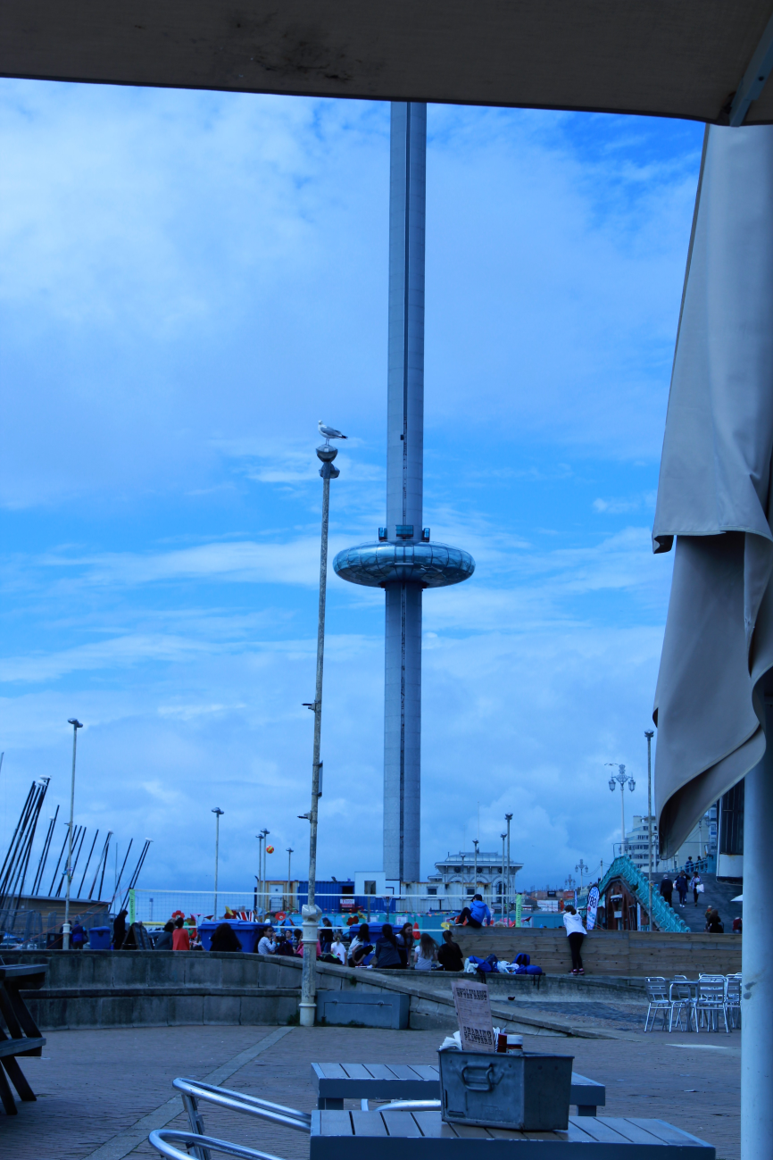
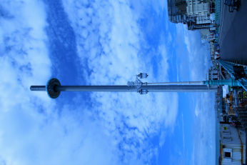
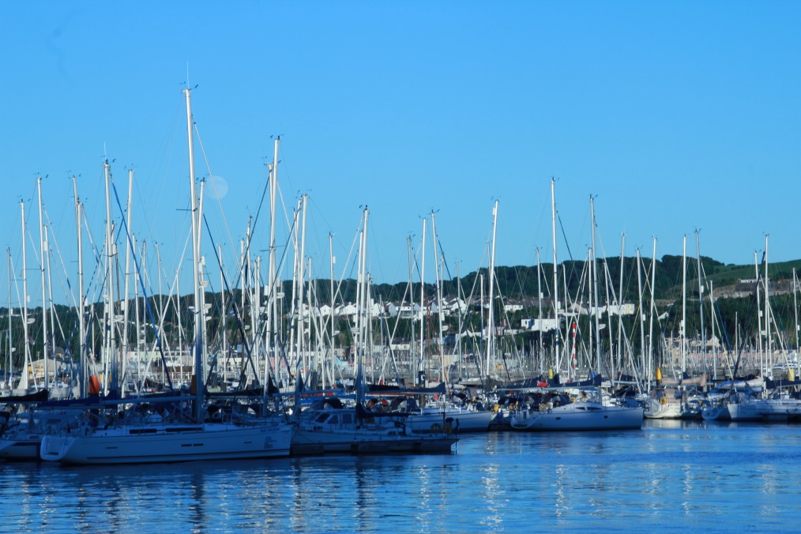
Importance of ‘Place’
Identity
Unique Selling Point
Community specific
Connectivity
Partnership
Ability to celebrate
Importance of CCT Economic Plans in coastal areas.
Notes:
Photo is Plymouth
Important to understand the identity of a place – what matters to the community, what should be preserved and where change is needed. Differences between tiny communities and cities also to be understood and addressed appropriately – e.g. Portwrinkle in Cornwall with their kayak racks, and Brighton’s i360, Hull’s Fruit Market
USP of the locality can be about entertainment, arts, heritage, maritime, night time, everything?
Importance of all aspects of community life joining together, transport, education, leisure, business, etc.
Serious option for public/private/community engagement

Slide 3
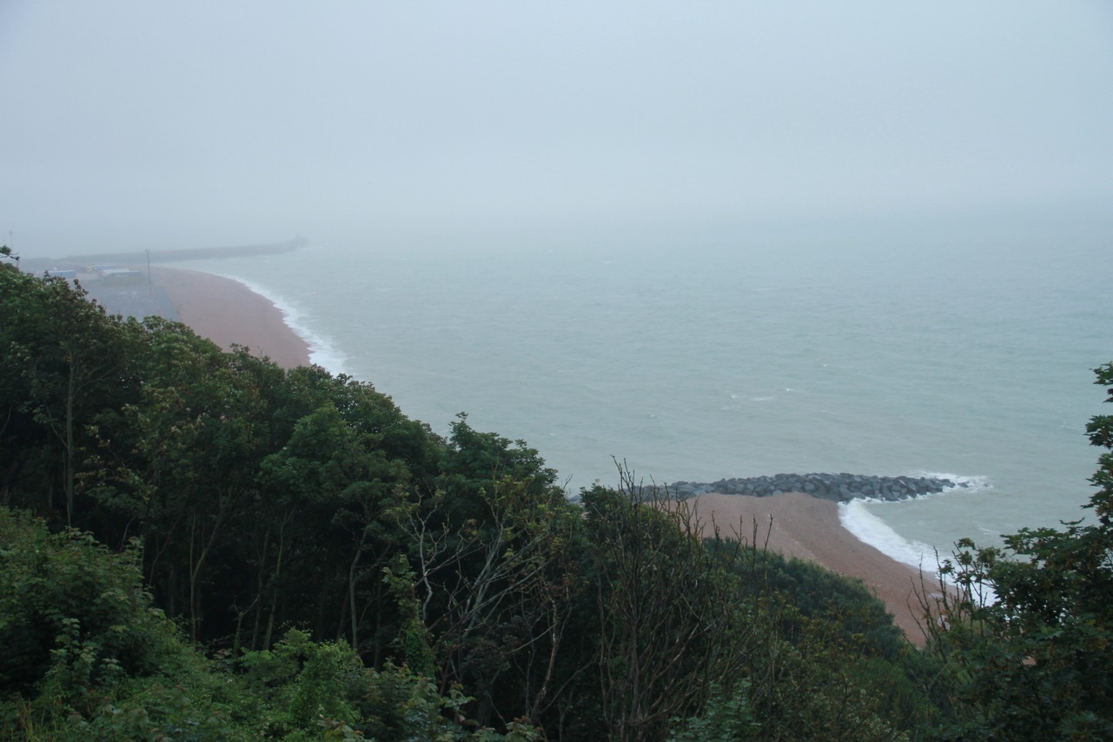
What Matters
Infrastructure – transport, weather, power, access, signage
Customer segmentation
Engagement
The ‘big picture’
Media, publicity, marketing
Notes:
Photo is Folkestone
You don’t need notes on this! Weather should be considered in terms of not needing to cancel. Power – Hull is building in power and water the whole length of their main street for their market stalls. access should consider all sorts of access issues but safety as well and the ability to maximise the space and use it for an array of uses and private investors. Digital capability?
Consider the different types of groups you want to attract, e.g, elderly, teenagers, kids, dog walkers, sports people, artists, environmentalists, etc
Everyone must be engaged in the development, the proposals and the decisions for it to be successful. ‘Fresh eyes’ – bring people in from outside the locality to find out what they would want
Not about the LA or the immediate community but the wider communities, visitors, economy, infrastructure, the future, etc
Do not emphasise impact of marketing at a local, wider, and social media level. At Manchester Picadilly, the wide screens are advertising the free Lightpool events in Blackpool

