Slide 1
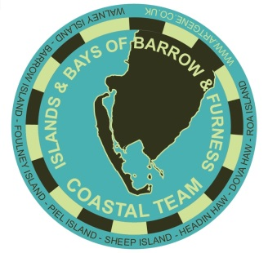
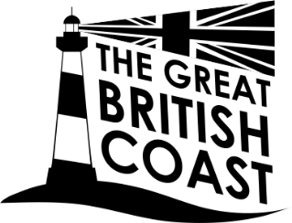
The Islands and Bays of Barrow and Furness
Coastal Community Team
Maddi Nicholson
Charlie MacKeith

Slide 2
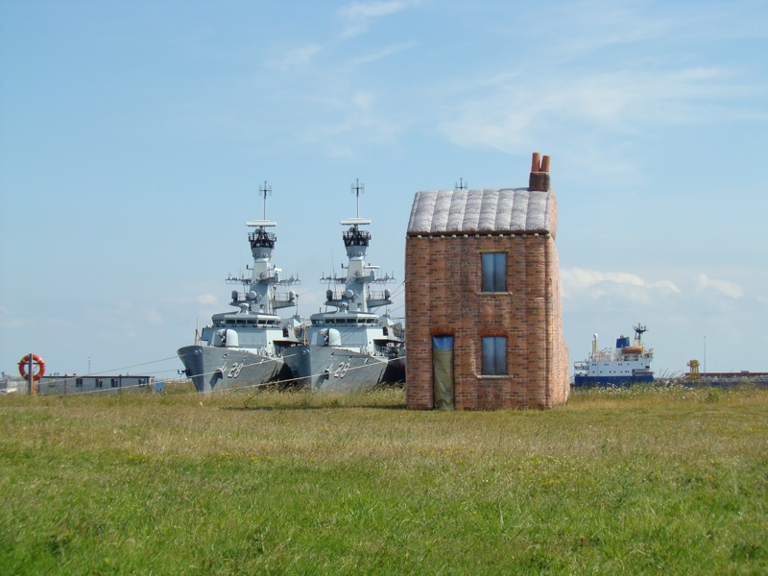
Maddi Nicholson: Barrow terrace on tour

Slide 3
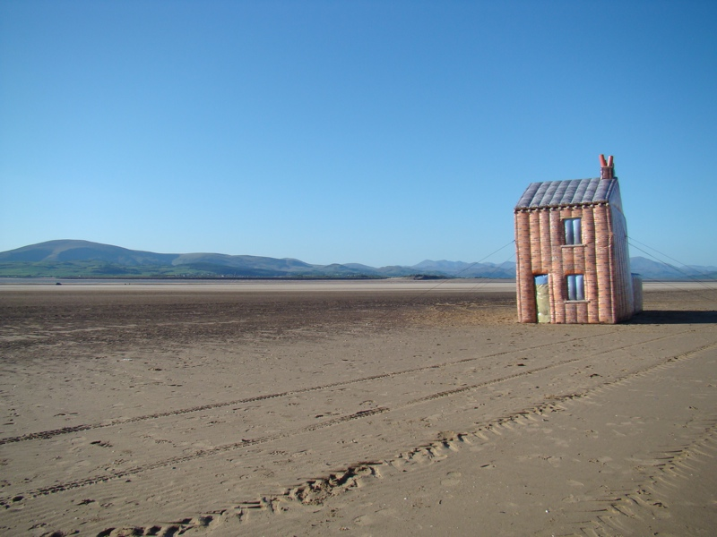
Maddi Nicholson: Barrow terrace on tour

Slide 4
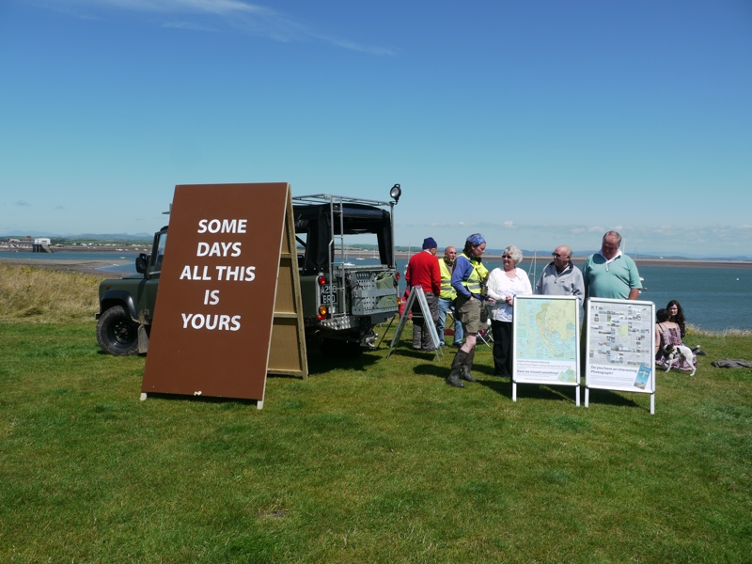
The Social: Mobilising & empowering people

Slide 5
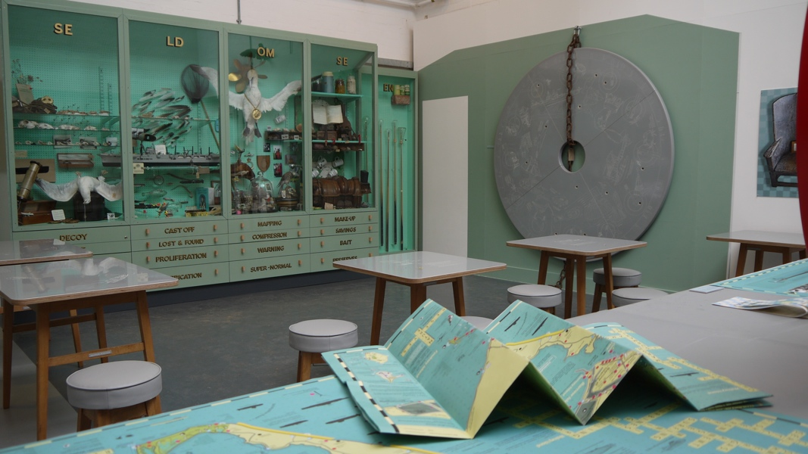
The Islands of Barrow Peoples' Museum:
Meat Pies, Natterjack Toads, Nuclear Submarines, Basking Sharks, The Fat Controller, Airships, Six Spot Burnet Moths, Mass Observation, Skinning Squirrels, Super Stimuli, Mythological Kings, Yellow Horned Poppies & the largest Off-shore Wind-farm in the world...

Slide 6
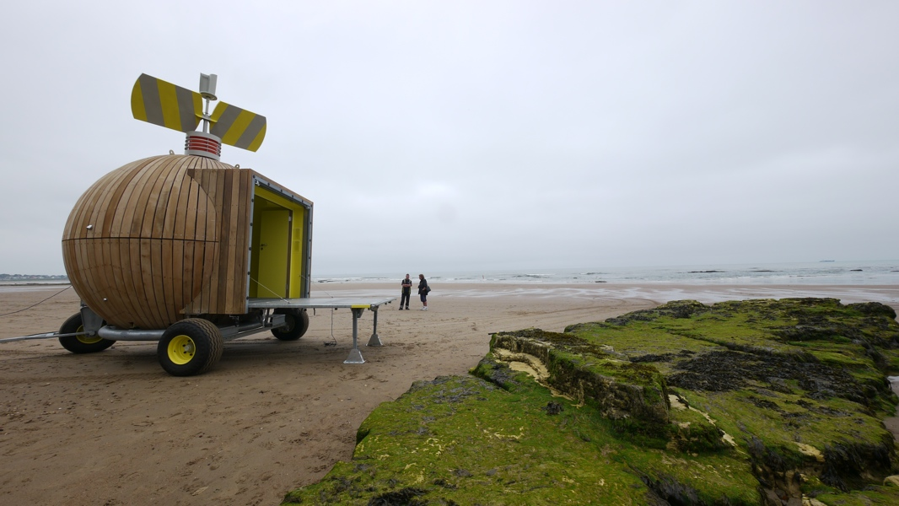
The Built:
including the unloved, the listed, vernacular, industrial, scheduled & the unsanctioned

Slide 7
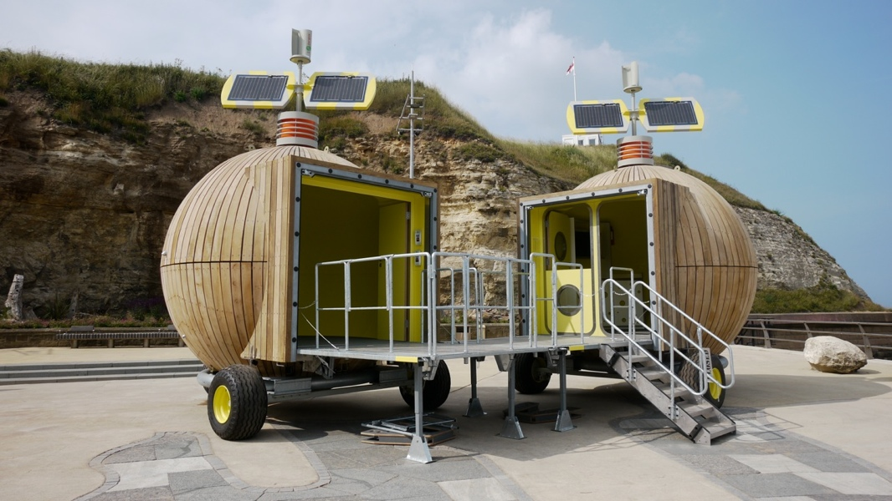

Slide 8
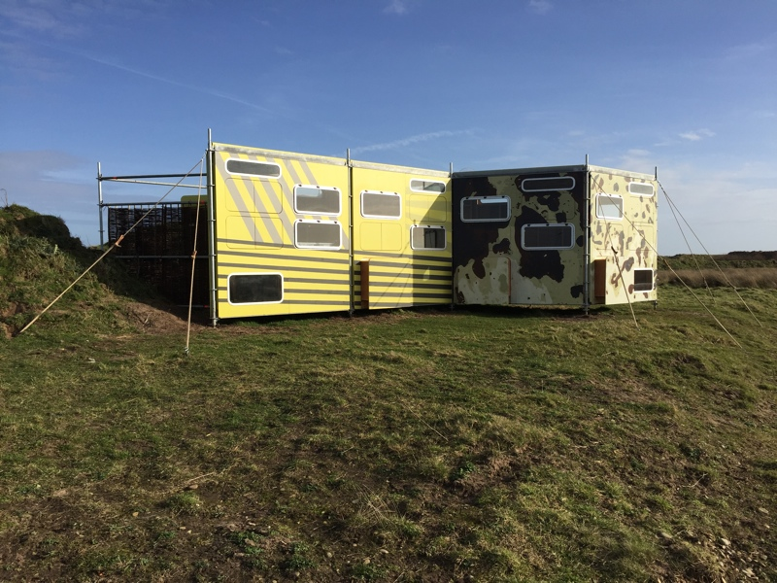

Slide 9
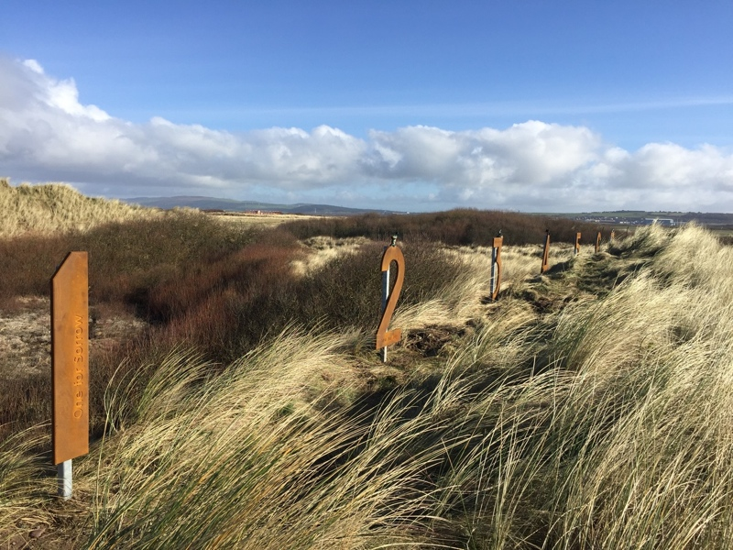

Slide 11
Snowdonia
Isle of Man

Slide 13
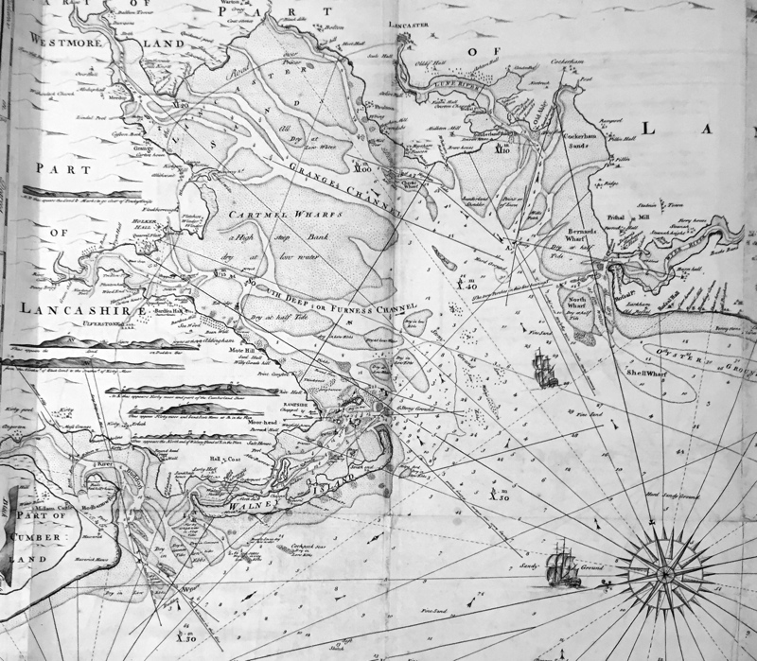

Slide 14
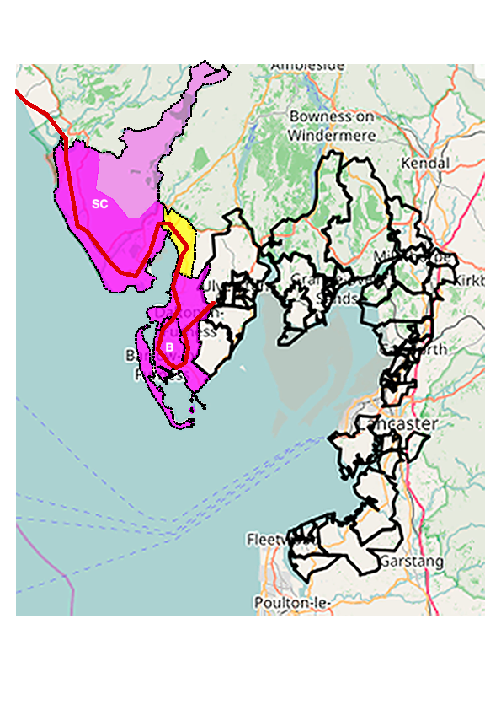

Slide 15
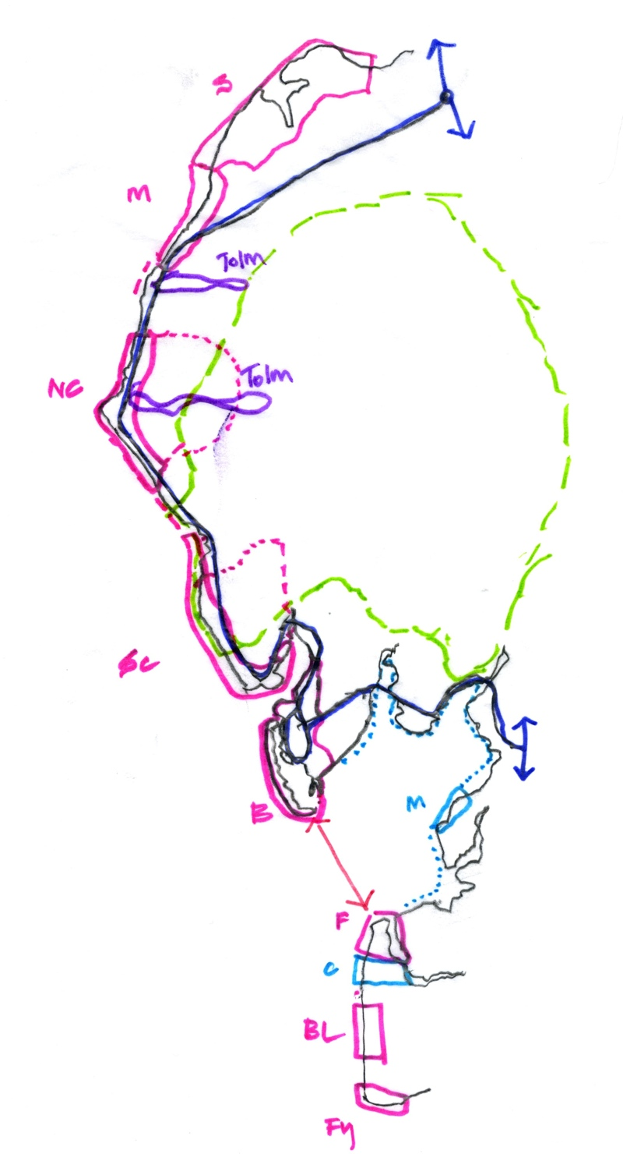
connecting Cumbria’s coast

Slide 16
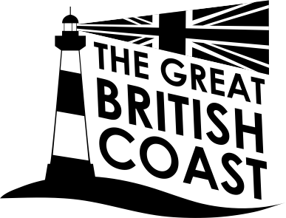
The Islands and Bays of Barrow and Furness
Coastal Community Team
Maddi Nicholson
Charlie MacKeith

