Slide 1
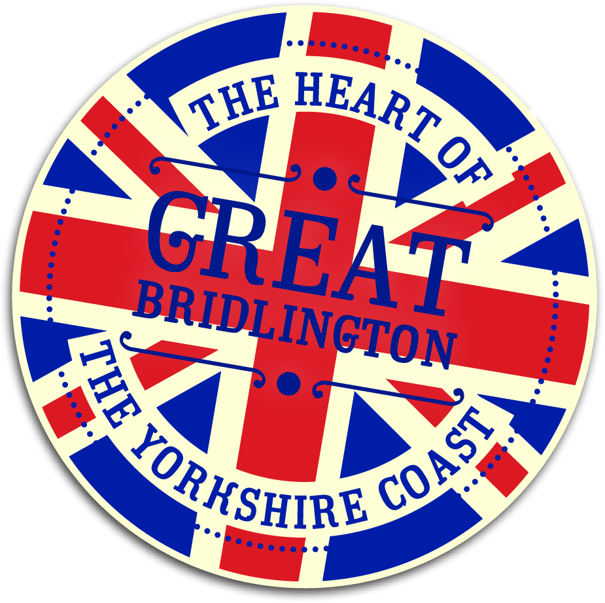
“Making Links” Bridlington Coastal Community Team
Liz Philpot
21st April 2017

Slide 2
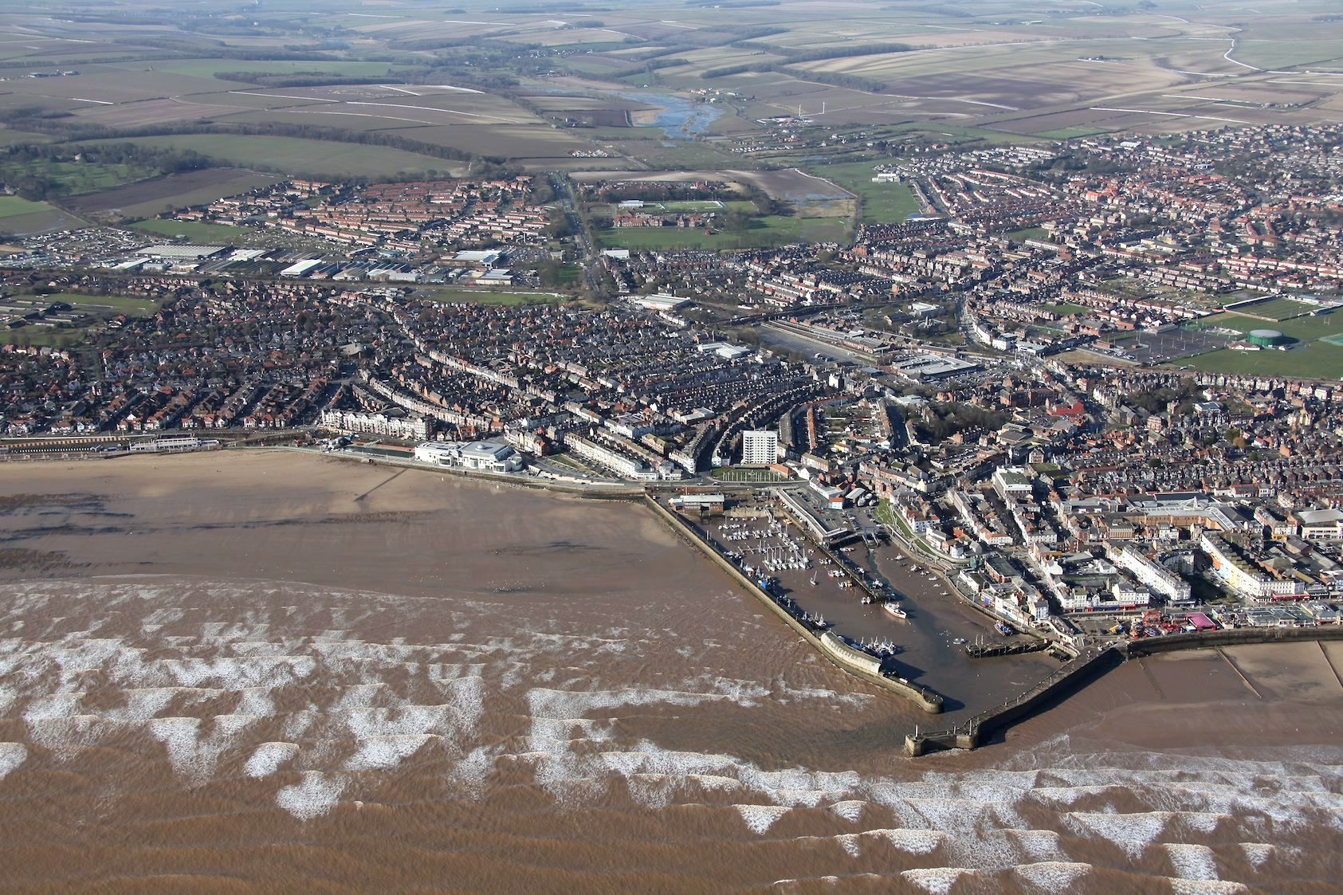
“Making Links” Bridlington Coastal Community Team
Notes:
Bridlington’s Regeneration Strategy was established in 2004, led by the unitary local authority, East Riding of Yorkshire Council, with an ambitious long term programme of master planning and major project delivery. It was prioritised by the Council as the largest town in the East Riding (35,000 population) with the most significant levels of deprivation – annual benefit payments estimated at approx £30million - but with the greatest prospects for change and economic growth. Many of the characteristics that you will all be familiar with, and why there is such a strong case for coastal communities to be supported to achieve their economic potential.
The Seven Point Regeneration Plan was based on a robust economic analysis of the local economy, which provided clear evidence for public interventions to tackle local market failures, particularly for more effective economic land use in the town centre.

Slide 3
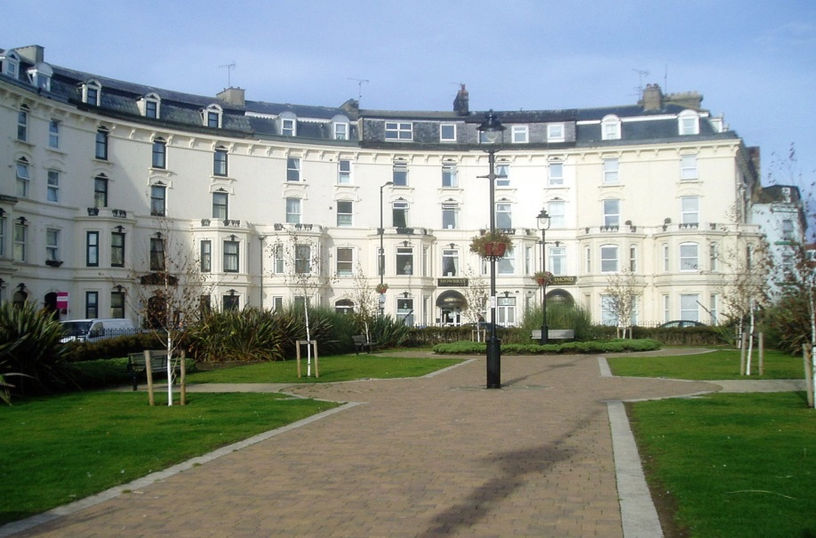
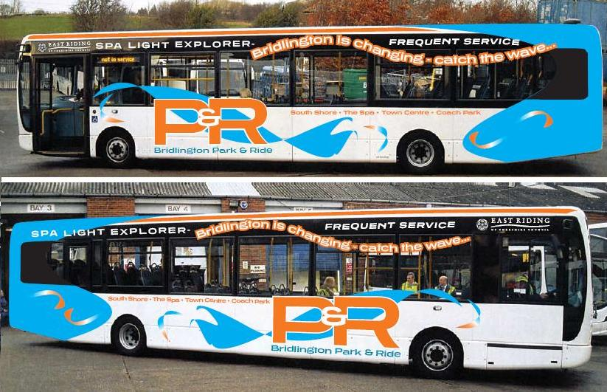
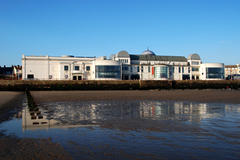
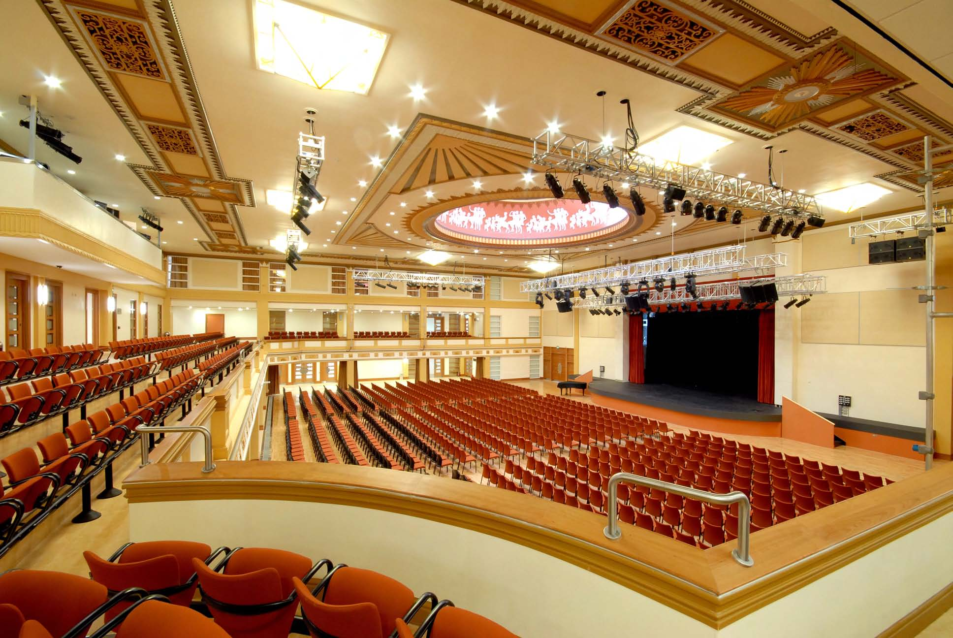
Bridlington’s Regeneration
Crescent Gardens, Public Realm
Bridlington Spa
Bridlington Park & Ride
Notes:
Projects have been delivered as opportunities have arisen - the first major project to go ahead was Bridlington Spa in 2006, which recognised the impact of Bridlington Spa on the local economy, investment of d £21m to re-model the building into one of the most prestigious entertainment venues in the region, now operating with a surplus. Major successes of Bridlington Spa have been to make links with local tourism businesses, maximising the potential of the venue to bring staying visitors into the town, and also links with the local community to maximise use of the facilities all year round.
Transport studies led to delivery of two major integrated transport projects – Phase 1 in 2010 with Dept for Transport funding for junction improvements on the main approach roads into Bridlington, and a new seasonal park and ride facility to relieve town centre traffic congestion; Phase 2 currently under construction for town centre highway widening, new bridgeworks and improved traffic circulation to service new development sites, supported by the Humber LEP Local Transport Fund. The Park & Ride service now carries around 90,000 passengers each season, saving around 30,000 car journeys into the town centre.
Bridlington harbour is the largest shellfish landing port in the UK, and has successfully diversified from traditional fishing, with younger generations now taking over their family businesses, and investing in new state-of-the-art vessels, the fleet has increased slightly in recent years. The historic harbour offers potential for a new marina, and waterfront commercial developments that will link Bridlington Spa with the town centre, and new developments.
Improvements to public spaces has also been a key part of the Regeneration Strategy – links between the town centre, harbour and Bridlington Spa were improved through the DCMS Sea Change programme, with further investment in areas connecting new developments.

Slide 4
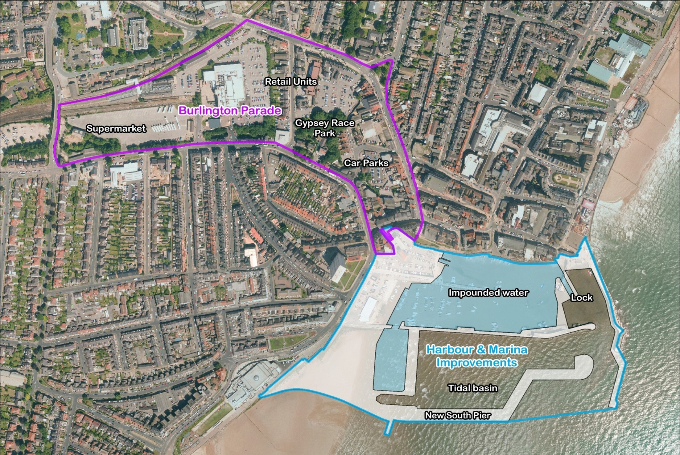
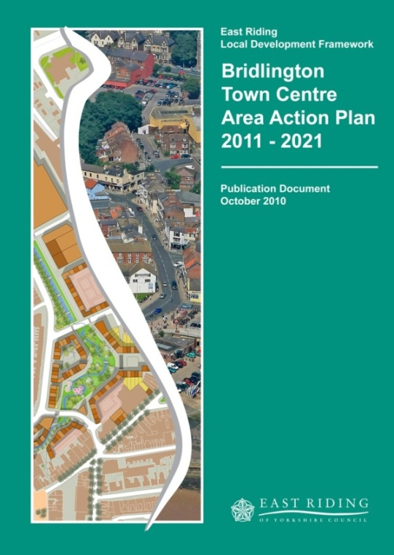
Bridlington’s Regeneration
Notes:
The Town Centre Development was the most ambitious and longest term proposal set out in the original Regeneration Strategy.
Initially a Land Use Strategy was commissioned, which led to the Council taking the decision to promote an Area Action Plan for the scale of change envisaged for the Town Centre. Initially this took the form of Issues and Options, then Preferred Options and subsequently the Submission Document that went through Examination in Public. It was found to be sound, in planning terms, and whilst ambitious, was consider by the Planning Inspector to be deliverable. The Bridlington Area Action Plan was therefore adopted by the east Riding of Yorkshire Council as planning policy in 2013, to enable mixed use town centre developments, linked to the existing town centre and historic harbour, including a new marina and improved facilities for commercial fishing.

Slide 5
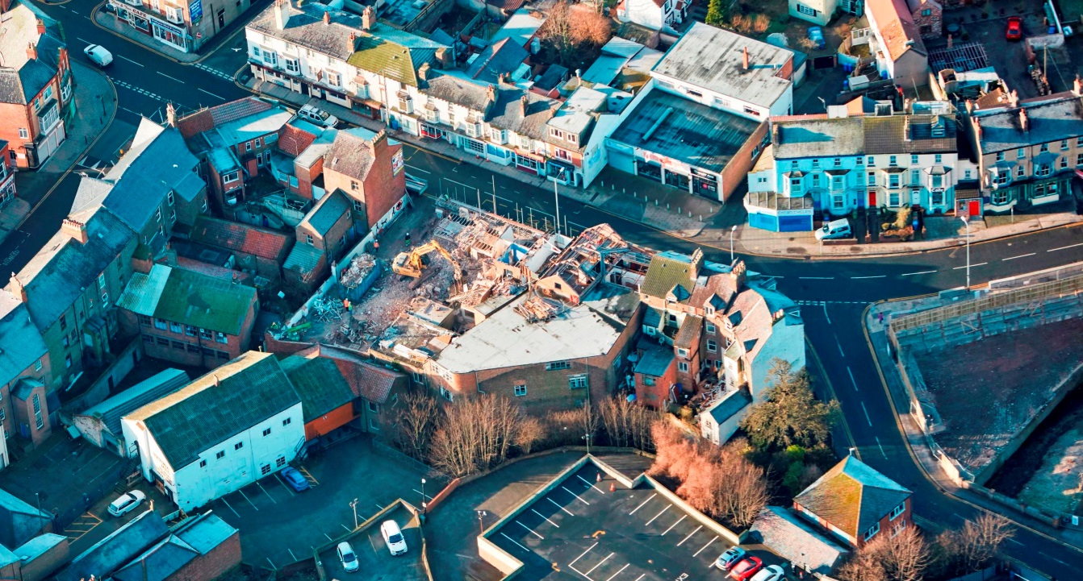
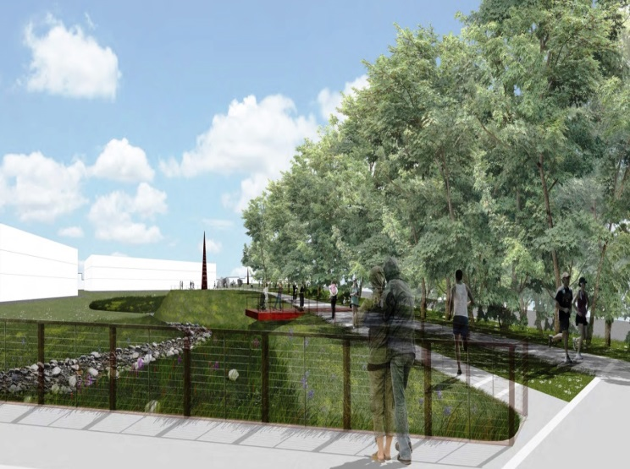
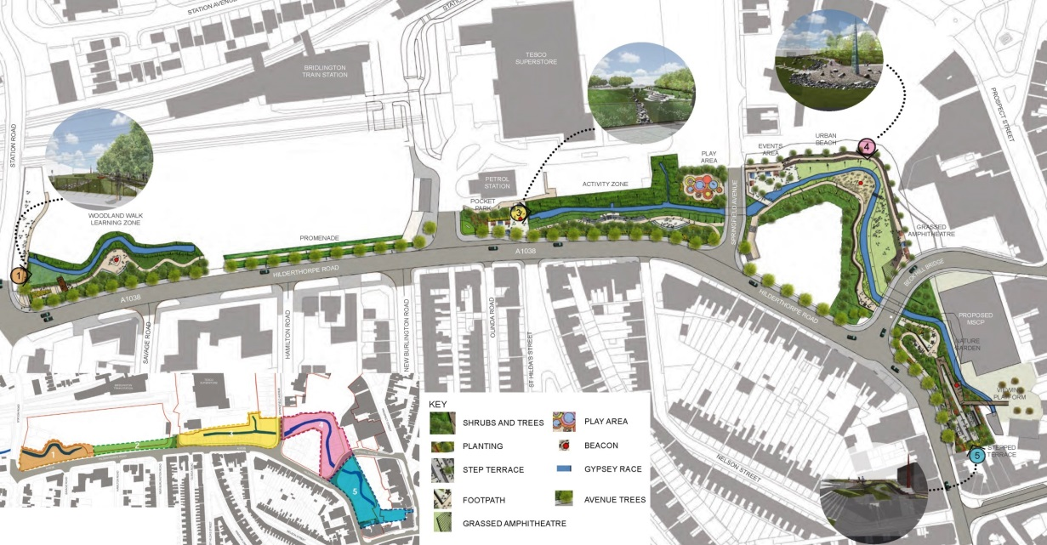
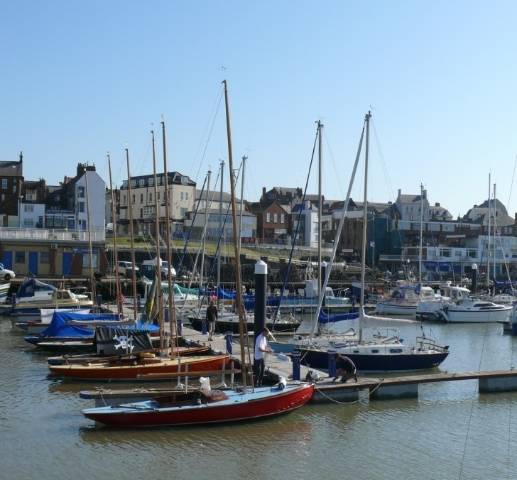
Bridlington’s Regeneration
Bridlington Spa
Town Centre Development
Gypsey Race Park
Crescent Gardens, Public Realm
Bridlington Harbour
Bridlington Harbour
Bridlington Park & Ride

Slide 6
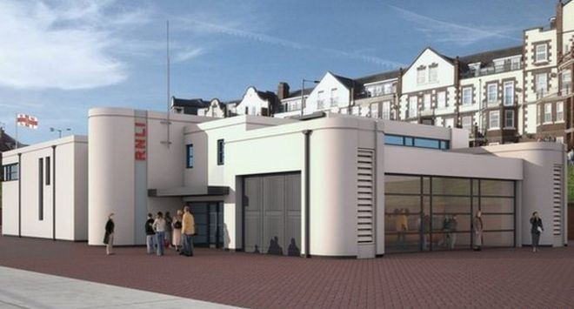
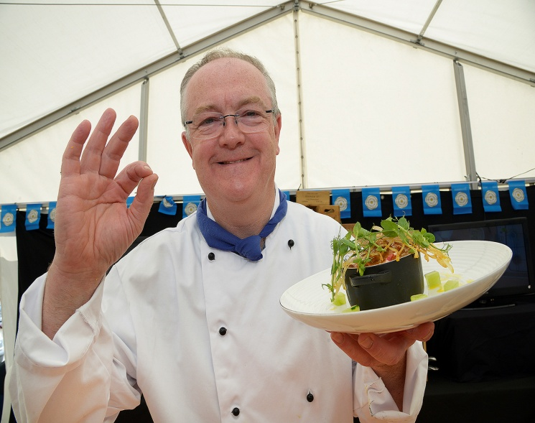
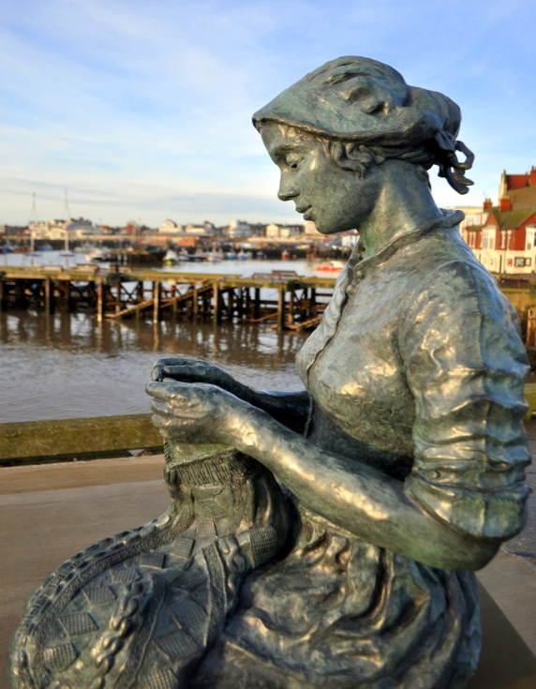
Bridlington’s Regeneration
RNLI Sea Safety Centre
Bridlington Seafood
Festival
Bridlington Spa
Crescent Gardens, Public Realm
Maritime Trail
Flamborough Head
Living Seas Centre
Bridlington Harbour
Bridlington Park & Ride
Notes:
Investments by other partners – RNLI, RSPB, Yorkshire Wildlife Trust, and of course private investment by local businesses and investors have all helped to achieve the progress to date.
Smaller projects have been equally as important to win public support while longer term projects are in development.
The Maritime Trail is self-guided around the heritage of Bridlington’s 700 year old harbour, with the star of social media the “The Gansey Girl” on the north pier by local sculptor Steve Carvill.
Several of these have attracted Coastal Communities Funding, including Yorkshire Wildlife Trust Living Seas Centre at Flamborough Head – delivering marine wildlife stewardship, living seas boat safaris, rock pooling, and a full educational event programme throughout the summer months.
The Yorkshire Wildlife Trust Living Seas Centre has also offered traineeships to those keen to work in the marine environment sector. In the last 12 months, two of these volunteer trainees have gone on to secure paid roles within the charity.

Slide 7
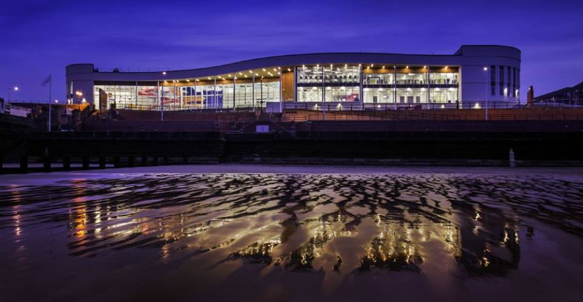
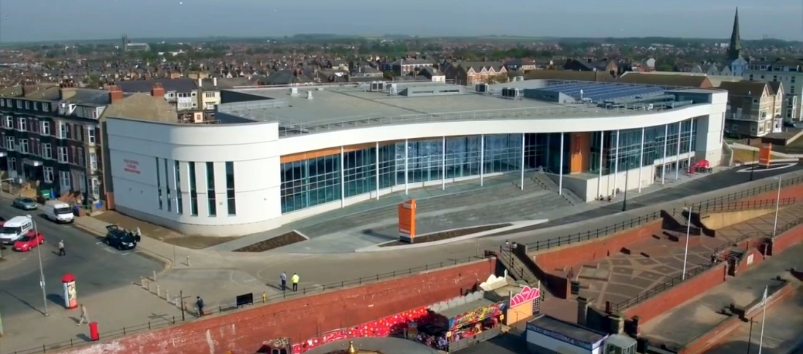
Bridlington’s Regeneration
East Riding Leisure Bridlington
Bridlington Spa
Crescent Gardens, Public Realm
East Riding Leisure Bridlington
Bridlington Harbour
Tone Zone Fitness Suite
Bridlington Park & Ride
Notes:
Most recently East Riding Leisure Bridlington opened in May 2016, an investment by the East Riding of Yorkshire Council of £25m, including Coastal Communities Fund and Sport England Grants of approx. £2m each. The emphasis of the project is again to provide excellent facilities for residents that visitors can also enjoy, and also aimed at promoting the health and well being of Bridlington’s coastal community.

Slide 8
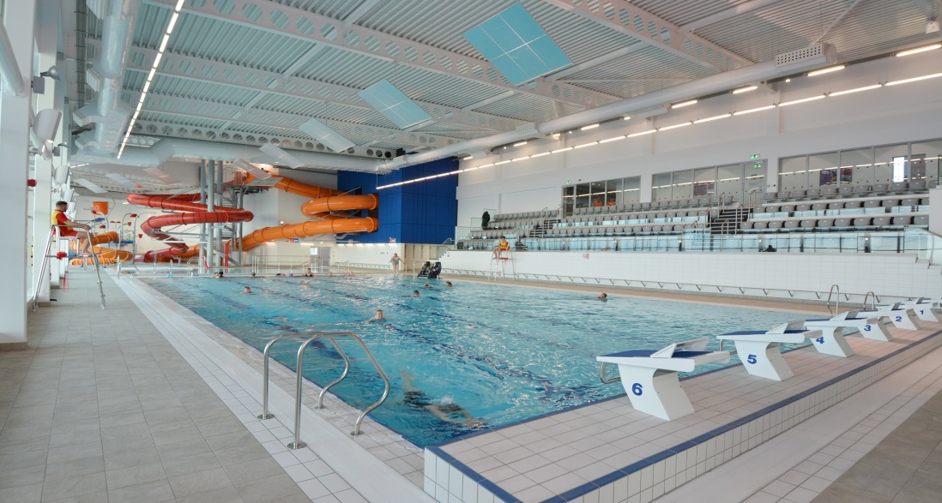
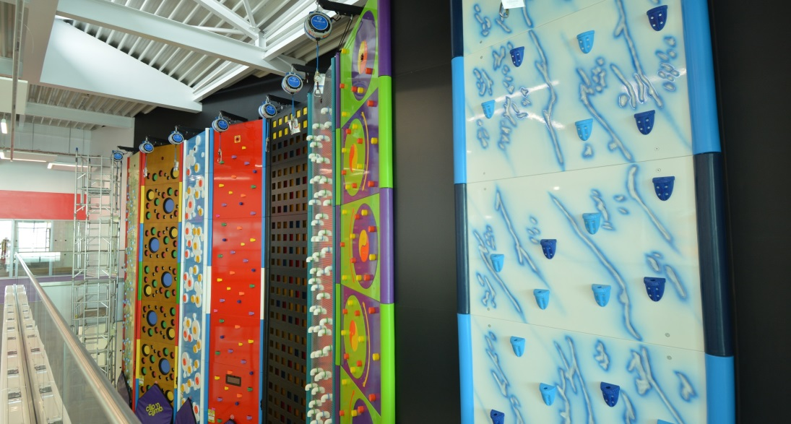
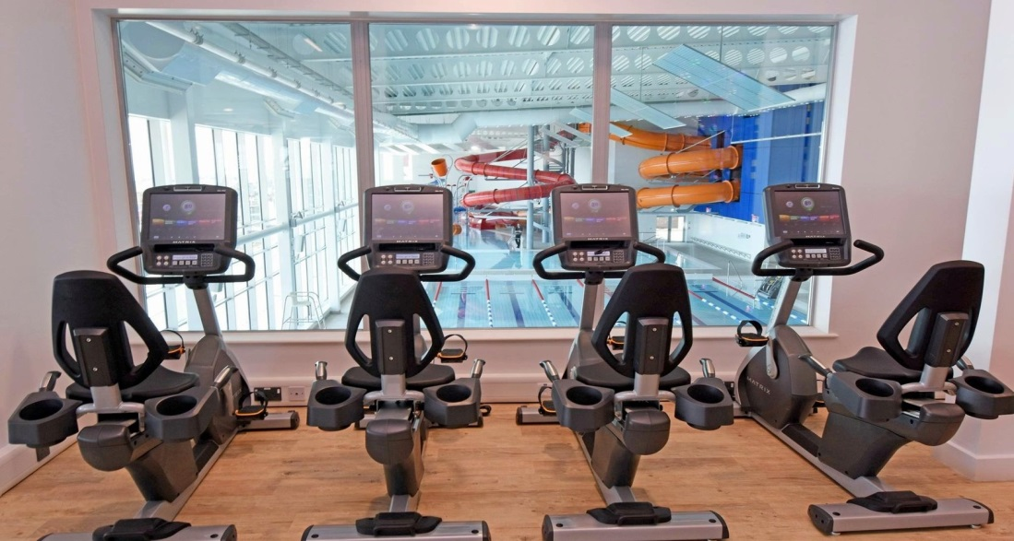
Bridlington’s Regeneration
Bridlington Spa
Clip & Climb Wall
Crescent Gardens, Public Realm
Bridlington Harbour
Tone Zone Fitness Suite
Bridlington Park & Ride
Notes:
The emphasis of the project is again to provide excellent facilities for residents that visitors can also enjoy, and also aimed at promoting the health and well being of Bridlington’s coastal community.

Slide 9
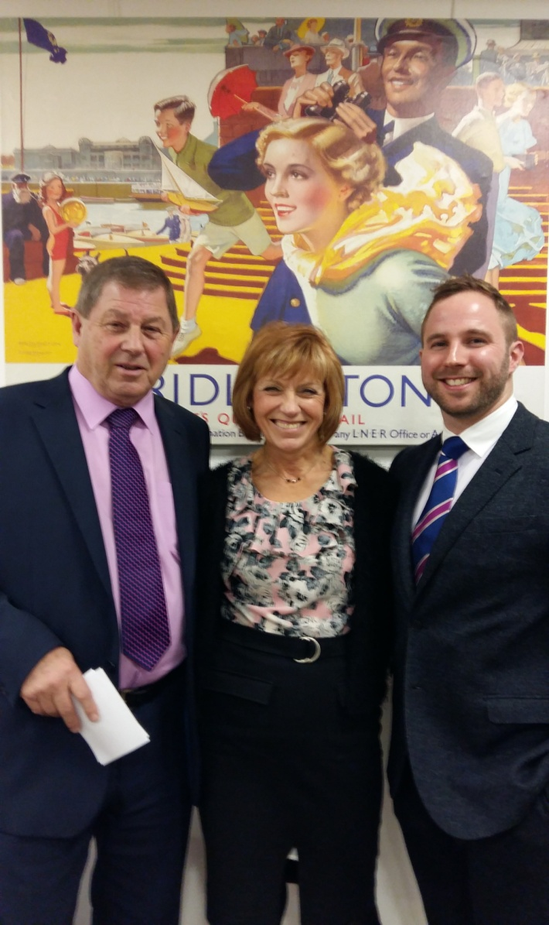
Bridlington Coastal Community Team
East Riding Leisure Bridlington
Bridlington Spa
Business Engagement
Local Business Networks
New Events
Ambassadors for Regeneration
Influencing investment decisions
Supporting the future of our young people
Crescent Gardens, Public Realm
Clip & Climb Wall
Bridlington Harbour
Tone Zone Fitness Suite
Bridlington Park & Ride
Notes:
The Great British Coast has enormous economic potential and the government is determined to see it thrive all year round.
That’s why we’ve funded Coastal Community Teams across the country to take control of their own area’s regeneration and drive forward future growth, jobs and prosperity
And by 2020 we will have invested over £210million in seaside areas through a dedicated Coastal Communities Fund.
These Coastal Communities Teams have brought together local people, councils and businesses – already they have submitted radical economic plans for how they plan to drive forward future growth, jobs and prosperity.

Slide 10
Bridlington Coastal Community Team
East Riding Leisure Bridlington
Bridlington Spa
Clip & Climb Wall
Bridlington Harbour
Tone Zone Fitness Suite
Bridlington Park & Ride

Slide 11
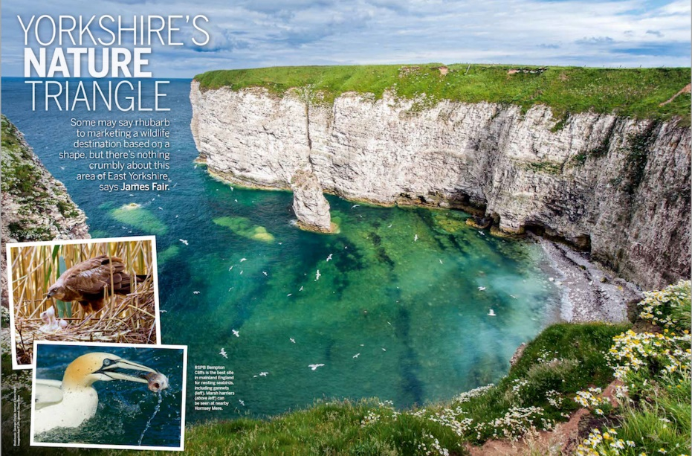
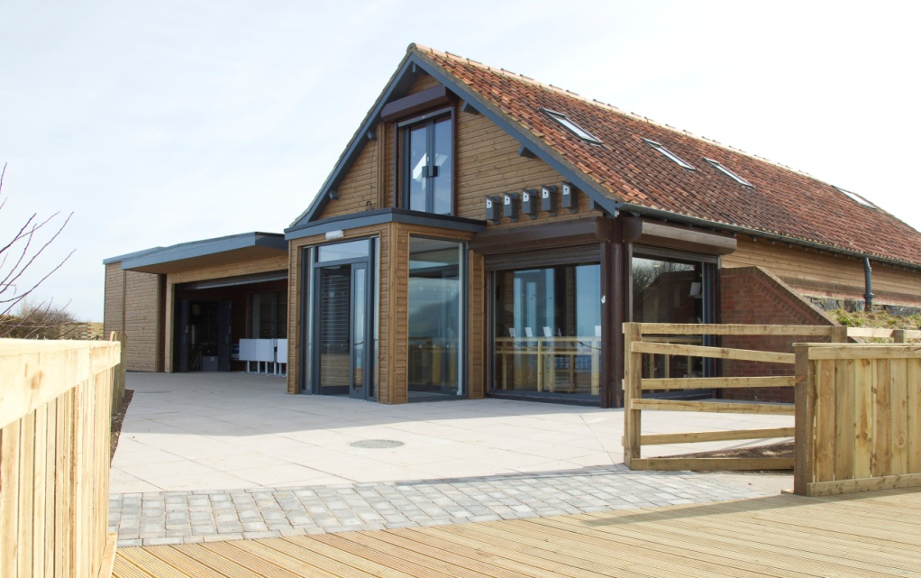
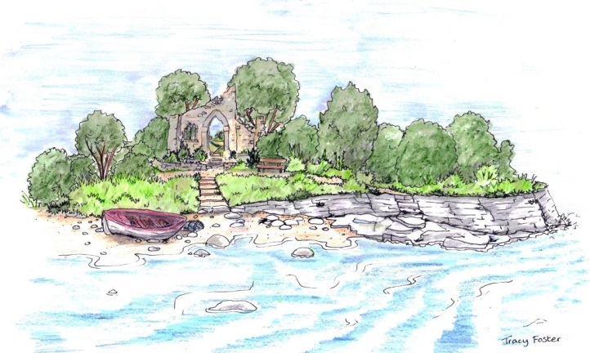
Bridlington Coastal Community Team
East Riding Leisure Bridlington
Bridlington Spa
Clip & Climb Wall
RSPB Bempton Cliffs
Bridlington Harbour
Tone Zone Fitness Suite
Bridlington Park & Ride
Notes:
Primary seven page feature in March edition of BBC Wildlife focused on wildlife and nature tourism in East Yorkshire
RSPB - 3 year visitor number targets hit in first year – helped by BBC Springwatch at Easter when it launched.
Welcome to Yorkshire RHS Chelsea garden - 2017 show garden will be based on Yorkshire coast
Materials inspired and sourced at Flamborough - Major media exposure. Chance to tell guests where they can get a taste of the real thing!

Slide 12
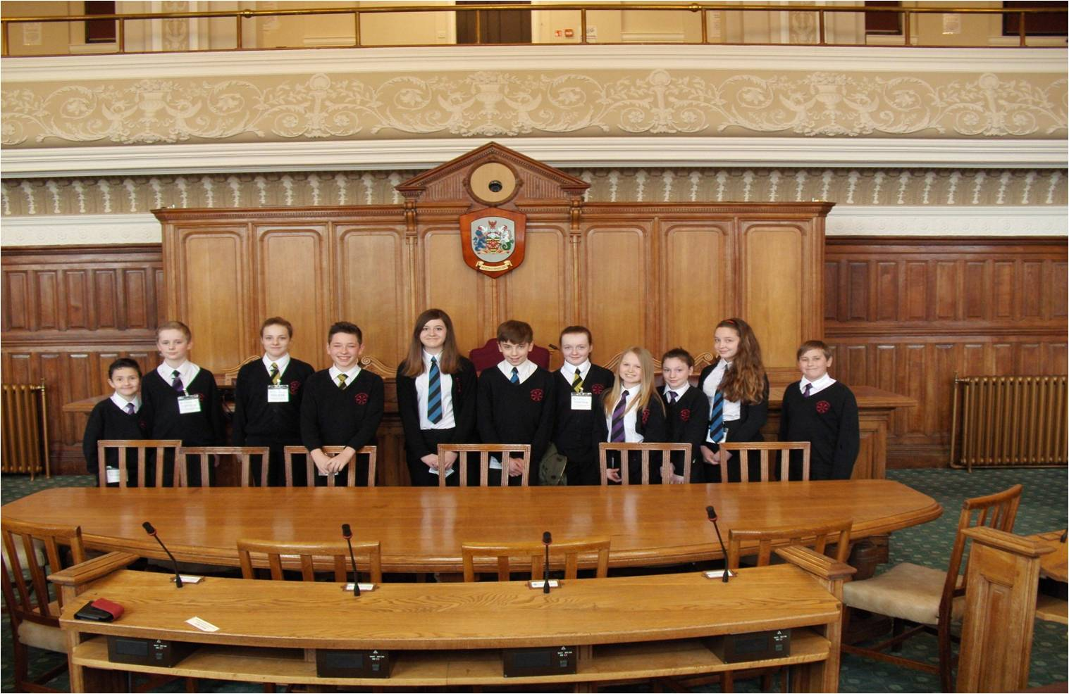
Bridlington Coastal Community Team
East Riding Leisure Bridlington
Bridlington Spa
Careers Information Advice & Guidance
Suggestions :
Careers days to see prospective jobs and progression routes
84% wanted interactive notice boards
Crescent Gardens, Public Realm
Clip & Climb Wall
Bridlington Harbour
Tone Zone Fitness Suite
Bridlington Park & Ride

Slide 13
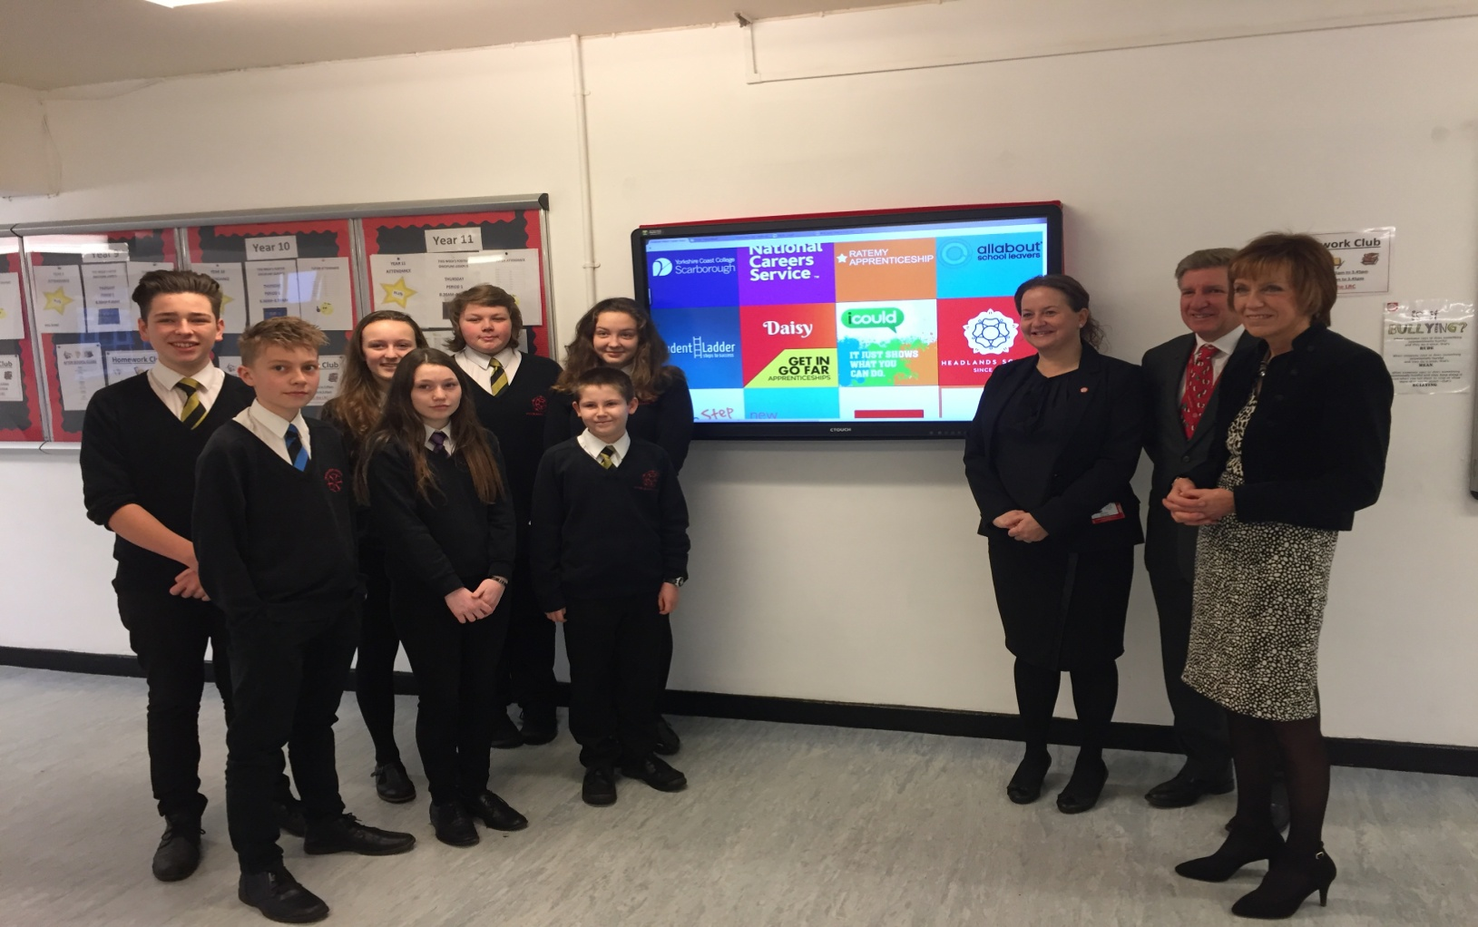
Bridlington Coastal Community Team
East Riding Leisure Bridlington
Bridlington Spa
Careers Information Advice & Guidance
Crescent Gardens, Public Realm
Clip & Climb Wall
Bridlington Harbour
Tone Zone Fitness Suite
Bridlington Park & Ride

Slide 14
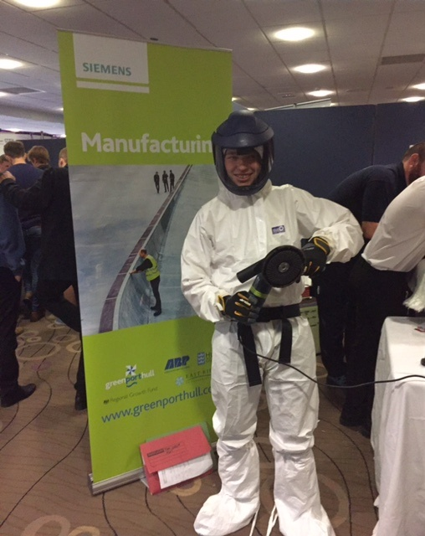
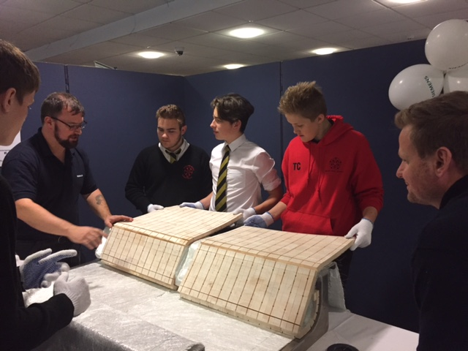
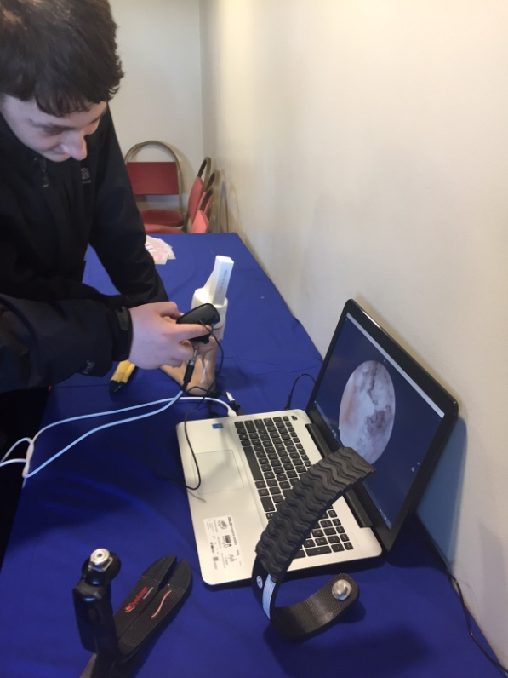
Bridlington Coastal Community Team
East Riding Leisure Bridlington
Bridlington Spa
Careers Visits
Crescent Gardens, Public Realm
Clip & Climb Wall
Bridlington Harbour
Tone Zone Fitness Suite
Bridlington Park & Ride

Slide 15
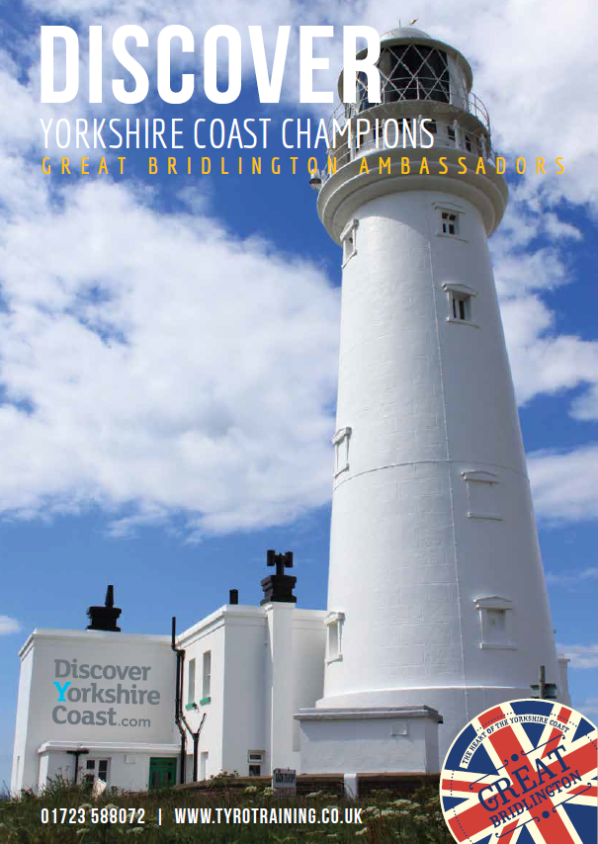
Bridlington Coastal Community Team
East Riding Leisure Bridlington
Bridlington Spa
Customer Care for the Visitor Economy
Working with local partners :
Bridlington Tourism Association
Yorkshire Wildlife Trust
RSPB
Local businesses
Local students
Crescent Gardens, Public Realm
Clip & Climb Wall
Bridlington Harbour
Tone Zone Fitness Suite
Bridlington Park & Ride

Slide 16
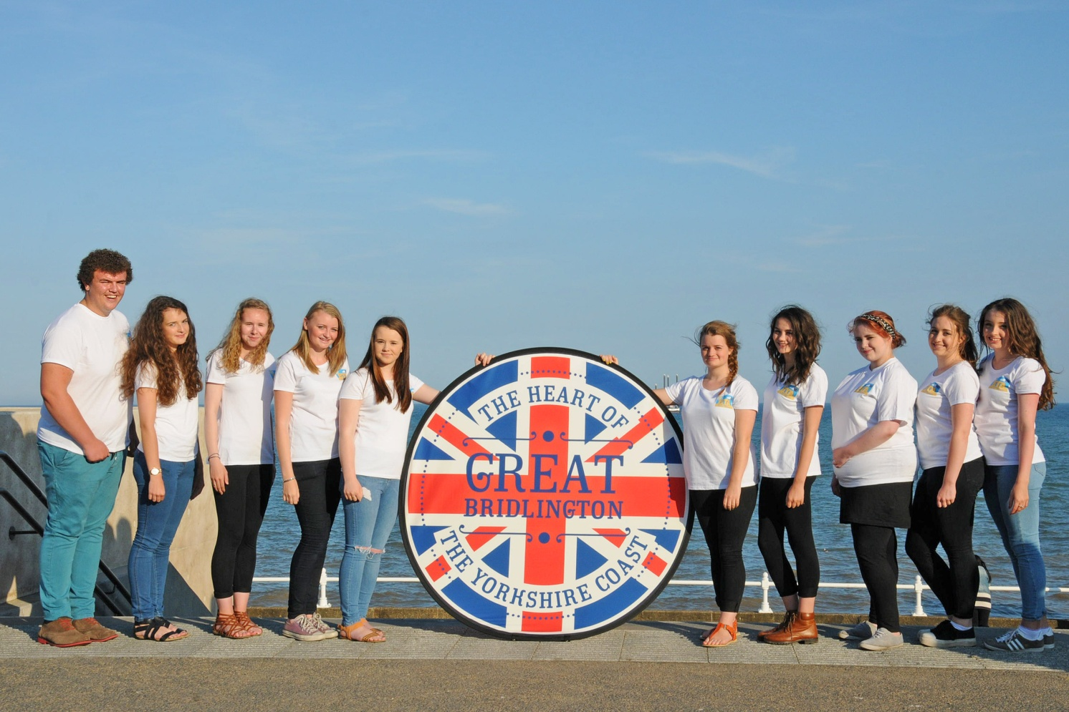
Bridlington Coastal Community Team
East Riding Leisure Bridlington
Bridlington Spa
Customer Care for the Visitor Economy
Crescent Gardens, Public Realm
Clip & Climb Wall
Bridlington Harbour
Tone Zone Fitness Suite
Bridlington Park & Ride

Slide 17
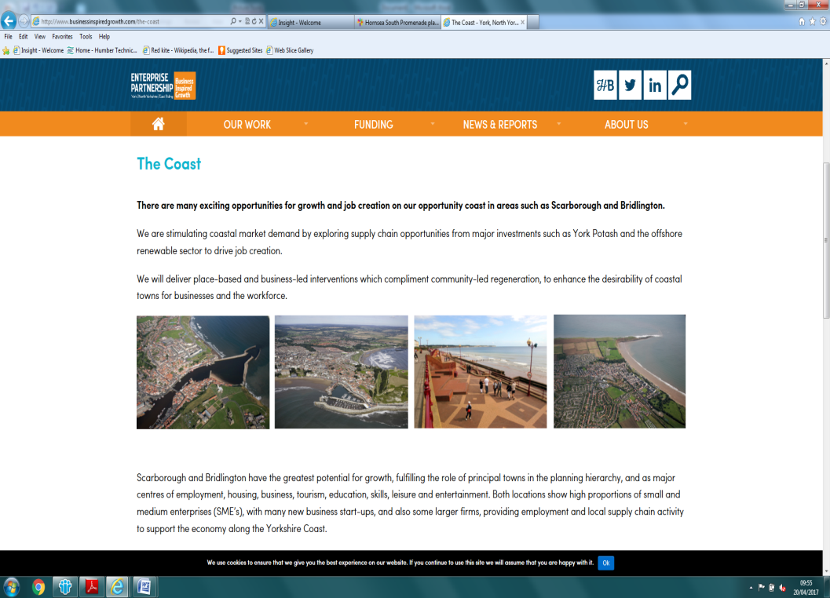
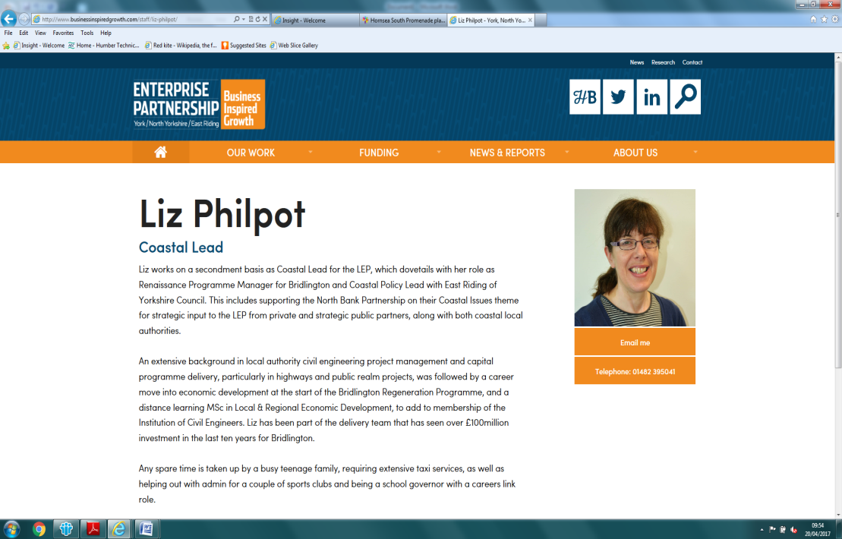
Bridlington Coastal Community Team
East Riding Leisure Bridlington
Bridlington Spa
Working with our Local Enterprise Partnership
Clip & Climb Wall
Bridlington Harbour
Tone Zone Fitness Suite
Bridlington Park & Ride
Notes:
York North Yorkshire East Riding Local Enterprise Partnership
Growth Towns – Scarborough and Bridlington
Secondment from local authority – East Riding – three days on Coastal Growth

Slide 18
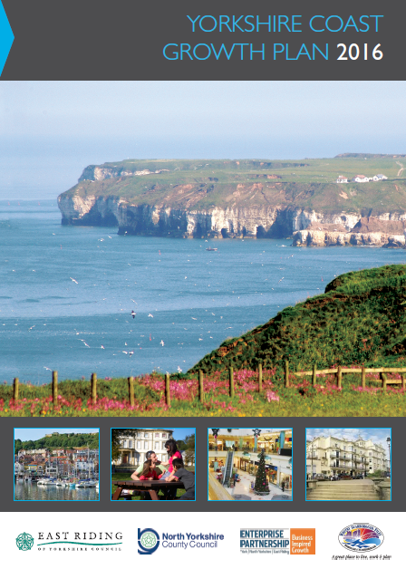
Bridlington Coastal Community Team
East Riding Leisure Bridlington
Bridlington Spa
Working with our Local Enterprise Partnership
Crescent Gardens, Public Realm
Clip & Climb Wall
Bridlington Harbour
Tone Zone Fitness Suite
Bridlington Park & Ride
Notes:
Identifies economic growth potential of both Scarborough and Bridlington as the largest towns on the Yorkshire Coast
Both towns together propose housing growth of approx. 12,000 in the Local Plan period to 2030 – 5,000 have permissions
6000 new jobs and 4000 construction jobs; 10,000 replacement jobs to backfill retirements
£30 million in FE and HE developments
£50 million in leisure and recreation facilities
Also
Whitby as a servicing hub for offshore renewables
Hornsea and Withernsea with potential for significant seafront development plans – Hornsea recently announced £3.77 million from CCF for the South Promenade Developments including commercial fishing facilities, leisure boat facilities, café, education centre, and other visitor facilities.

Slide 19
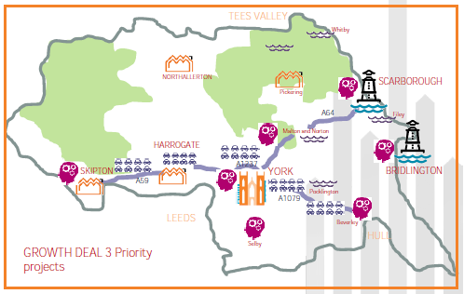
Bridlington Coastal Community Team
East Riding Leisure Bridlington
Bridlington Spa
Working with our Local Enterprise Partnership
Crescent Gardens, Public Realm
Clip & Climb Wall
Bridlington Harbour
Tone Zone Fitness Suite
Bridlington Park & Ride
Notes:
Strategic Context to support bids for Round 3 Growth Deal :
Scarborough – major junction improvements on the local highway network to unlock housing growth and private development of approx. 3,500 homes identified for delivery in Scarborough Local Plan
Bridlington – investment to enable the pre-construction development stage of the Yorkshire Marina and harbour Improvements to be advanced to pre-tender stage within the next 2-3 years
Follow on investment of approx. £50 million for the Harbour/Marina construction, and a further £80 million of commercial waterfront mixed use development linking the town centre with Bridlington Spa

Slide 20
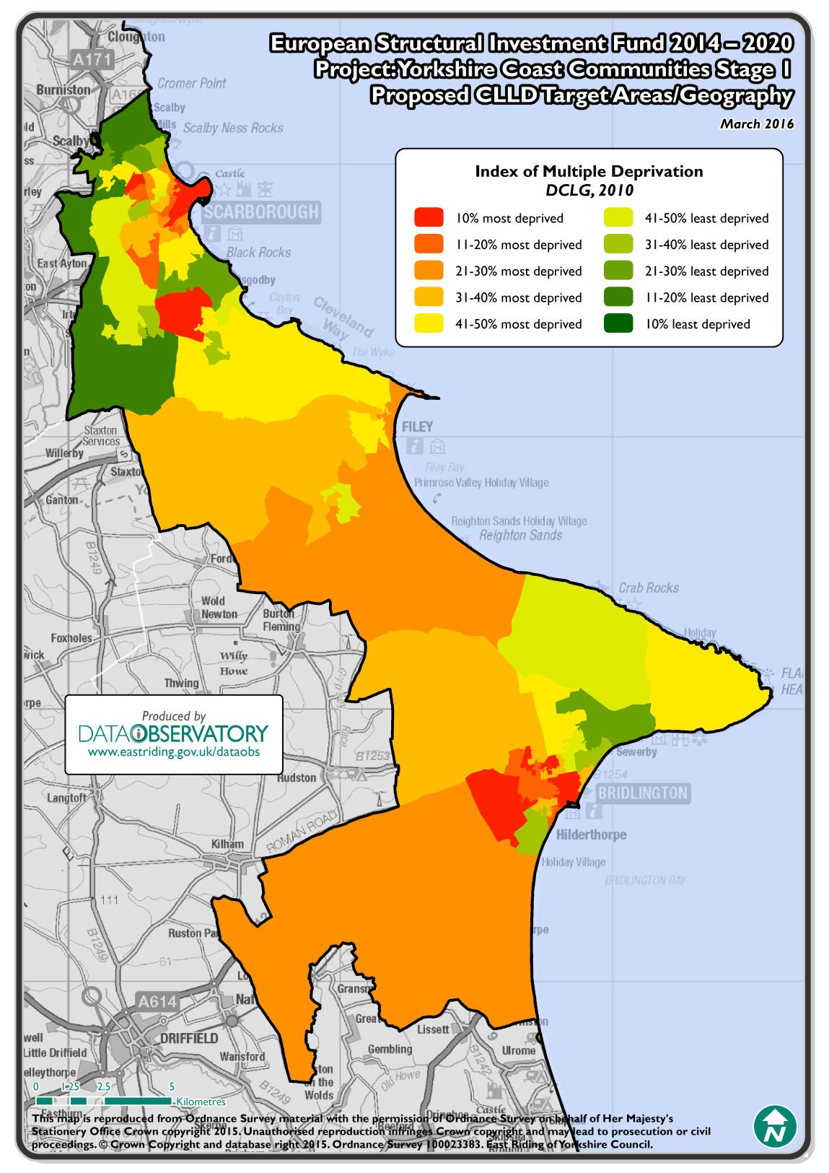
Bridlington Coastal Community Team
East Riding Leisure Bridlington
Bridlington Spa
Working with our neighbours
Community Led Local Development
Function Economic Geograpahy
Population >10,000 and < 150,000
Targeting the 20% most deprived communities
Crescent Gardens, Public Realm
Clip & Climb Wall
Bridlington Harbour
Tone Zone Fitness Suite
Bridlington Park & Ride

Slide 21
Delivering Local Growth
Local Growth
Housing Growth
Local Demand
Business Activity
Employment & Skills
Quality of Place

Slide 22
“Making Links” Bridlington Coastal Community Team

