Slide 1
Dr James Davies
MP for the Vale of Clwyd
The Great British Coast National Conference, Hull
Notes:
Introduce yourself and maybe a bit of background – GP, Town and County Councillor etc.

Slide 3
The Vale of Clwyd…
Prestatyn
Rhyl
Notes:
The Vale of Clwyd Constituency is in North East Wales
A very varied seat which combines rural hinterland with the seaside resort towns of Prestatyn and Rhyl
Most of the population of the constituency is clustered around the coastal towns

Slide 7
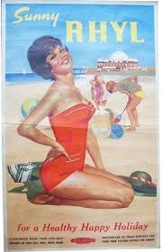
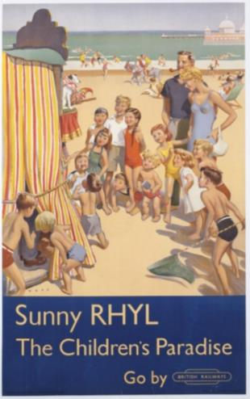
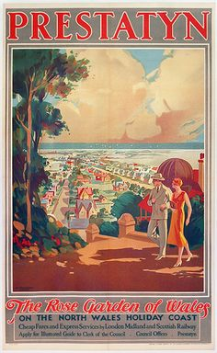
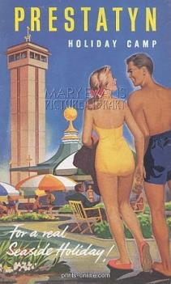
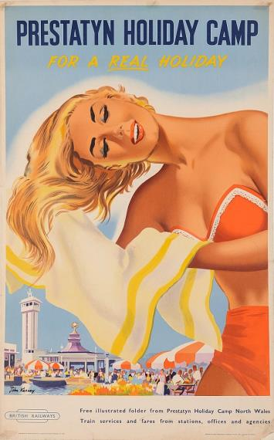
Sun, Sea, Sand and Fresh Air…
Notes:
The emergence of the tourism sector for Rhyl and Prestatyn happened in the early 1900’s. The arrival of the railways made the resorts in to popular Victorian tourist destinations
British Railways carried out the bulk of the marketing for Rhyl and Prestatyn
Slogans such as ‘for a healthy, happy holiday’ and ‘for a real seaside holiday’ were used to attract people from the cities where the health benefits of fresh air were felt necessary.
Then during the World War, the local holiday camps were used to home many soldiers.
After the war, the nature of holidays changed and weekend and day trips became very popular.
The resorts boasted a number of different attractions which kept holiday makers returning such as boating lakes, fun fairs, donkey rides, putting courses, open air pools, theatres, pierot shows, a pier and of course the fresh air and beaches!

Slide 8
Over time…
Notes:
Whilst tourism is still a very important sector for both towns, the changes in the tourism industry have meant that the towns have had to diversify and that there is less reliance on the tourism industry.
The challenges Rhyl and Prestatyn have faced were not unique and all coastal towns have been met with similar.
The changes in the ‘traditional holiday’ were brought about by arrival of low-cost package holidays abroad in the 1970s and so the British holiday maker travelled abroad.
This had an impact on local businesses and jobs. In particular the ‘repurposing’ of former guest houses into HMOs which in turn created low rent accommodation.
This has been a particular issue for Rhyl and the nostalgia factor for people who were once tourists attracted them to life by the sea because of earlier happy times visiting

Slide 9
Infrastructure improvements
Rediscovering economic success
High environmental standards
Urban and social renewal
Retail/Town centre regeneration
Major capital projects and attractions
Promotion
Notes:
It has been widely acknowledged, in particular by the DCLG Coastal Communities, that to turn around the fortunes of coastal towns a number of areas need to be focussed on.
For Prestatyn and Rhyl a team of people including politicians, local authorities, private investors, local businesses and members of the community have been working together to improve the resorts for residents and visitors alike.
Efforts include:
Improving accessibility
Enhancing the attractiveness
Working with the community
Creating additional attractions
Promotion of the towns
Collaborative working
I will go into more details on each of the individual points throughout the rest of the presentation.
Both Rhyl and Prestatyn are currently in different stages of regeneration – but there are very positive stories for both

Slide 10
Infrastructure improvements
Notes:
Making the towns accessible has been a key priority.
Focus has been placed on the gateways to towns to try and enhance first impressions.
Gateways includes signage, access points, public transport, infrastructure

Slide 11
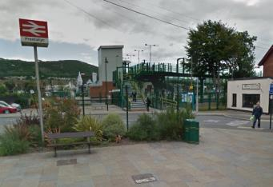
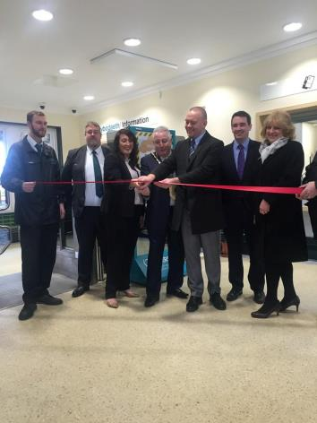
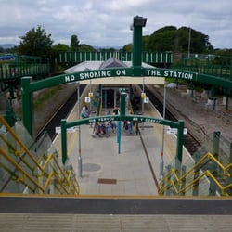
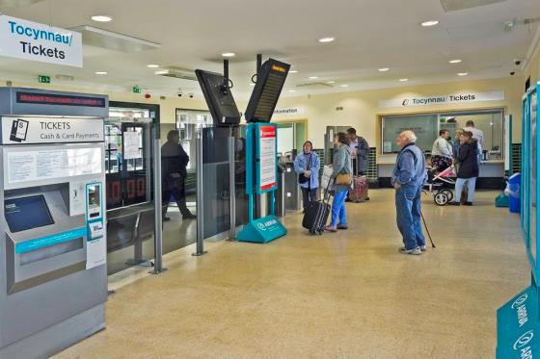
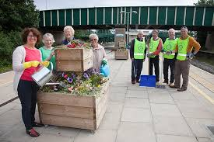
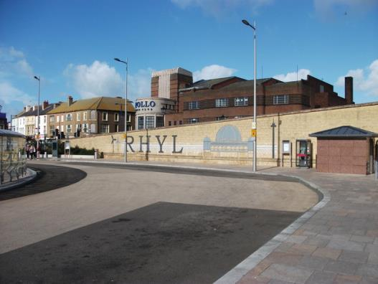
Rail
Prestatyn
Rhyl
Notes:
Another access point to the towns are the train stations
Both Rhyl and Prestatyn have welcomed investment into the train stations which have helped to improve the aesthetics, security, disability access and facilities.
A community group, Friends of Prestatyn Railway Station, which I chaired, has also taken on management of the Prestatyn station and have had planters made to line the station and create a bright and cheerful welcome to the town. FOPRS maintain the planters, conduct regular litter picks and have also planted thousands of bulbs on the banks of the railway line.
While improving the stations was very important so is improving the services provided. I have campaigned for the electrification of the railways and the replacement of the Victorian signalling.
Explain about the North Wales Economic ambition board and the Growth Track Wales efforts…
Improvements of services and links to the airports

Slide 12
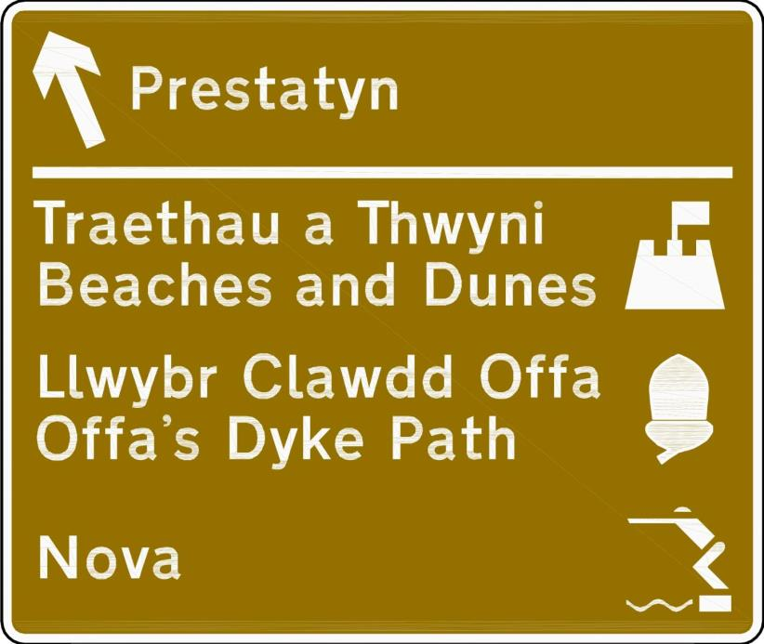
A55 Dual Carriageway
Notes:
The main access road to both seaside towns is the A55 dual carriageway and up until last year the brown tourist signage to highlight the Prestatyn junction was years out of date and did not reflect the town’s current offer.
I worked relentlessly with Denbighshire County Council to try and get the through the extremely difficult and lengthy process of replacing the sign and was pleased that this sign was installed last year.
As well as their directional function, brown signs are a good advert for the town and allow for A55 users to see what Prestatyn has to offer.
When the various planned developments for Rhyl are complete I will be working to have the brown signs for Rhyl updated and the follow up signage changed.

Slide 13
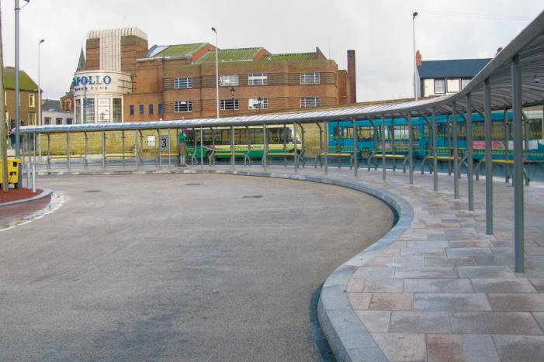
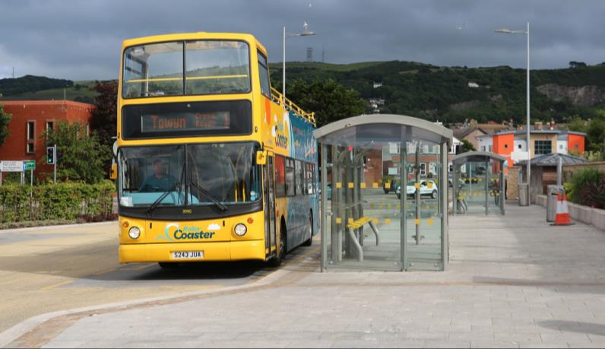
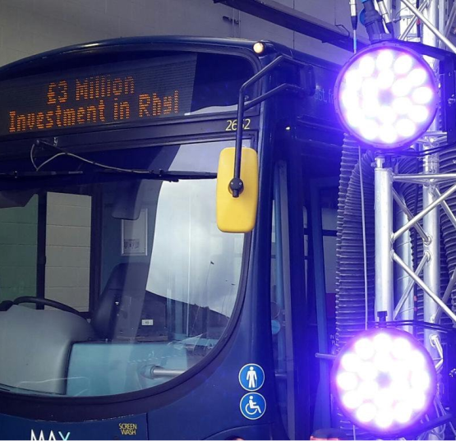
Bus services
Enhanced Rhyl Bus Station
Improved Prestatyn Bus Station
£3 Million investment in Arriva Bus Depot, Rhyl
Notes:
Over the last few years there has been redevelopment of both Rhyl and Prestatyn Bus Stations.
And in the last couple of months Arriva, the primary bus company in North Wales, has invested £3million in a new bus depot in Rhyl.
Also over the last few years Arriva invested in their fleet; upgrading the buses to ensure maximum comfort; WIFI connectivity; and audio-visual stop annunciation

Slide 14
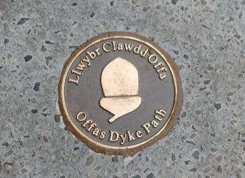
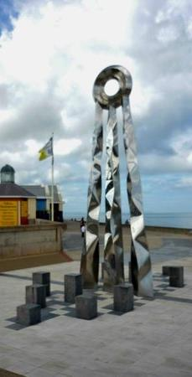
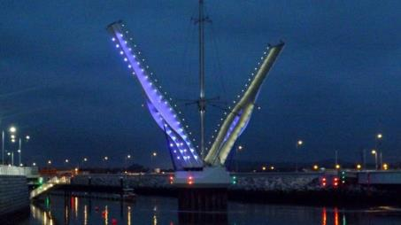
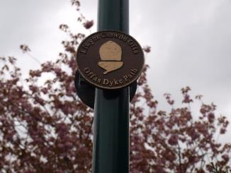
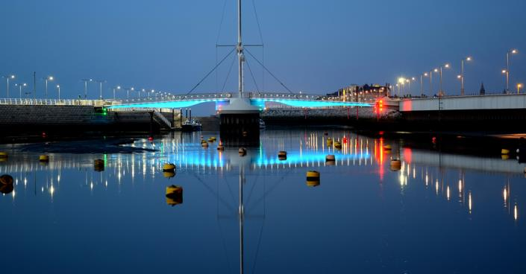
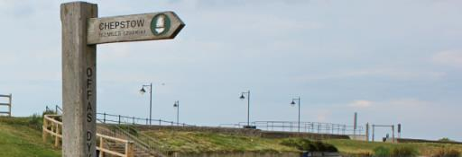
Walkers and Cyclists
Pont y Ddraig – Rhyl
The Offa’s Dyke Path – Prestatyn
Notes:
Improving access for all also covers people choosing to travel on foot and by bike.
Along their coastline Prestatyn and Rhyl are a part of the All Wales Coastal Path and the National Cycle Route 5.
£4.3 Million investment was made in Rhyl to install the Pont y Ddraig Bridge - Pont y Ddraig (Dragon's Bridge) provides the final link in 15 miles (24km) of traffic-free cycling across Conwy and Denbighshire.
It was named by Rhyl pupil Leon Jones following a schools competition and local children were invited to the opening.
Prestatyn also boasts the beginning or the end of the Offa’s Dyke National Trail. This attracts a large number of walkers each year.
To help walkers follow the route acorns plaques have been installed in lamp posts and in the ground as a trail and a large statue ‘Diwedd and Dechrau’ meaning ‘beginning or end’ has been placed along the sea front.
Prestatyn is also a Walkers are Welcome accredited town

Slide 15
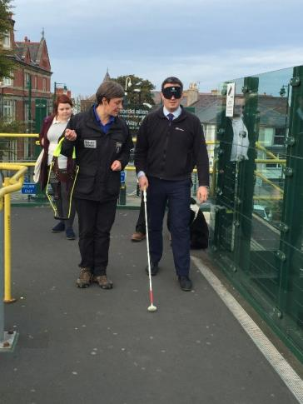
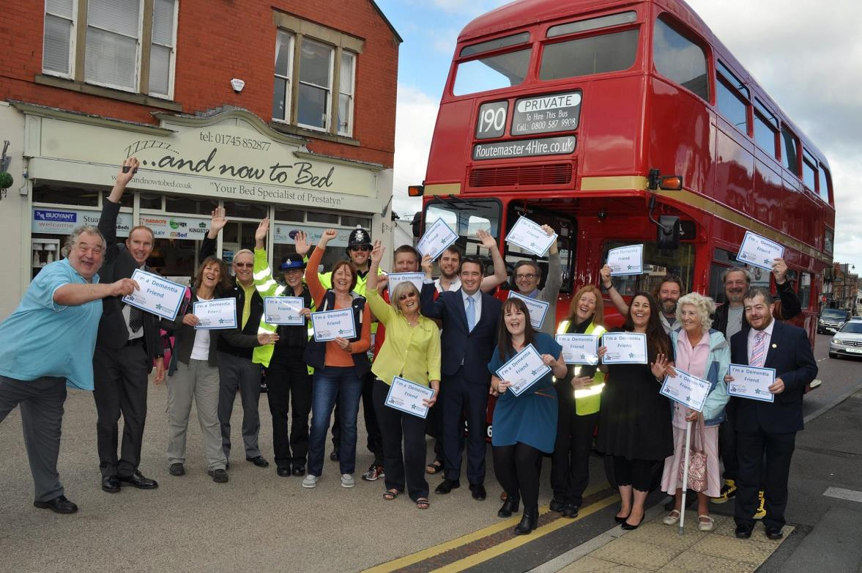
Accessibility to all
Notes:
I have been working with various charities and organisations to try and ensure that the towns are welcoming for all members of the community.
As part of this I have conducted a led walk with the Guide Dog Association to get the feel for how it is to navigate the towns for people who are visually impaired.
Another initiative I have initiated in Prestatyn is the Dementia Friendly Communities. This is with the Alzheimer's Society and a local community group and aims to make the towns and all residents ‘Dementia Friendly’.
We have had over 130 people trained as Dementia friends over the last few years, shops have made pledges to make any necessary changes to support people living with dementia such as changing any black mats by the doorways which may be seen as a black hole or puddle by someone with dementia.
So far schools, community groups, businesses, local authorities, charities and transport operators have taken the dementia friends training.

Slide 16
High environmental standards
Notes:
Making a town clean and welcoming is imperative to engender civic pride amongst residents and to ensure that visitors enjoy their experience and return.

Slide 17
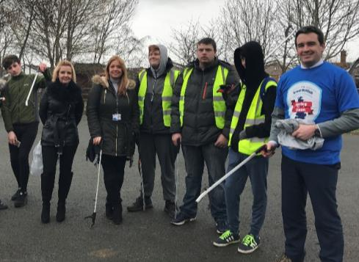
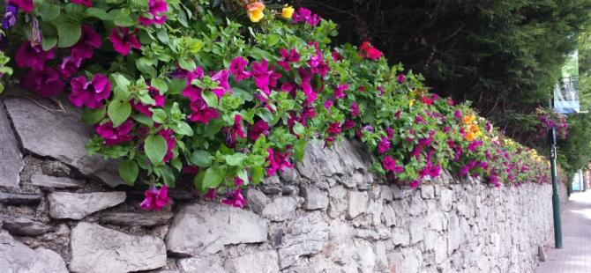
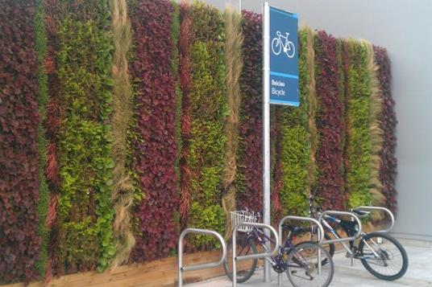
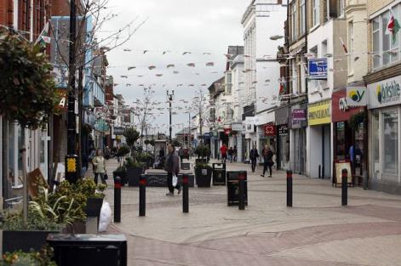
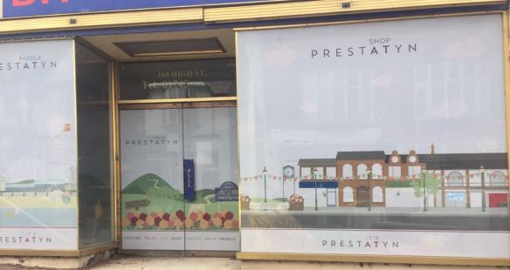
High environmental standards
Litter Picks
Floral Displays
Window Vinyls
Conservation areas
Strict legislation on fly posting
Public Space Protection Order
Enforcement Officers
Bunting and Banners
Liaison with developers
Notes:
A number of initiatives have been carried out in both Rhyl and Prestatyn to help ensure that the town’s look their best throughout the year. These include:
Regular litter picks carried out by the local authority and also many community groups.
Denbighshire County Council Public Realm efforts – maintaining floral displays, grass cutting,
Empty shop window vinyls to cover up long term vacant units
Ensuring the town centres are conservation areas so that additional care is taken when planning applications are submitted
Strict legislation on fly posting
PSPO to combat any anti-social behaviour and street drinking
Enforcement officers to fine people who are caught dropping litter
Working with developers such as Stadium Developments who built a shopping park in Prestatyn to landscape the area and also secured the additional of living walls.

Slide 18
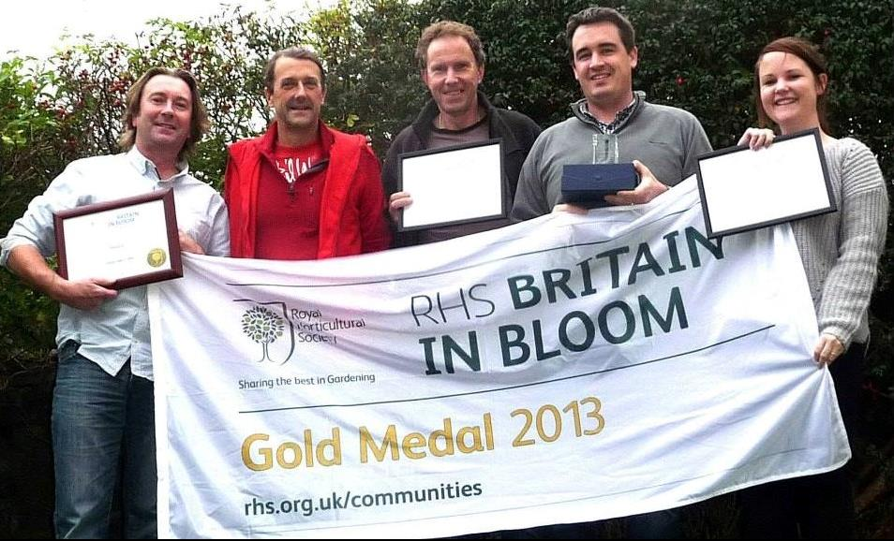
Wales in Bloom, Britain in Bloom and International Communities in Bloom
Notes:
Both Rhyl and Prestatyn have had success with the In Bloom competitions
These are considered important as they allow for continuous improvements to be monitored each year, get all the community involved, help to raise the profile on a national stage, give a deadline for improvements to be made by which is before the main tourism seasons, set benchmarks to strive for.
Prestatyn has successfully achieved a gold medal and category winner in Britain in Bloom and then went on to be placed third in the world wide competition ‘International Communities in Bloom’

Slide 19
Urban and social renewal Economic inactivity – JSA, ESA Seasonal, low-paid employment
Notes:
For coastal towns to be successful it is important they do not think of themselves purely as places for people to visit and think of themselves as places for people to live.
This means investing in housing, schools and other public services.
It also requires a variety of employment opportunities. Rhyl and Prestatyn have been reliant on public sector jobs and seasonal jobs and so encouraging development and businesses to establish will help to boost the local economy.
By getting the community to work with you in moving the town forward will not only help with civic pride but will also help to improve a town’s reputation.

Slide 20
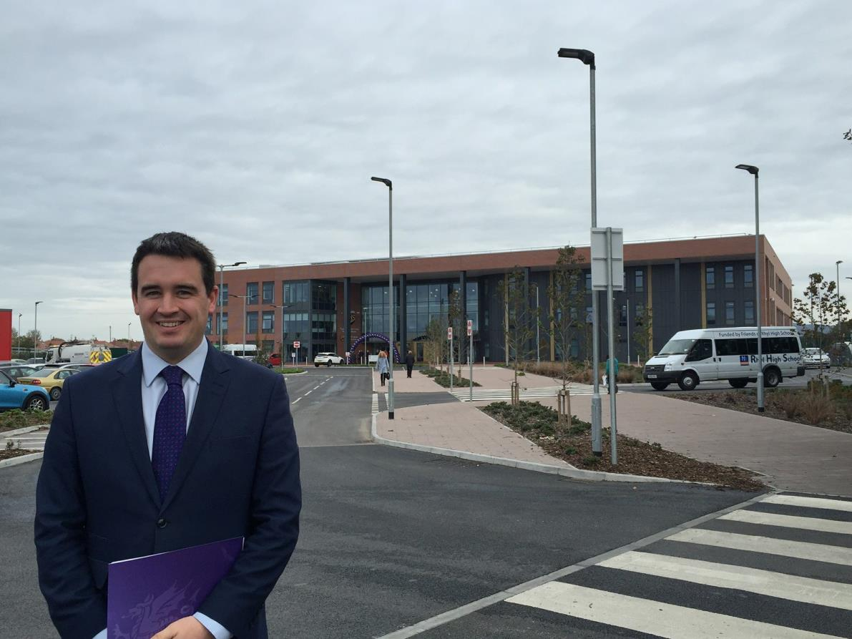
Investment in Schools and Colleges
Notes:
Providing good quality schools is equally important to assist the regeneration of coastal towns.
Denbighshire County Council have been investing in a number of schools throughout Rhyl and Prestatyn including creating a brand new building for Rhyl High School.
£25 million has been invested in the rebuild of Rhyl High School and the school opened last year. Welsh Government and Denbighshire County Council funded this project with a 50:50 split.
Ysgol Bodnant, a primary school in Prestatyn has also been blessed with a new building for the pupils.
The proposal being put forward is for a brand new 3 – 16 Catholic School which will be the first of its kind in Wales
This would be progressed as part of the 21st Century Schools and Education Programme to be delivered in partnership with the Welsh Government.

Slide 21
Improvements to Housing
Notes:
As previously mentioned West Rhyl had a large amount of hotels and holiday accommodation which over the years changed in to apartments and houses of multiple occupancy.
In 2011, West Rhyl was identified as the most deprived area in Wales according to the Welsh index of Multiple Deprivation
Denbighshire County Council have put an enormous amount of emphasis on tackling this issue including issuing compulsory purchase orders on dilapidated properties and then demolishing them. New builds were constructed in their place. The new houses offer homes for families and high quality apartments.
These developments have been carried out with public sector funding and also with investment from North Wales Housing, West Rhyl Community Land Trust, Pennaf Housing Group and the Welsh Government.
New houses are a mixture of rental and purchase.
Prices for two bed properties will start at £105,000 (with a Maximum Homebuy Loan of £52,500 available) to £117,000 for a three bed (maximum loan of £58,500).
The properties are available as part of North Wales’ first Urban Community Co-operative housing project. This means that residents have been selected based on what they can offer to the local community i.e. help with the gardens, keeping communal areas tidy etc. It also allows residents a greater say on day – to – day issues that can affect their quality of life.
The new houses are also built around a green space which has been specifically designed for the use of the residents.
There are many different housing schemes coming to fruition in West Rhyl.

Slide 22
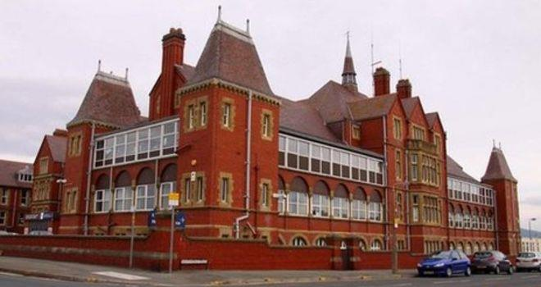
Health services
The Royal Alexandra Hospital
Notes:
The Health Board are progressing for a re-developed Royal Alexandra Community Hospital which would bring services closer to the people of Rhyl and Prestatyn. Following a safety review, in-patient wards were closed in 2009 and since then limited services have been offered at the site.
I have been working with the Health Board to secure funding from Welsh Government for much needed investment in the hospital site.
The current NHS services locally are struggling and so this development would help with the regeneration of Rhyl and also reduce the pressure on the local health service.
A bid has been put in which proposes an investment of £39.89m to redevelop the Royal Alexandra Hospital on East Parade in Rhyl.
This will offer a broad range of health and well being services.
Proposed facilities at the new hospital include a same day care centre, which would offer a range of treatments for minor ailments, and a ward with individual bedrooms.
If approved by the Welsh Government, and providing it receives planning consent, work on the project is anticipated to begin in 2018.

Slide 23
Retail/Town centre regeneration
Notes:
Town centres are pivotal to seaside town regeneration.

Slide 24
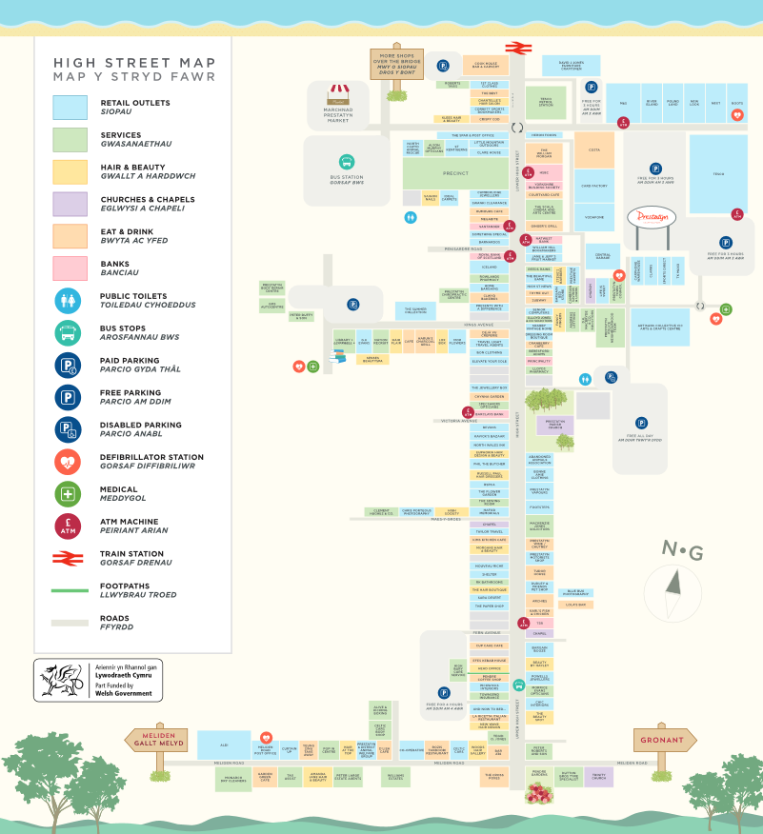
Prestatyn Town Centre
Notes:
Prestatyn Town Centre has managed to buck the trend of the declining High street and has flourished in the last few years.
With a development of a shopping park in the town the independent businesses were nervous of what the future may hold. After lobbying from local members the shopping park was built at the bottom end of the High Street.
With a collaborative effort from Prestatyn Town Council, Denbighshire County Council and the local businesses and Business Forum work began to ensure that the shopping park complimented the high street offer rather than threatened the smaller high street stores.
A weakness of Prestatyn is the topography of the high street which is on a relatively steep incline, making it more difficult for people to walk the length of the high street especially with the aging population in Prestatyn. There was also a silo mentality from many of the businesses as they saw themselves in competition with each other rather than using the opportunity to upsell other businesses and support the high street as a whole.
Prestatyn Town Council employed a Town Events and Community Support Officer to work with both the shopping park and the high street to turn identify gaps and concerns and make sure that the high street was given a fighting chance against the national retailers in the shopping park.
The main aim of the job was to make the Town centre a community hub.
A ‘Prestatyn Together’ group was formed of various stakeholders including businesses, local authorities, local members, schools, community groups, event organisers.
It was found that many local people did not use their local high street and so a ‘Totally Locally’ campaign was started to encourage residents to support their high street.

Slide 25
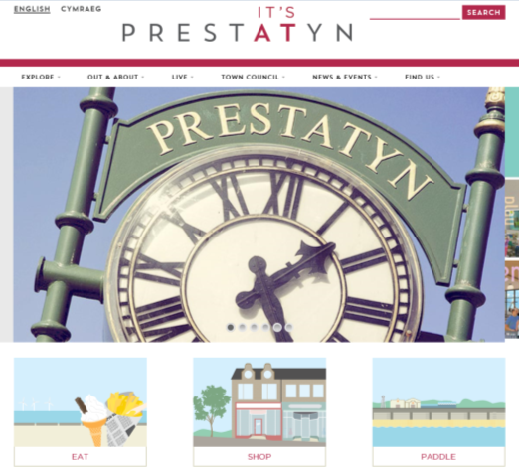
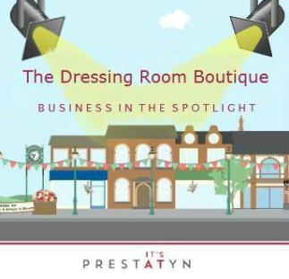
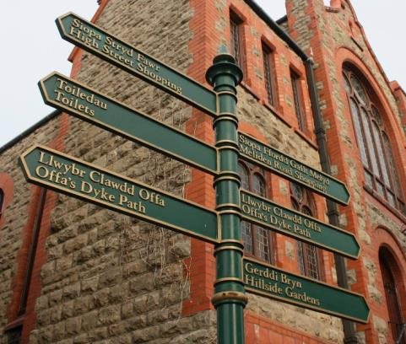
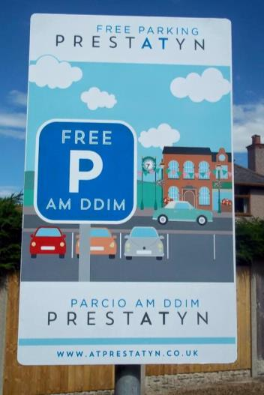
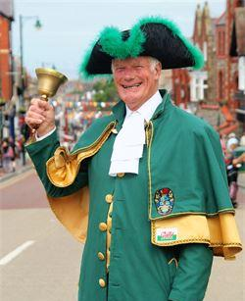
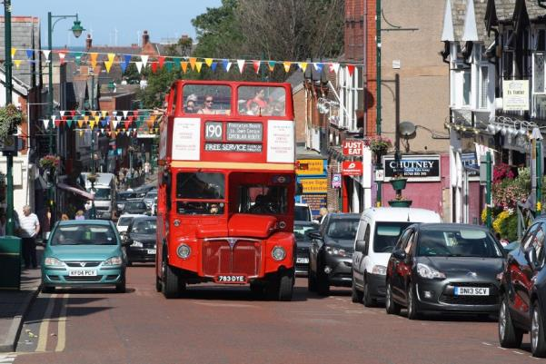
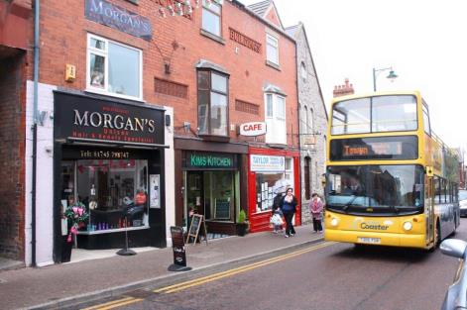
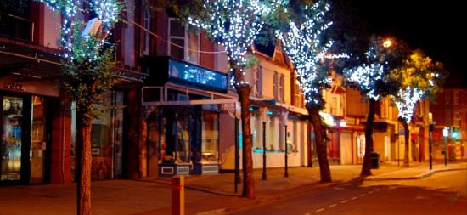
Prestatyn Town Centre
Notes:
A number of initiatives were started including:
Free parking was provided in a number of car parks along the length of the high street and free on street parking was extended to 1 hour.
Directional signage was used to make sure people visiting the shopping park were aware about the high street
Delays were put on traffic light systems to encourage drivers to use the exit from the shopping park which navigated people up the high street
A Town crier was appointed
Town Events are planned on a regular basis
A town map was created and was put in boards on the shopping park
Bunting and lighting was used to draw the eye line up the high street
Finger posts were installed to help people navigate the town
A town brand was created
Social media campaigns were set up to advertise different businesses – this is called ‘business in the spotlight’ and businesses are chosen at random
A new website for the town was set up using the town branding
A bus stop was created at the top of the high street and buses have been re-routed so that they now come up the high street making the incline less of an issue for people who have walking difficulties
A Routemaster Bus is hired over the summer which does a route to connect the high street with the beach front, holiday parks and shopping park. The Routemaster bus was chosen due to Prestatyn Links with ‘On the Buses’ and it also was an attraction in itself for local people and not just as a method of transport.

Slide 26
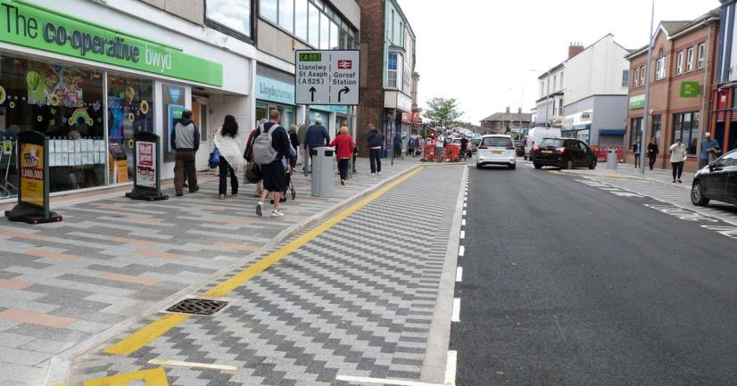
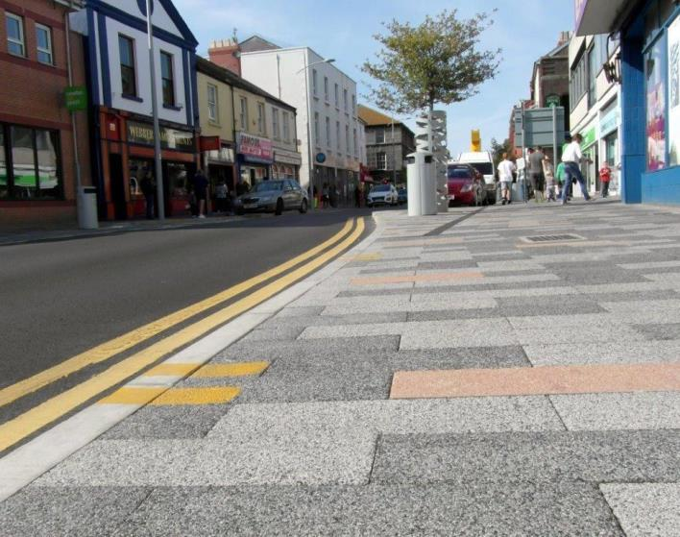
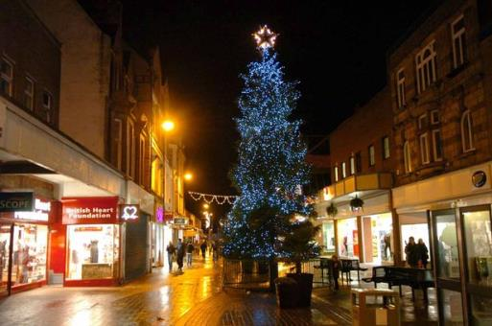
Rhyl Town Centre
Notes:
Rhyl Town Centre has unfortunately faired as well as Prestatyn due to a combination of factors which have seen the town centre hit hard.
Marks and Spencer has a large central high street store in Rhyl but this was vacated when the retailer moved to their Prestatyn store. Marks and Spencer had acted as a destination shop as so when it moved footfall declined.
Rhyl was also affected by a number of major high street retails going into liquidation.
Rhyl also had extremely high business rates which were set at an impossible level which hindered any new businesses who may have wanted to set up in the town. Many landlords were having to rent their properties out rent free to try and keep tenants, or they faced having to cover the business rates personally.
Work to change the fortune of Rhyl Town Centre has began and the recent business rates revaluation has seen a drop in the rateable values of many town centre properties which will begin to assist with the regeneration of the High Street.
Sections of Rhyl high street have recently been landscaped and trees with pea lights have been installed.
Town events have also been held in Rhyl to help increase footfall.
Denbighshire County Council has also got an ambitious plan which will allow for complete regeneration of the high street. This plan includes:
Creating high quality accommodation above shops
Creating a new town centre car park
Improving signage around the town
Rationalising the parking restrictions
Improving run down buildings and vacant units to make them more appealing to businesses
Considering reversal of the pedestrianisation of the high street
Ensuring any new developments compliment the high street and encourage visitors to utilise local businesses
Moving Council office accommodation into the town centre so that workers will use the shops on their lunch breaks or before/ after work.

Slide 27
Major capital projects and attractions

Slide 28
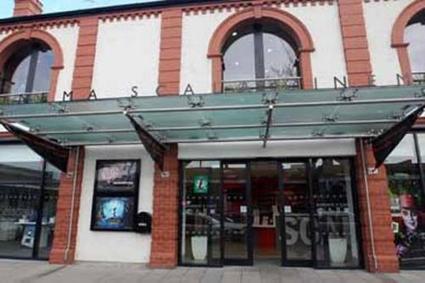
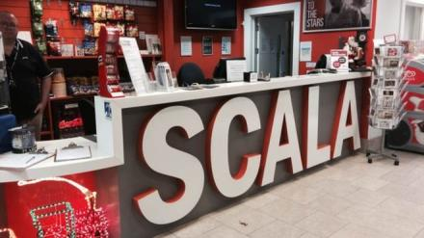
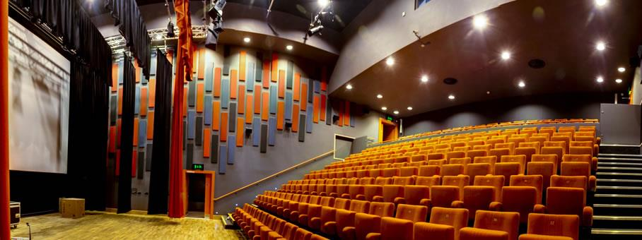
Developments & Regeneration in Prestatyn
The Scala Cinema
Notes:
The Scala cinema was first opened in the early 1900 as part of Prestatyn’s Town Hall. The cinema was sadly forced to close due to safety concerns in 2000.
In 2001 Friends of the Scala community group was set up to campaign for the cinema to reopen.
The scheme cost £3.4 million and this was funded by Denbighshire County council, Welsh Assembly and Prestatyn Town Council.
The Scala Arts Centre development is the result of much commitment, hard work and tenacity and the generosity of a number of individuals and funding bodies. The ambition of the Scala Prestatyn Company is to make the centre a major cultural and entertainment destination for North Wales.
As Wales’ first fully digital cinema the Scala represents a whole new experience for local cinema-goers. The two 150 seat screens feature state of the art high definition digital projection systems offering a quality and flexibility to the cinema which is unrivalled in any other Welsh cinema.

Slide 29
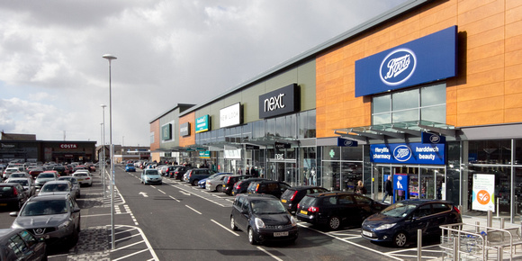
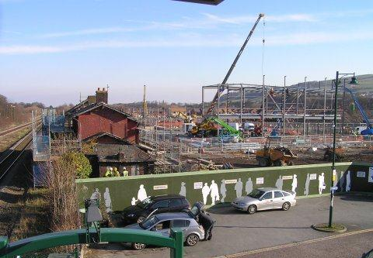
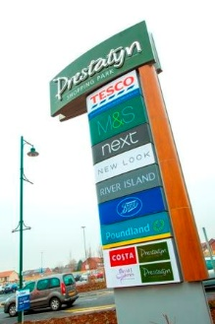
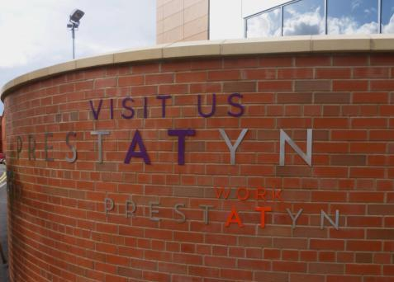
Developments & Regeneration in Prestatyn
Prestatyn Shopping Park
Notes:
Prestatyn shopping park opened in 2013.
Working with developers is important to ensure that the views of the local communities are taken in to account during the design phase.
For Prestatyn shopping Park – Parc Prestatyn we worked to ensure that the town’s ‘Green theme’ was taken in to account
That buildings were complimentary to the surroundings
That the shopping park was landscaped with trees and the living walls
Prestatyn Shopping park has around…. Cars visiting a day and offers 800 free parking spaces for 3 hours
Local authorities also worked with the developers to encourage them to extend the planned 2 hour free parking to 3 hours to ensure there was ample time for people to visit the high street should they wish to.
Free parking after 6pm has also been negotiated to assist the night-time economy – the cinema and restaurants
In 2015, Phase 2 was opened which added an additional 4 shops including TK Maxx, Car Phone Warehouse, Clarks and Sports Direct.
During the design of phase 2 the back of the units were a contentious issue as they would be facing Nant Hall road which is a very picturesque approach to the town centre. There are also residential flats facing them so it was important to ensure they were aesthetically pleasing. The previously designed red brick walls were broken up with green shrubbery, windows were added to the back of the units and tasteful silver lettering was used rather than the individual shops’ branding, the town branding has also been featured on the walls which helps to tie the shopping park and the high street in together.

Slide 30
Developments & Regeneration in Prestatyn
The Nova Centre
Notes:
The redevelopment of the Nova involved a capital investment in the region of £4.8 million.
The ‘New’ Nova re-opened in December 2015 following a major refurbishment and building transformation programme.
This included:
60 station fitness suite
3 storey soft play zone
Multi-purpose studios/suites - capable of hosting events and functions
Café and adjoining ‘Guisto’ restaurant
Beachside retail units
Wi-Fi throughout the building DCC’s bold commitment to the Nova led to a significant investment in the facility – with the ‘new look’ facility designed to serve both the local community and visitors to the north Wales coast.
The Centre is now considered to be a premier, ‘fit for the future’, seaside attraction and leisure complex – an important visitor destination.

Slide 31
Difficult times for Rhyl

Slide 32
Developments & Regeneration in Rhyl
Marina Quay
Notes:
The £23m Marina Quay development on the former Rhyl funfair site is set to open this summer
Tenants that have been secured so far include The Range, Poundworld, Farmfoods, Burger King and Greggs
The scheme is on target for completion in May with the new stores expecting to open for trading in July or early August.
Skills Fairs are taking place to highlight the jobs on offer and ensure as many local people as possible are in a position to secure a role, with the eventual plan to have 500 jobs on the site.

Slide 33
Developments & Regeneration in Rhyl
Premier Inn
Notes:
Bringing extra hotel beds to Denbighshire is the aim for the coming year as tourism in the county is rising, bringing hundreds of millions of pounds into the local economy.
The main focus for the coming year is to increase the quality and number of beds in the county and developments in the pipeline include a Premier Inn and Travelodge in Rhyl which will bring an extra 140 beds to the county.

Slide 34
Developments & Regeneration in Rhyl
Waterfront Developments & Aquatic Centre
Neptune Developments and Alliance Leisure
Notes:
Rhyl waterfront is due to undergo a massive redevelopment project.
The waterfront development project is worth £29million in total and has been funded partly by the Welsh Government and Denbighshire County Council, with the remainder from private sector investment being secured by our development partner. This includes £3.5million of funding through the Welsh Government’s Vibrant and Viable places scheme.
Exciting proposals for a brand new waterpark in Rhyl have moved a step closer, with the planning application for the ambitious leisure attraction now submitted for consideration.
The proposal is for a 1200 metre square water space, with indoor and outdoor flume rides, children’s water play frame and slides, double height children’s play activity zone, climbing facilities, party rooms, reception, sales areas, outside Splash Pool – two wet splash pads, sun lounger areas and café terraces to provide wet play entertainment.
There will also be beach ‘style’ changing huts in the outdoor splash zone and WC facilities, as well as a bar and terrace to cater for evening trade.
It is anticipated that the development will create 60 new jobs and attract 350,000 additional visitors to the town every year.
Subject to planning permission, work will begin in September 2017 with the new facilities open in early 2019.
The waterpark is a flagship project for the Councils and the development is an essential element of efforts to increase footfall in the town, to create jobs and increase spend in the local economy. This has also been at the forefront of our proposals to redevelop the waterfront and is a major part of our regeneration plans for Rhyl.

Slide 35
Developments & Regeneration in Rhyl
Rhyl Pavilion Theatre
Notes:
As part of the Rhyl Waterfront Developments Rhyl Pavilion Theatre is receiving a make over. The pavilion is being reclad and has had an internal make over to the entrance way, foyer and box office. There will also be a restaurant which will over look the beach.

Slide 36
Developments & Regeneration in Rhyl
Rhyl Harbour
Notes:
Rhyl Harbour has already undergone a dramatic regeneration which has hugely improved the facilities on offer. A new boat park has been built, together with a new launching slipway, pontoons and a quay wall. Seeing this become a reality has set a precedent for the wider regeneration project, instilling real confidence (both in and outside of the town) that the new facilities and amenities we are developing will really deliver a fantastic result for Rhyl.

Slide 37
Events in Prestatyn
Notes:
Events in Prestatyn are regularly organised by Prestatyn Town Council and Community Groups to attract visitors and residents to the town centre. Events have been planned to attract a variety of ages throughout the year in the hope that they will help to advertise the businesses in the high street.
Some of the events:
Carnival
Classic Car Show
Flower Show
Prestatyn Rocks
Prestatyn Walking Festival
The Romans Return
It’s a knock out
Easter Eggstravaganza
The Guinness World Record Sandcastle Attempt
Halloween Spooktacular
Christmas in Prestatyn including a Christmas parade
Santa’s Grotto
Fantasy Funday
To ensure a circulation of the high street different locations are used throughout the high street and people are encouraged to walk between them. Car parks are often utilised as the event location too.
Treasure hunts are organised where an object is hidden in different shop windows and when someone has found it they go in to the shop to collect a sticker and when all the stickers are collected they would be issues a prize. This was done so that people unknowingly window shopped whilst at the event.
Events were also organised to celebrate the town’s heritage such as the Roman event where locally discovered artefacts were showcased and a trip to Prestatyn’s Roman bath house was also incorportated

Slide 38
Guinness World Record Attempt in Prestatyn - Most Sandcastles Built in Hour
Notes:
This is over 3 minutes long so you may not want to play it depending on your timings
A very windy day in Prestatyn wand we unfortunately fell short of the record but it brought out the crowds and was featured in the telegraph and on BBC and ITV news.

Slide 39
Events in Rhyl
Notes:
Rhyl has its own events area which is positioned between the beach and the town centre.
Due to this area Rhyl attracts a variety of large events which are attended by thousands of people.
These include:
Rhyl Air Show
Proms on the Prom
Touring live music concerns such as Madness
They hold fan zones for major sporting event
A Circus
Charity event such as race for life
Beach Fest
Other local events are also held through the year such as:
Rhyl Carnival
Local music festivals
The Christmas lights switch on
Rhyl Air Show is organised by Denbighshire County Council and supported by Rhyl Town Council and local business sponsors. It attracts over 100,000 visitors over the two day event.
This year’s air show will be on Saturday 26th and Sunday 27th August 2017 – and I definitely recommend it.

Slide 40
Promotion
Notes:
Ensuring the good work that is being done in both towns is noticed it has been vital to promote the towns.
The promotion has also helped to combat problems with poor reputations.
Having positive image and news coming up top on internet search engines is particularly important
As previously mentioned entering national competitions also helps to promote the towns

Slide 41
Town Branding
Notes:
Both Towns have had their own brands created to help market the towns.
Prestatyn’s Brand ‘It’s at Prestatyn’ was created when Prestatyn Town Council asked a local design company to capture the essence of Prestatyn and the fact traditional meets modern. This brand has been designed to ensure it can be used by everyone and so there are a variety of options such as ‘shop at Prestatyn’ ‘Paddle at Prestatyn’ ‘walk at Prestatyn’.
The website, social media channels and all events marketing utilises the brand. Signage around the town has also been created in the brand.
The Love Rhyl brand was about changing perceptions of the town and incorporating everything that everyone loves about Rhyl.
This brand is also used on all their online efforts and events marketing.
To change the reputation for Rhyl there has been a ‘changing perceptions’ project which targets both internal and external stakeholders.
To raise awareness and to allow residents to help shape the town’s future, we have appointed over 30 town champions – from all walks of life – to help us communicate the changes happening in Rhyl through their networks in the town and further afield. These champions range from representatives from community projects, to local business owners and college students, and we have more volunteers for this every month.
There have also been ten amateur photographers appointed to capture Rhyl as it changes, and show why people choose to live here through our LoveRhyl Instagram page. They have been tasked with sharing their favourite locations, memories and perspectives of the town during the redevelopment. They share a regular stream of photos which are posted onto the official Instagram page, and each Wednesday, the very best of these is published as a ‘picture of the week’ in the local Rhyl Journal newspaper, website and social media pages. Rhyl really is on the cusp of change and their photographs really capture this.

Slide 42
Prestatyn Town Promotional Video
Notes:
Prestatyn Town Council and Denbighshire County Council have funded a promotional video which has been….
Prestatyn Scala Cinema also plays a shortened version of the video before every film they show.

Slide 43
Current Tourism Statistics
Notes:
Denbighshire County Council’s Tourism Growth Plan has helped contribute to a rise in the number of visitors to the county to 5.86million, a 5.3 per cent increase on 2014, while more than 6,100 jobs, up 7.4 per cent, are supported by the sector.
Tourism is a vital part of Denbighshire’s economy. Tourism helps makes towns and villages sustainable and the Tourism Growth Plan, sets out the county’s approach to developing this sector.
The aims of the Plan are to increase numbers and, importantly, visitor spend as well as creating more jobs and more opportunities.
The total economic impact of tourism in the county for 2015 was £458.39m, a six per cent rise from the previous year.
This table shows the figures for tourism for just the coastal towns in Denbighshire.

Slide 44
Thank you!

