Slide 1
Developing & Managing Multiple Projects
Bridget Betts
Dorset Coast Forum Coordinator
Lead of the Dorset CCT

Slide 2
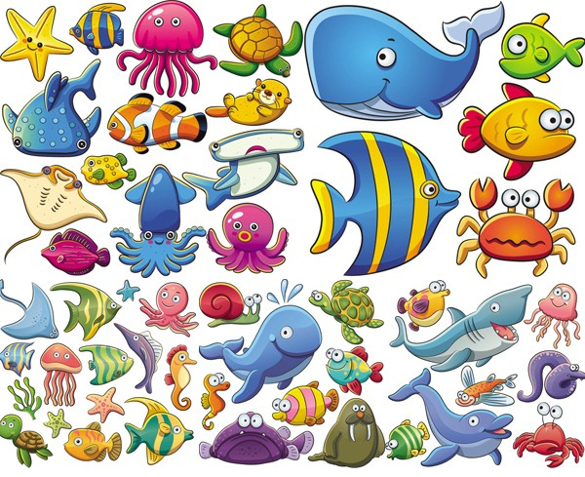
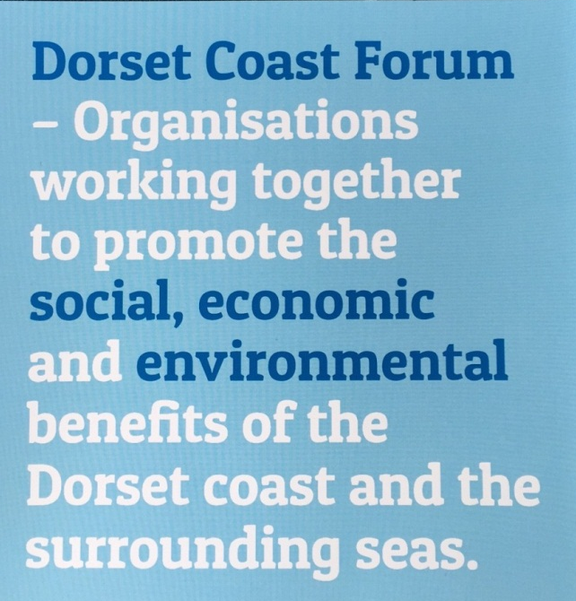
The Dorset Coast Forum
Who we are
Fair & balanced approach Independent
Neutral Experienced
Notes:
Been in existence for just over 20 years
260 organisations with over 700 members
Cross sector membership dealing with a range of issues and opportunities relating to the coast
A small core team hosted within Dorset County Council – we have a fair and balanced approach, are independent, neutral and experienced

Slide 3
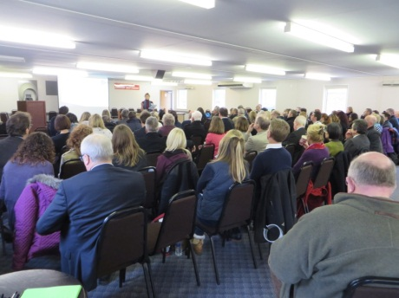
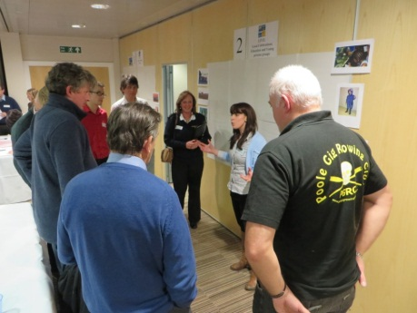
What the Dorset Coast Forum do
OBJECTIVE 1 - A coast that is at least as beautiful, and as rich in wildlife and cultural heritage, as it is now.
OBJECTIVE 2 - A thriving and diverse coastal economy which uses the resources of the coast sustainably
OBJECTIVE 3 - A coast that is used, enjoyed and appreciated by the people of Dorset and visitors.
OBJECTIVE 4 - A coast where Dorset is a world-leading area in coastal management, where all the key partners are taking decisions and acting together to deliver the highest practical quality of management possible.
Notes:
Work in partnership to provide benefit to the Dorset coast and inshore waters
Deliver the Dorset Coast Strategy
All objectives linked to sustainable economic development of the coast and inshore waters
An ideal candidate for being the Dorset CCT for a large area – already know the people, understand the coast and have the expertise within the membership

Slide 4
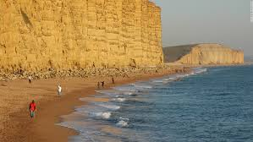
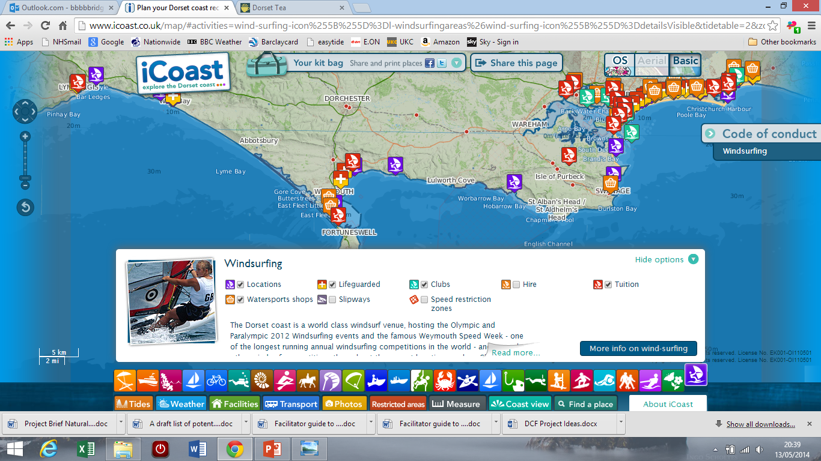
Some of our Key
achievements
Notes:
All types of projects/work – by working together (usually on multiple projects/areas of work) some of our key achievements include:
Gaining Jurassic coast WH status – 2001 – a recent report
LFCS
iCoast – under CSCOPE – delivered 1st marine plan for England – helped MMO with their work in their initial work and with stakeholder engagement – Dorset leading the way – being pro active

Slide 5
Dorset’s Coastal Community Teams
Dorset Coast
Forum
Dorset Coastal Community Team
Lyme Regis & Charmouth Coastal Community Team
Bridport & West Bay Coastal Community Team
Weymouth Coastal Community Team
Portland Coastal Community Team
Notes:
In July 2015 the Department for Communities and Local Government granted funding for 116 Coastal Community teams. The main aim of the CCTs was to take control of seaside regeneration and for Seaside towns to benefit from funding and support. The Teams are expected to bring together local business, councils and people. They are also expected to help coordinate regeneration projects in their area and get the chance to shape the next wave of the £90 million Coastal Communities Fund, which these teams will have access to.
The Dorset Coastal Community Team will cover the areas not already covered by the other teams and will have an economic plan for each local area to fit in with the other teams economic plans for their area. This will then link into an overarching economic plan for the Dorset coast which links to the Western Growth Corridor Strategy and Dorset LEP plan.
Whilst respecting that each area has different issues, the CCT’s propose to work together on any common themes that may come out of the economic plans
CCT has allowed us to focus on particular areas and widen the discussion. Knowing there is a funding potential has helped and focused the mind

Slide 6
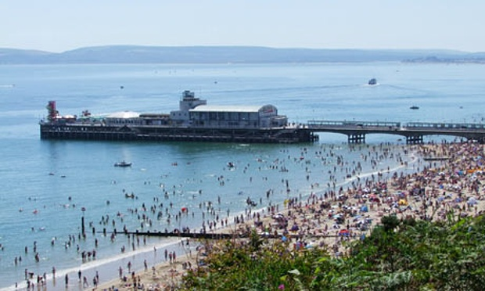
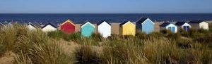
Dorset CCT Connective
Economic Plan for the Dorset coast
Main aim/ambition
To have a connected coast where partners work together to achieve a thriving and diverse coastal economy which uses the resources of the coast sustainably to enhance its natural offer.
Key themes to deliver this aim include:
Theme 1: Sustaining and developing the tourism economy - The quality of the visitor offer in coastal areas will be continuously improved to encourage longer visitor stay, out of season visitors and encourage visitor spend while adapting to the changing coast and climate change.
Theme 2: Having thriving and dynamic coastal and maritime businesses to encourage economic growth- typical businesses for the Dorset coast include ports and harbours, commercial and recreational fishing, marine and environmental technology and manufacturing. This also includes having the necessary skills within the community for these businesses.
Theme 3: Connecting the urban, rural and coastal communities across the Dorset coast – This will include investing in infrastructure, services and facilities so that they are fit for purpose, increased sustainable transport and access for all to the natural and built environment.
Theme 4: Conserving, enhancing and promoting Dorset’s special natural and cultural assets -while ensuring coastal communities play a key role in the good management and sustainable exploitation of natural resources in the coastal and marine environment and celebrate Dorset’s built heritage.
Notes:
Themes we developed

Slide 7
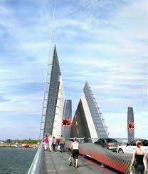
Developing the Dorset CCT work
Identifying the projects:
Looked at projects submitted for the all the Coastal Community Team Economic Plans in Dorset

Slide 8
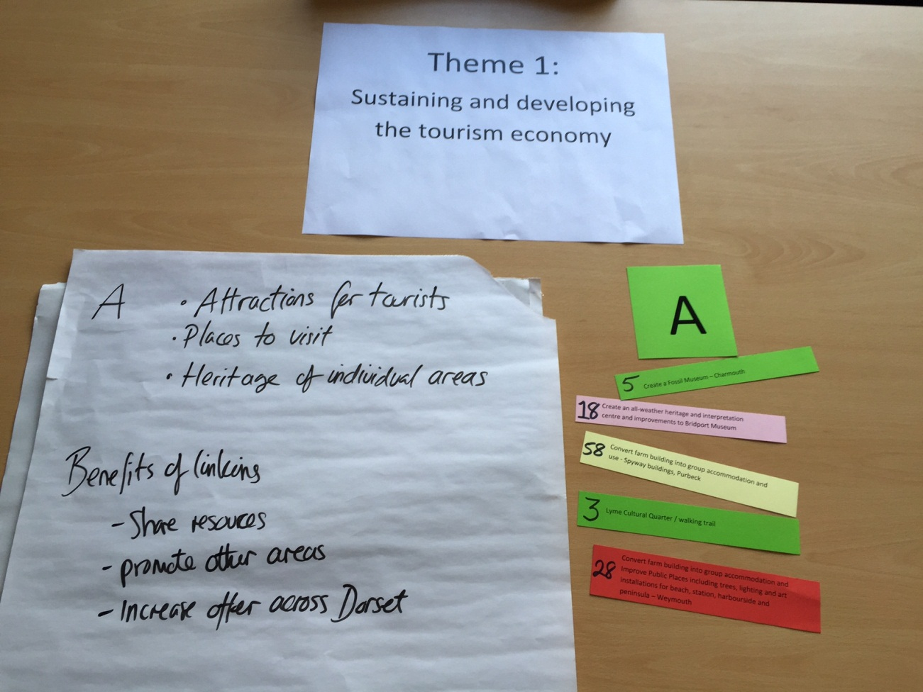
Delivery of the Plans
Identify potential links between these projects – common threads, what connects them what is the benefit to connecting them?

Slide 9
Delivery of projects
Key things needed for success:
Coordination
Clear plan
Working together in partnership
Communication
Sharing information
Trust
Delegation of tasks
Getting right people on board (communities and authorities)
Notes:
Coordination
Clear plan – timescales, finances, milestones,
Working together in partnership
Communication
Sharing information
Trust
Delegation of tasks
Getting right people on board (communities and authorities)

Slide 10
b.betts@dorsetcc.gov.uk
01305 224760

