Slide 1
Old Sunderland CCT
How becoming a CCT can encourage investment in your area

Slide 2
Vision
Tell the story/Make a plan
CONNECTIONS

Slide 3
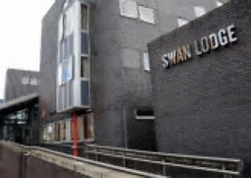
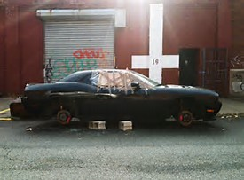
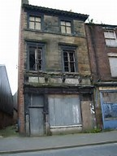
VISION

Slide 4
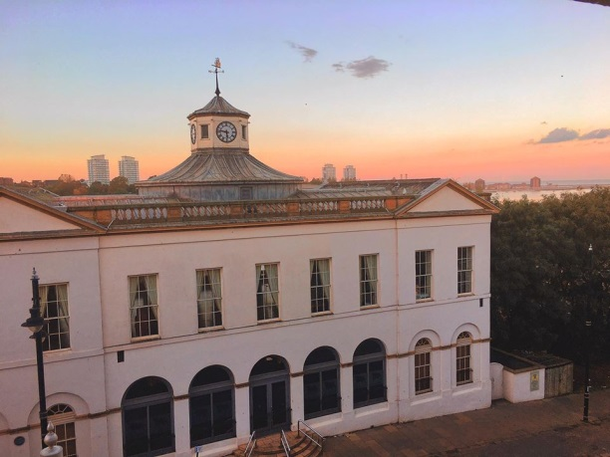
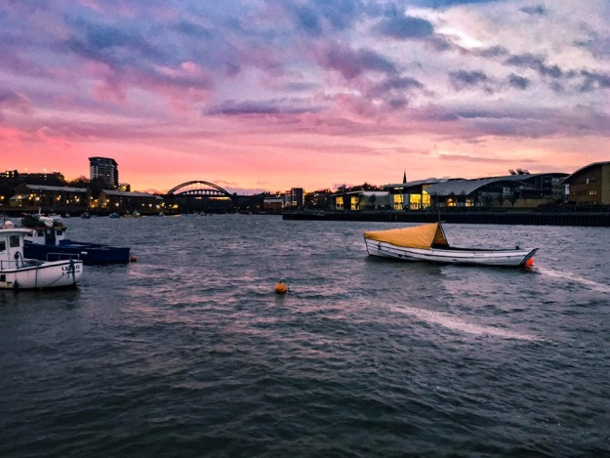
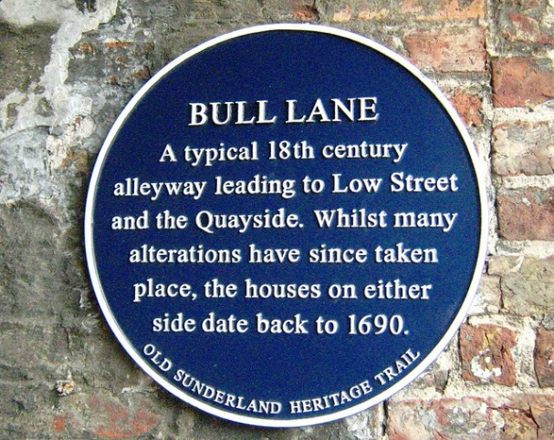
VISION

Slide 5
VISION

Slide 6
VISION
What is your area known for?
What do you want it to be known for?
What is your “UNIQUE”
HOW
Why
What
When
Where

Slide 7
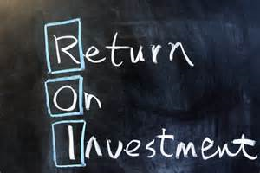
VISION

Slide 8
Make a Plan

Slide 9
Make a Plan
500 Jobs – Waste to Energy Plant on the port
CATALYST
Hotel Bedrooms
ATTRACTORS
Cafes, restaurants – fit with theme
ATTRACTORS
River and history…
ATTRACTORS
Cable car (river crossing) and tram (from city)
CONNECTORS
KNOWN FOR FISH, SHIP BUILDING AND THE RIVER

Slide 10
Make a Plan

Slide 11
Connections

Slide 12
Connections

Slide 13
Connections

Slide 14
andrea.winders@disruptieve.com

