Slide 1
BLACKPOOL
City Life On The Beach
Resort Repositioning
Head of Visitor Economy
{Philip Welsh
Head of Visitor Economy

Slide 2
The scale of Blackpool’s Visitor Economy
A total of 16.827 million
Tourism Visits, equating to 27% of all tourism visits to Lancashire
3.404 million visits were made by visitors staying in Blackpool as part of a holiday or short break, generating 9.418 million nights in accommodation across the district
WELCOME
Philip Welsh
Head of Visitor Economy
13.422 million tourism visits made by Day Visitors to the district

Total bedstock in Blackpool is 68,781 beds
Comprising 14,235 non-serviced and 54,546 serviced beds
£
A total of £1.333 billion was generated within the local economy through visitor and tourism business expenditure
Day Visits generated £441,150 million for the local economy of Blackpool in 2014
In total, staying visitors generate a total economic impact of £892 million for the businesses and communities of Blackpool

Visitors to Blackpool supported 23,888 full time equivalent jobs

More than 22.5 million Visitor Days and Nights generated by visitors in 2014

Economic Impact rose by 2.9% between 2013 and 2014

Slide 3
Key Aims of Resort Regeneration
Long-term re-positioning of Blackpool as quality destination
Year-round destination – events and attractions
Clear linkages between town and beach
Maximise status, role and relevance of heritage sites
Retail, business, civic and cultural centre for Fylde Coast
Enhance transport connections
Deliver high quality public realm
Create jobs, business confidence and inward investment
Delivered through Destination Management Plan
Philip Welsh
Head of Visitor Economy

Slide 4
The Challenges
Retention of the resort’s “golden core”
Elimination of sub-standard accommodation
Change in negative public perceptions
Under-performing retail centre
Lack of connectivity between “city” and beach
Seasonal nature of tourism-related employment
Growing threat from urban destinations – leisure/business tourism
Building sustainable town centre/visitor economy partnership (CCT)
Philip Welsh
Head of Visitor Economy

Slide 5
What’s already been achieved
Remodelling of seafront and promenade
Hounds Hill Shopping Centre Phase 1
Revitalised tramway
£2m CCF investment in Illuminations
Town centre regeneration schemes
Gateways to Blackpool
Acquisition and regeneration of key leisure assets
Programme of world-class events
Private sector investment in visitor economy
Securing of first “Blue Flag” for South Beach
Philip Welsh
Head of Visitor Economy

Slide 6
Future developments
Further regeneration of Winter Gardens
Hounds Hill Phase 2
Central Business District expansion
Completion of rail electrification
Tramway extension to main rail network
New housing replacing outmoded hotel stock
Central Station site redevelopment
Enhanced conference facilities
Further private sector investment in visitor economy
Future CCF bids via Coastal Communities Team
Philip Welsh
Head of Visitor Economy

Slide 7
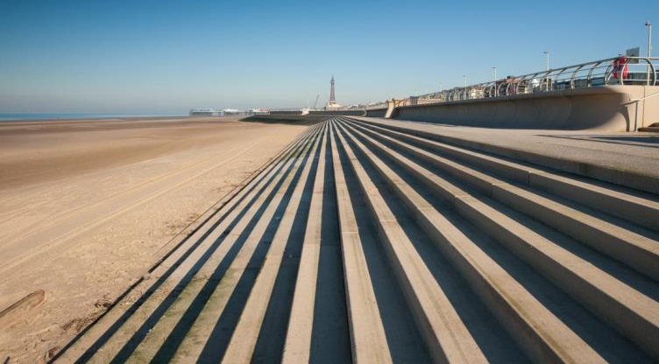
Remodelled Seafront - £200m investment
WELCOME
Philip Welsh
Head of Visitor Economy

Slide 8
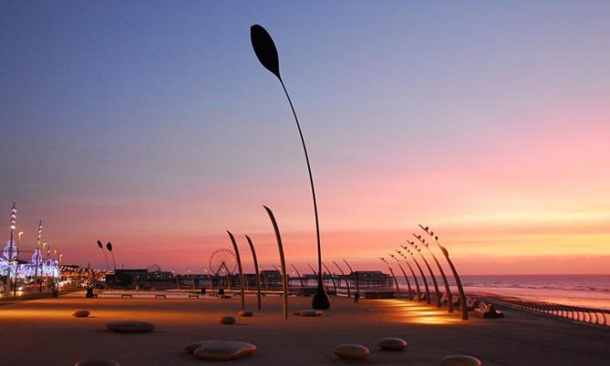
Tower Festival Headland – outdoor event space
WELCOME
Philip Welsh
Head of Visitor Economy

Slide 9
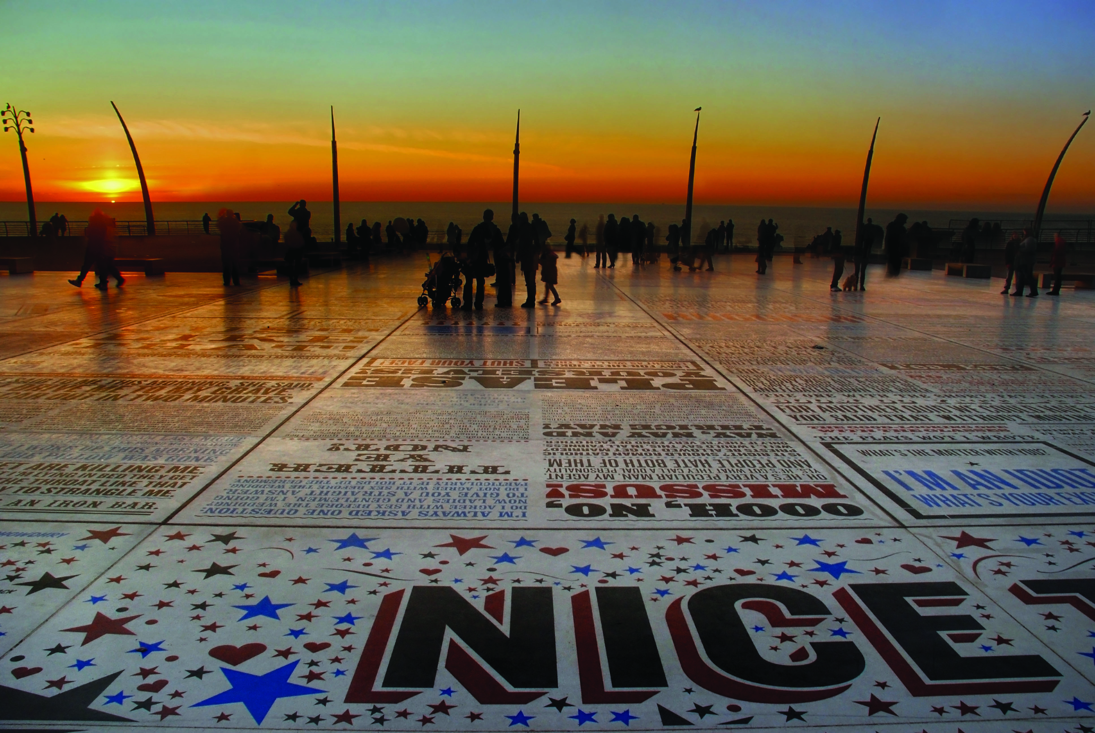
Public Artwork: The Comedy Carpet
WELCOME
Philip Welsh
Head of Visitor Economy

Slide 10
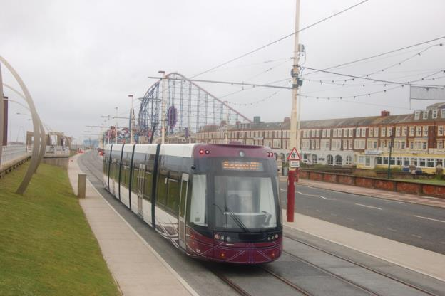
Revitalised tramway - £85m of investment
WELCOME
Philip Welsh
Head of Visitor Economy

Slide 11
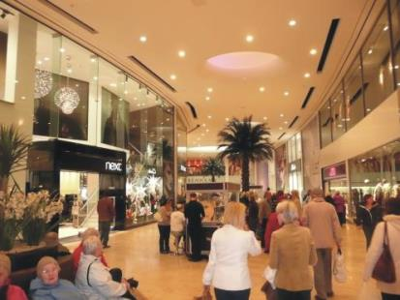
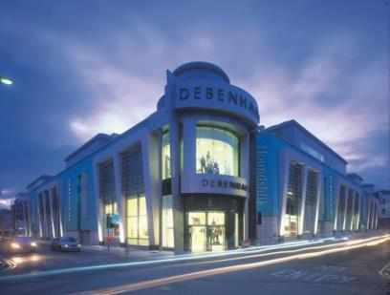
Hounds Hill Phase 1 - £150m private investment

Slide 12
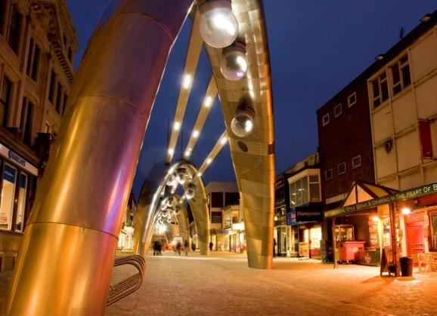
Town Centre Brilliance - £5m investment
WELCOME
Philip Welsh
Head of Visitor Economy

Slide 13

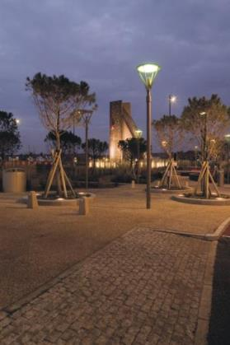
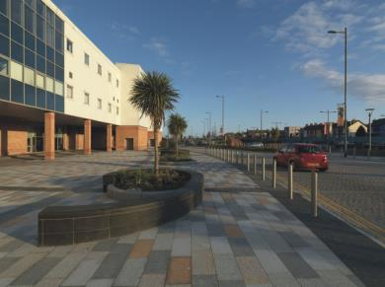
Improved gateways to resort - £7m investment
WELCOME
Philip Welsh
Head of Visitor Economy

Slide 14
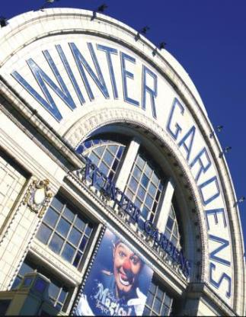
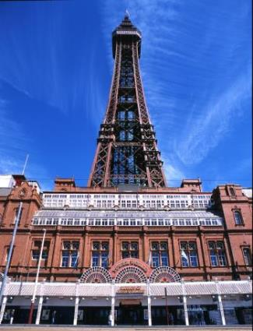
Key Leisure Assets - £50m investment
WELCOME
Philip Welsh
Head of Visitor Economy

Slide 15
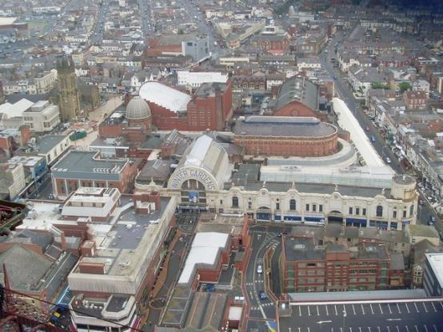
Winter Gardens Masterplan
WELCOME
Philip Welsh
Head of Visitor Economy

Slide 16
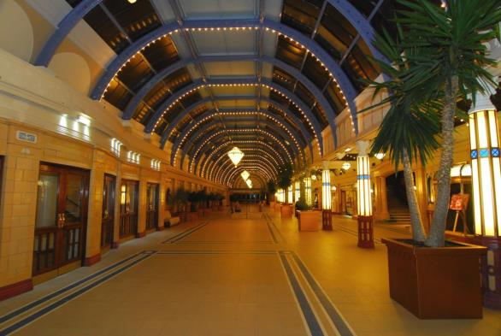
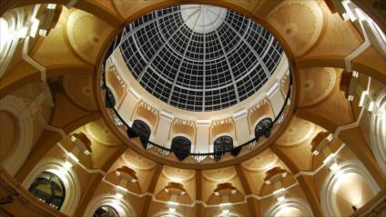
Regeneration of Original Architecture
WELCOME
Philip Welsh
Head of Visitor Economy

Slide 17


Return Of The Summer Show
WELCOME
Philip Welsh
Head of Visitor Economy
2014 season – 100,000 tickets sold in 12 weeks
2015 season – 63,000 tickets sold in 8 weeks

Slide 18
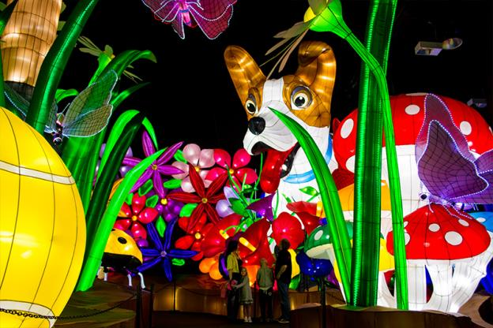
Illuminasia: Chinese investment

Slide 19
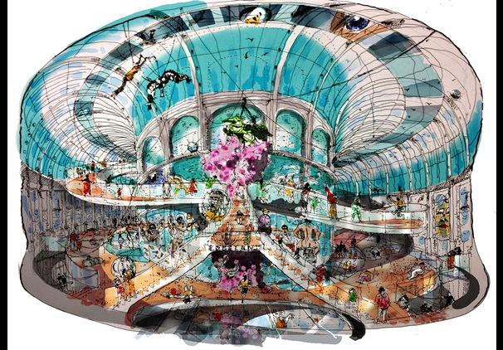
£20m Museum For Blackpool Project
WELCOME
Philip Welsh
Head of Visitor Economy

Slide 20
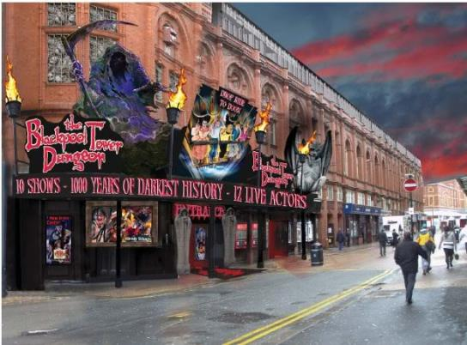
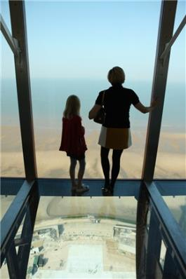
Blackpool Tower Investment
WELCOME
Philip Welsh
Head of Visitor Economy

Slide 21
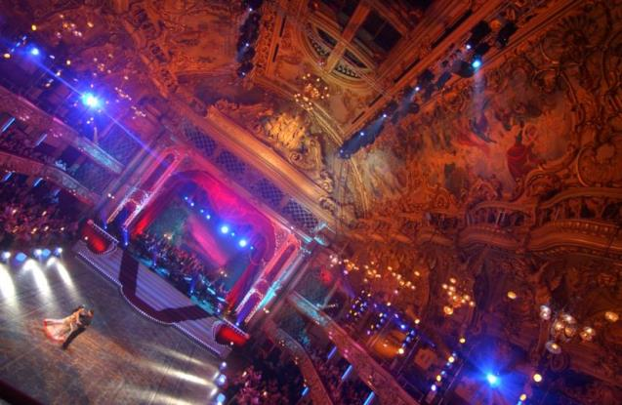
The Blackpool Tower Ballroom
WELCOME
Philip Welsh
Head of Visitor Economy

Slide 22
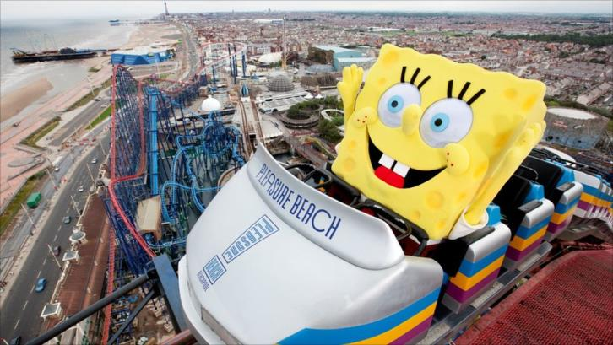
Private Sector Investment In Visitor Economy
WELCOME
Philip Welsh
Head of Visitor Economy

Slide 23
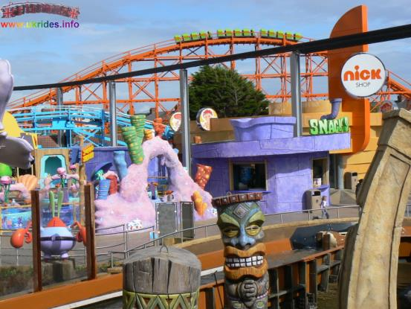
Council-supported investment
WELCOME
Philip Welsh
Head of Visitor Economy

Slide 24
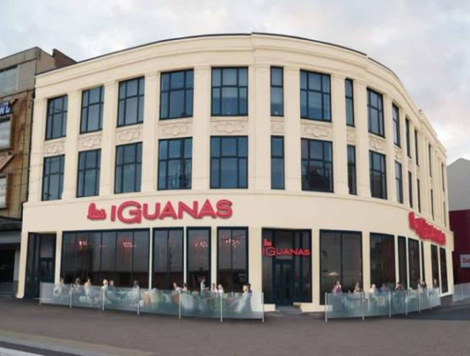
New branded family restaurants/attractions
WELCOME
Philip Welsh
Head of Visitor Economy

Slide 25
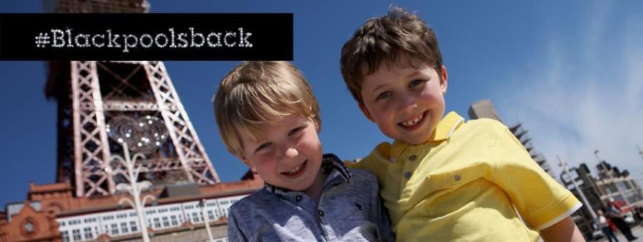
Destination Marketing: £2.2m Over Three Years
WELCOME
Philip Welsh
Head of Visitor Economy

Slide 26
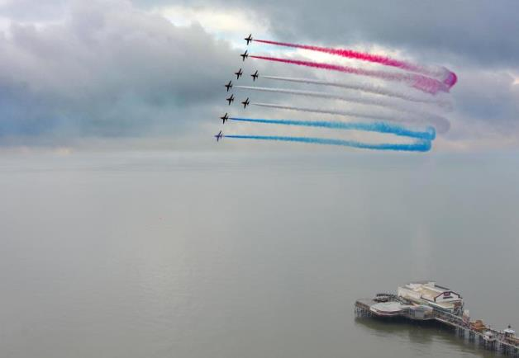
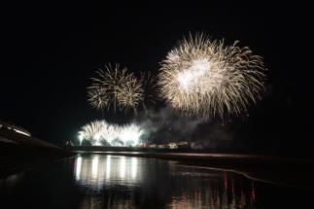
World Class Events Programme
WELCOME
Philip Welsh
Head of Visitor Economy

Slide 27
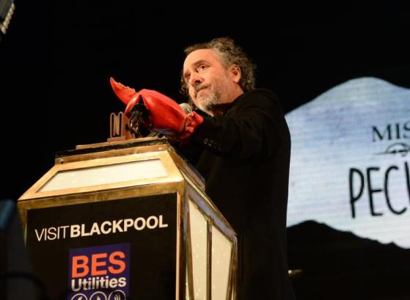
World Class Events
WELCOME
Philip Welsh
Head of Visitor Economy

Slide 28
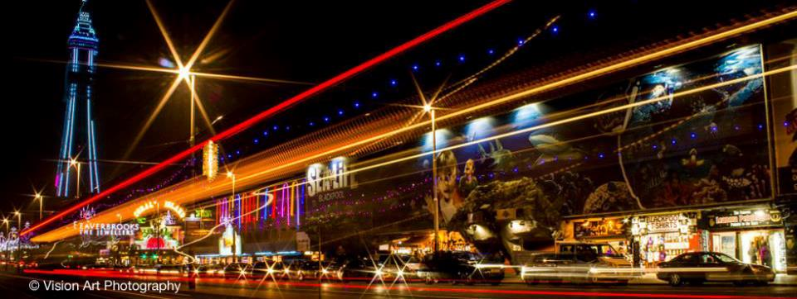
Blackpool Illuminations
WELCOME
Philip Welsh
Head of Visitor Economy

Slide 29


Blackpool Illuminations: £2m investment in 2015/16

Slide 30
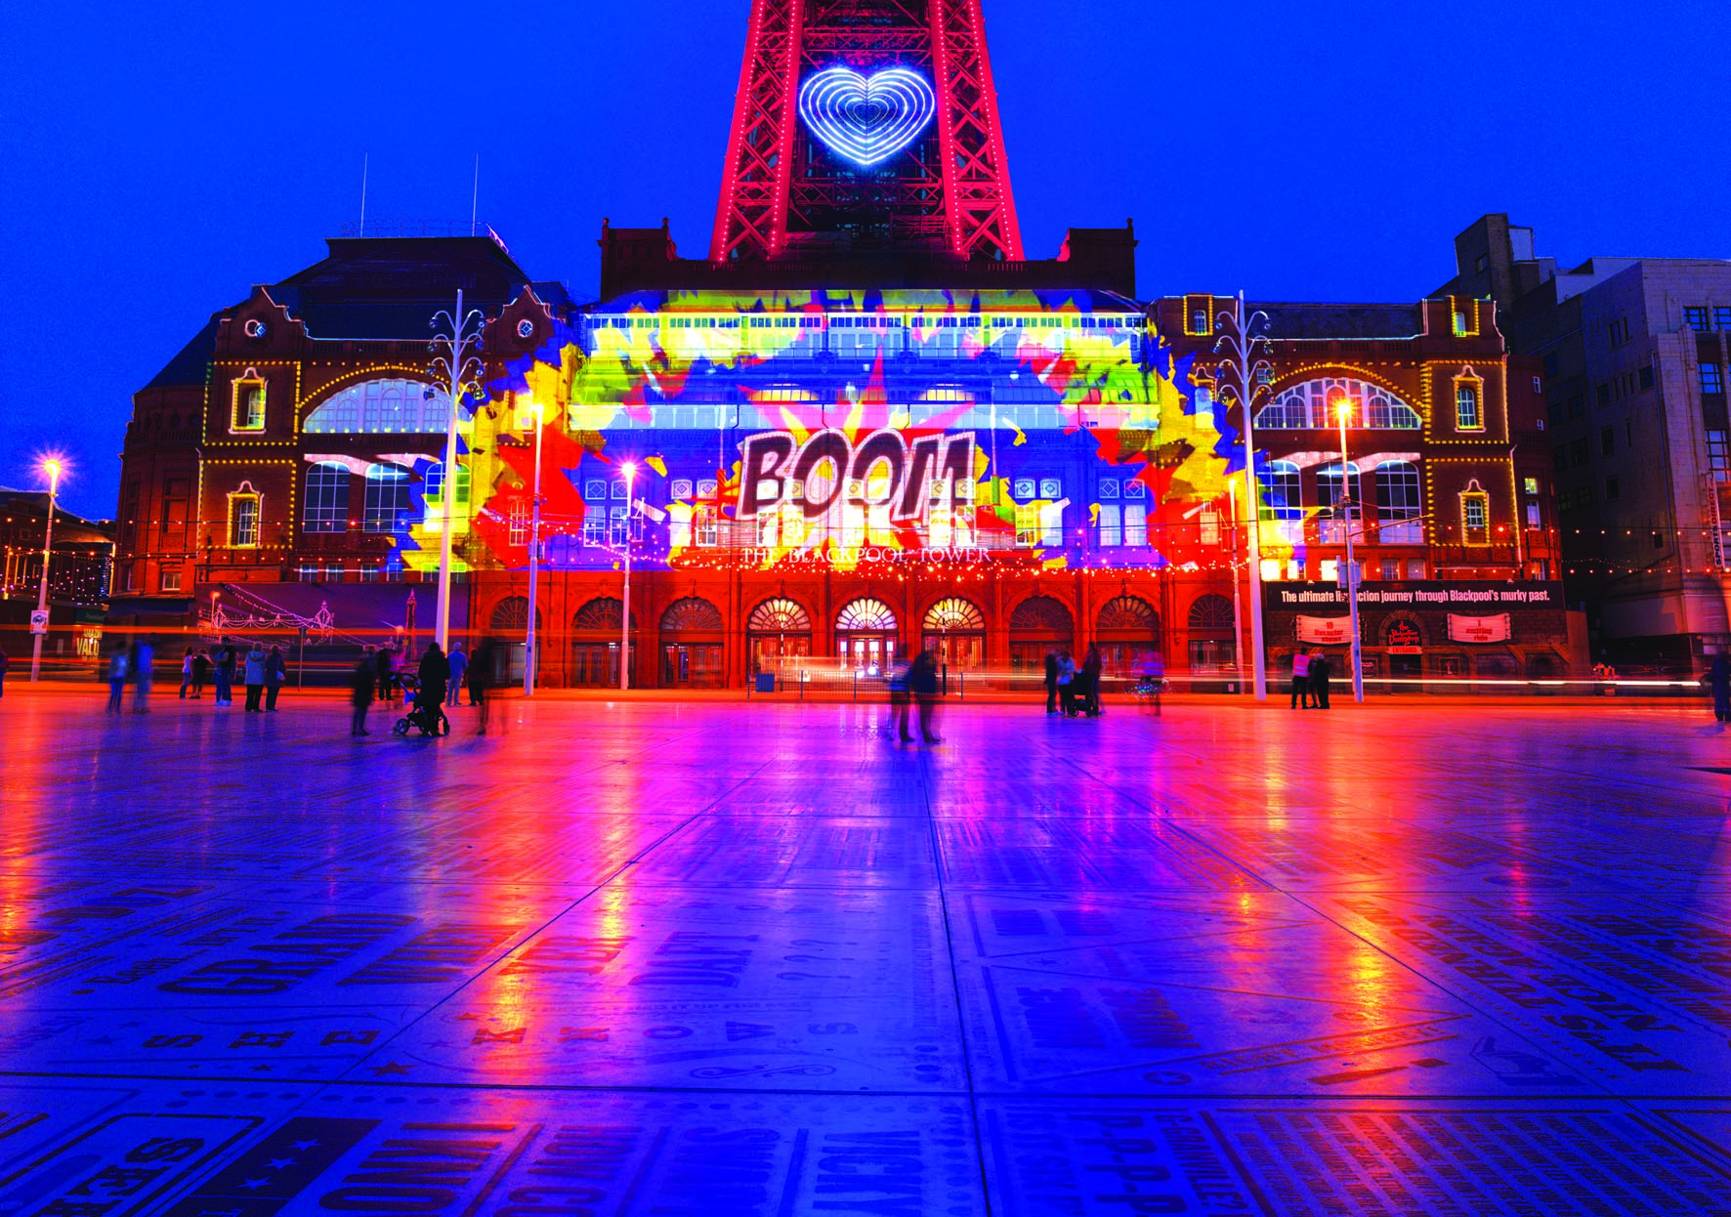
LightPool: Reinventing the Illuminations

Slide 31
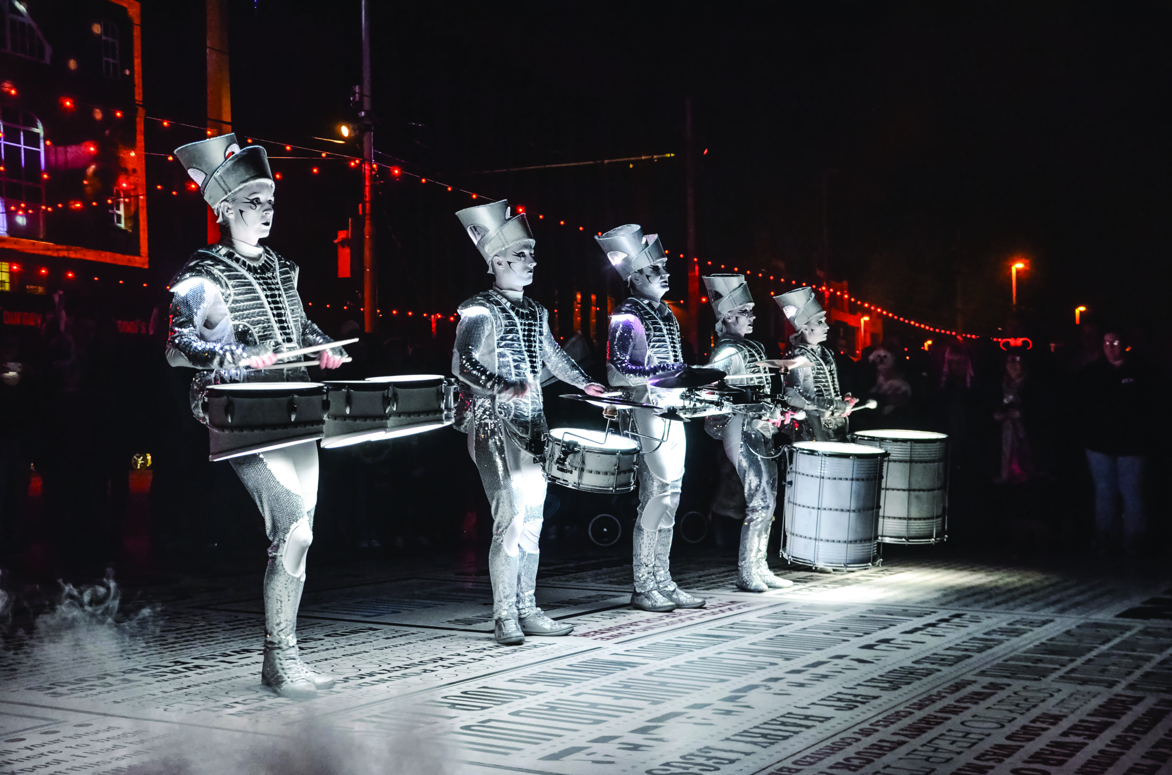
LightPool: Connecting town and beach

Slide 32

LightPool: New for 2016
Internationally-designed 3D projection
Town centre festival, October
Neon exhibition with Tracey Emin
16 resort ambassadors

Slide 33
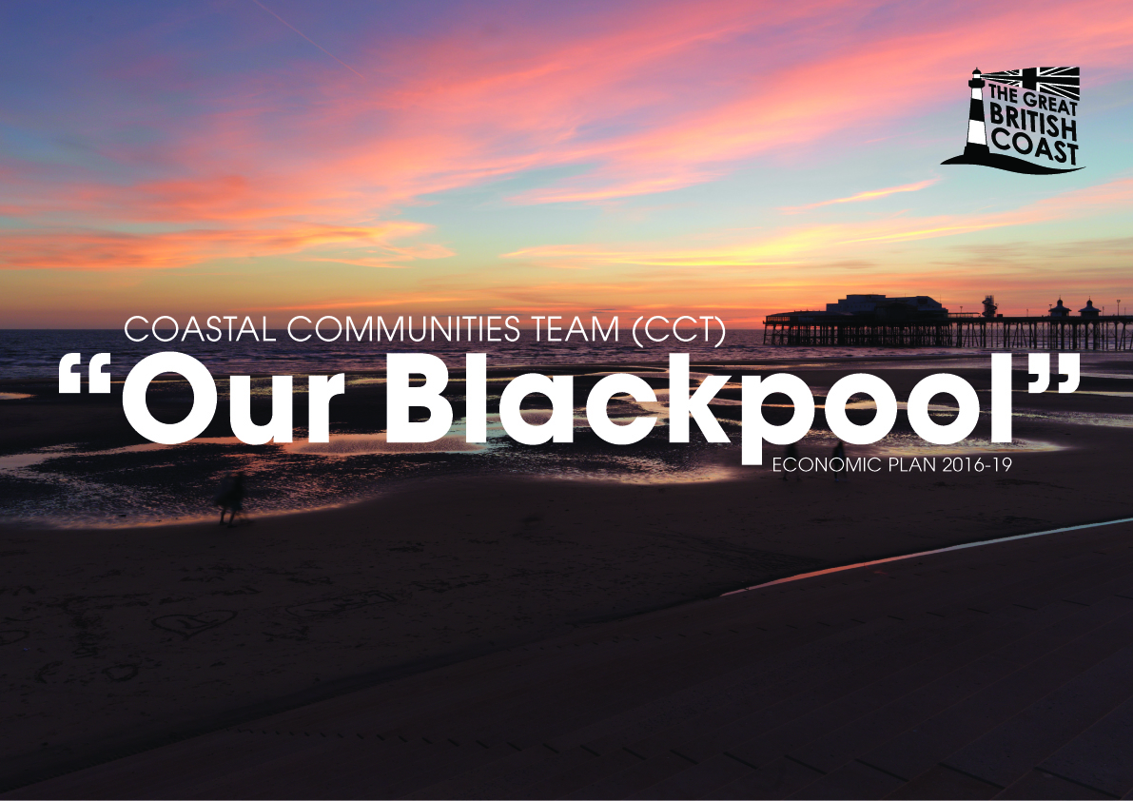
The role of Blackpool’s CCT team

Slide 34

Overarching objectives
Support Town Centre Strategy and Destination Management Plan
Develop ethos of town centre/visitor economy partnership working (including Town Centre BID and Healthy High Streets)
Focus on the early evening economy
Grow footfall via cultural, leisure and retail economy
Engage with local community
Job creation in town centre
Devise initiatives to reduce vacant property rates
Maximising potential of CCF programme
Support and refine CCF bids
Philip Welsh
Head of Visitor Economy

Slide 35
Any Questions

