Slide 1
DELIVERING LITTLE & LARGE PROJECTS Coastal Communities Conference 21st April 2017 - Hull Richard Harrison – Senior Regeneration Officer Harland Deer – Business & Marketing Officer

Slide 2
Purpose of the Workshop
To share our experiences from Hartlepool including the work with the two Coastal Community Teams.
To share your experiences of coastal regeneration.
To share good practice.

Slide 3
CONTENTS
HARTLEPOOL – LOCAL CONTEXT
LARGE PROJECTS
BUZZ GROUPS – TASK 1
LITTLE PROJECTS
BUZZ GROUPS – TASK 2

Slide 4
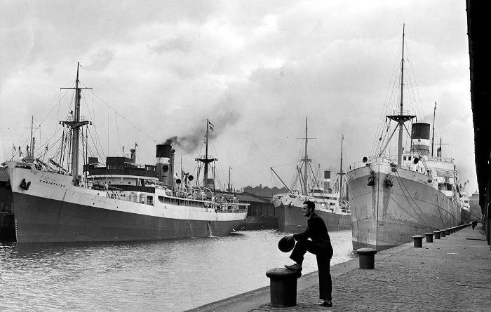
Hartlepool – Local Context
Located in the North East of England with a population of c95,000.
Issues with unemployment and job opportunities.
Economy of Hartlepool traditionally linked to the port, heavy industries and ship building sectors.
Following the decline in these industries there is a need to diversify the economy and seek job growth in other sectors.

Slide 5
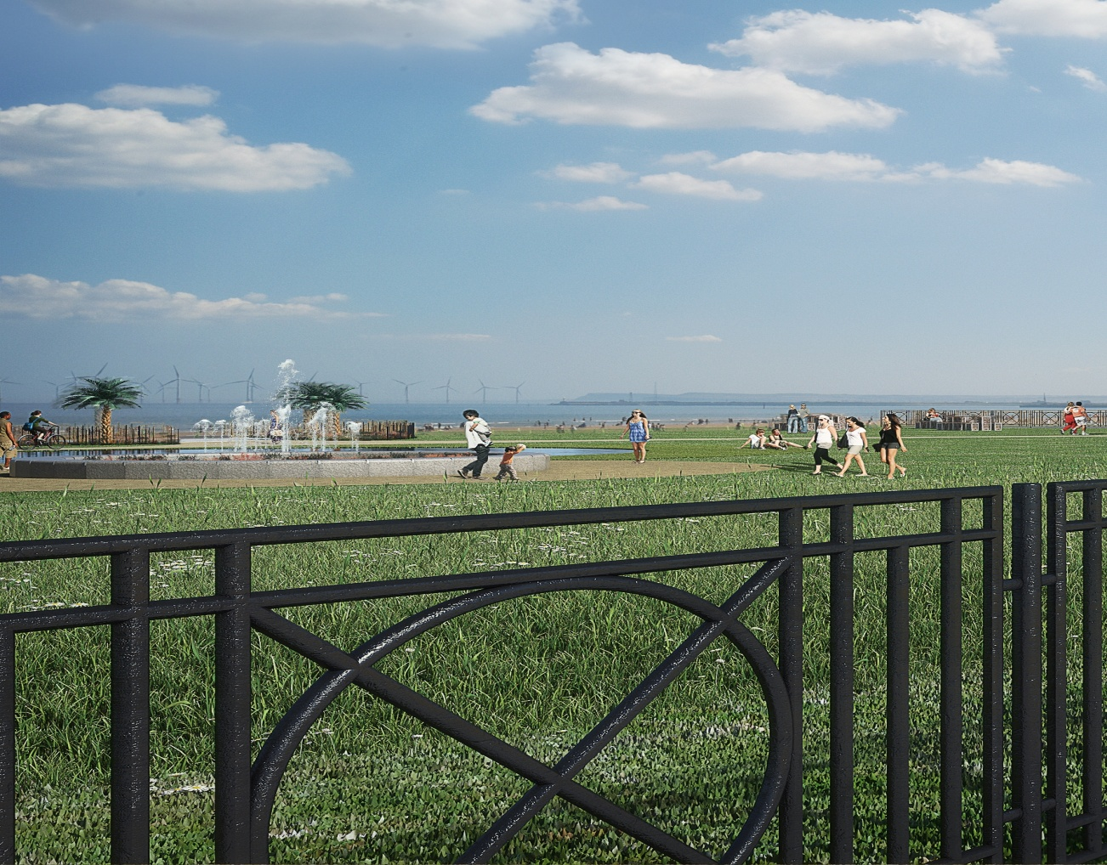
Local Context - Continued
Hartlepool is aiming to change perceptions by investing in sectors such as the visitor economy and creative industries.
Hartlepool has 2.8m day visitors annually with 413,000 staying overnight, spending £149m in the local economy.
There is a need to modernise and upgrade the visitor offer by building upon the maritime heritage if the town is to become more competitive as a visitor destination.

Slide 6
Tourism Day Visitors: Hartlepool Catchment
0- 15 minutes
161,092
16-30 minutes
516,155
31-60 minutes
1,5121,251
Total in population
Catchment of less
than 1 hour
2.2m
Source: Geoplan

Slide 7
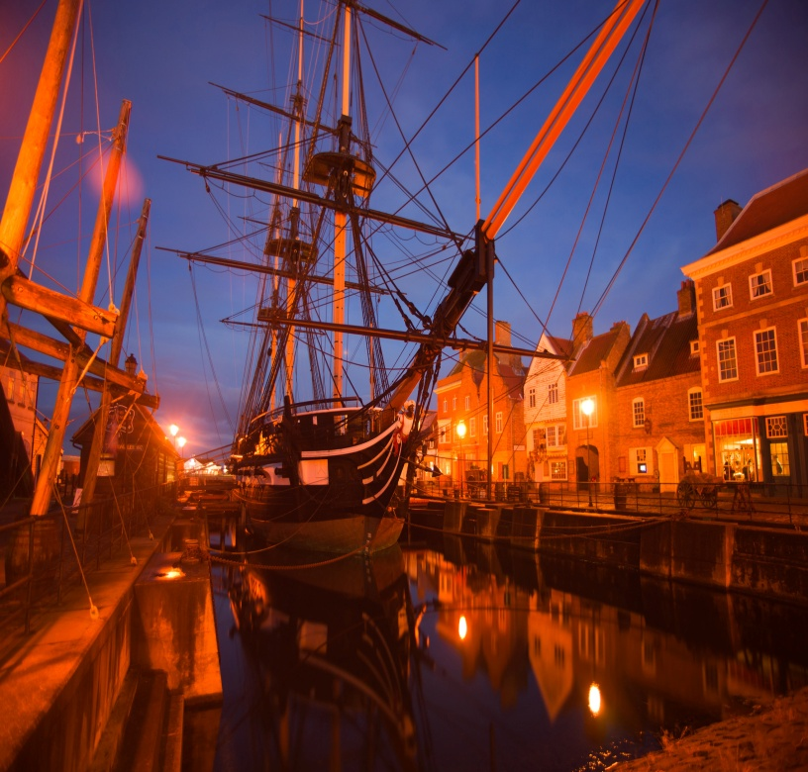
Local Context - Continued
There is an opportunity to build upon our rich maritime heritage & natural coastal assets.
The National Museum of the Royal Navy (Hartlepool) recently opened at the Waterfront and will be a catalyst for change.
Their target for paid visitors is 100,000 per year which will spread economic benefits to the rest of the town.
The museum includes HMS Trincomalee -the oldest floating warship in the world – built in 1817!
HMS Trincomalee

Slide 8
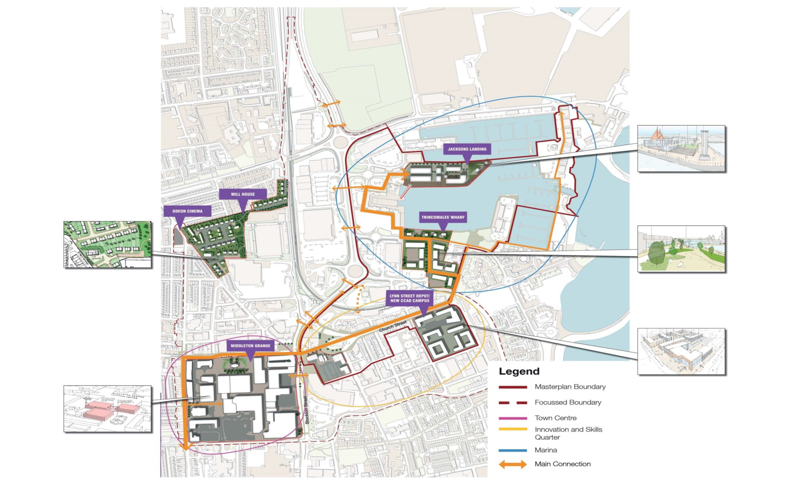
Large Projects
November 2015 - Council adopted a new Regeneration Masterplan: Hartlepool Vision.
The masterplan sets out priorities for delivering key capital projects over the next 15 years.
It seeks to coordinate investment and align the aims of the public and private sectors.
£165m worth of public & private investment has been identified.
Potential to create up to 700 new jobs and 1,200 construction jobs.

Slide 9
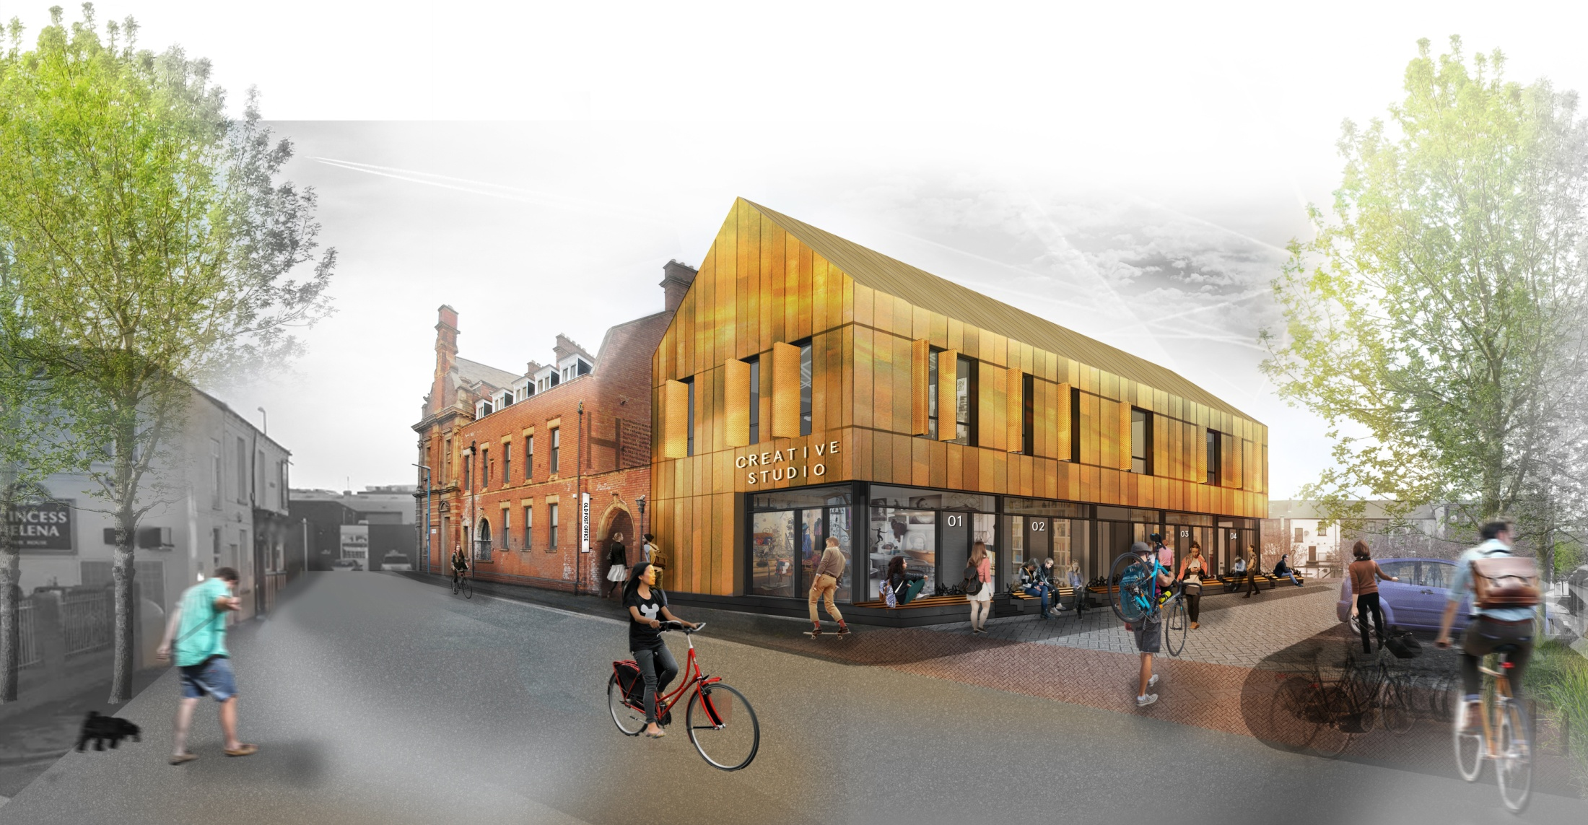
£2.9M NEW MANAGED WORKSPACE FACILITY PROVIDING START UP SPACE FOR GRADUATES IN THE CREATIVE INDUSTRIES SECTOR

Slide 10
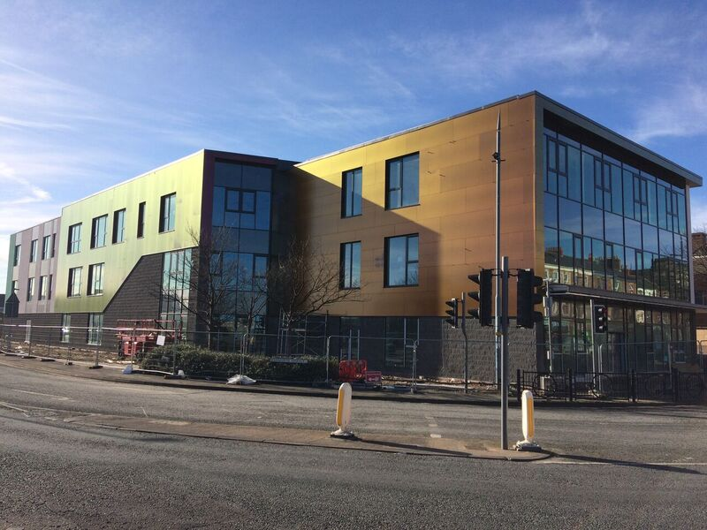
CLEVELAND COLLEGE OF ART & DESIGN – NEW £11M CAMPUS AND TEACHING FACILITIES

Slide 11
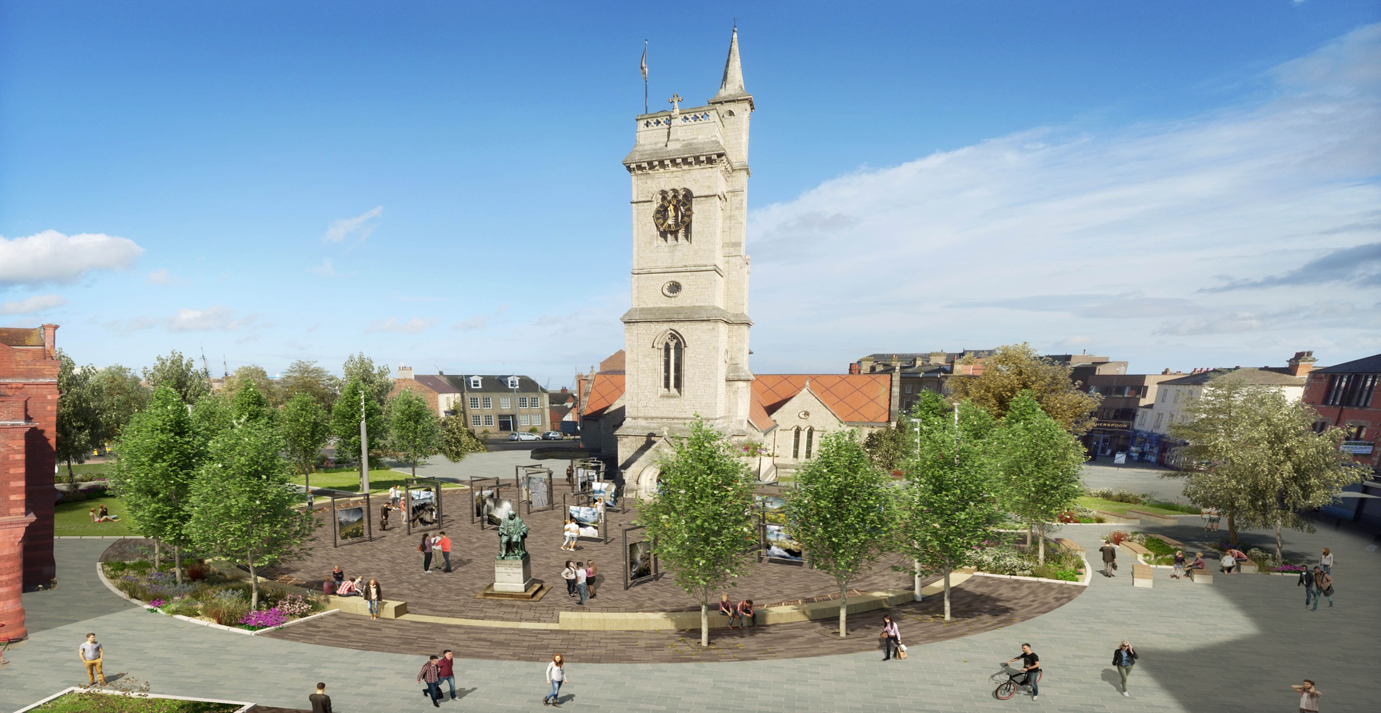
CHURCH SQUARE – REVITALISING PUBLIC REALM SPACE AND IMPROVING PEDESTRIAN CONNECTIVITY

Slide 12
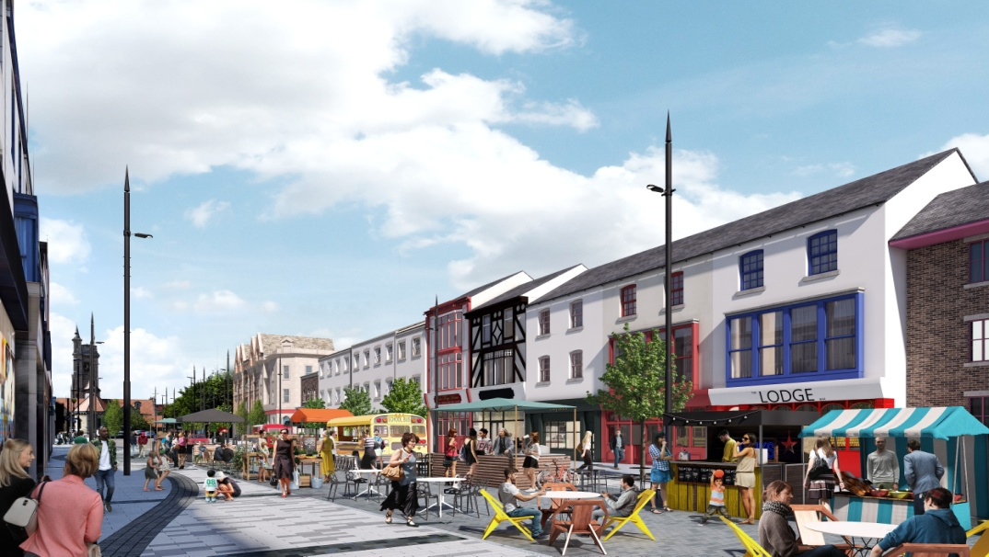
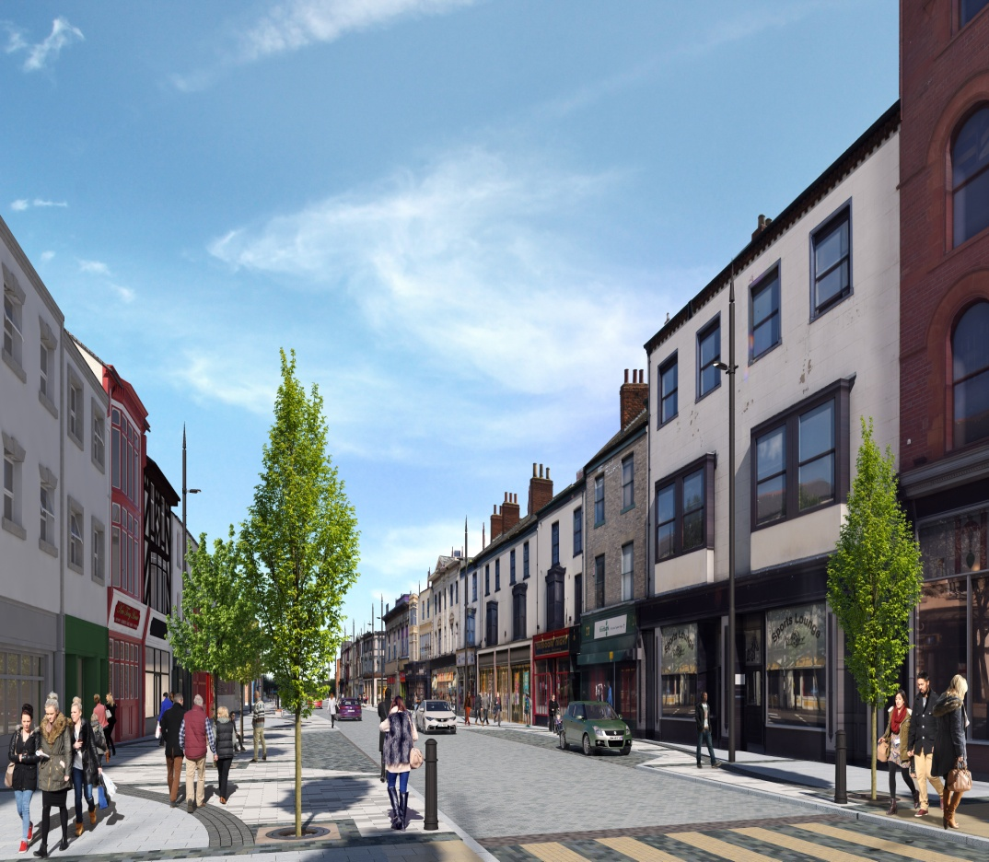
CHURCH STREET – REVITALISING A HERITAGE ZONE BETWEEN THE WATERFRONT AND THE TOWN CENTRE

Slide 13
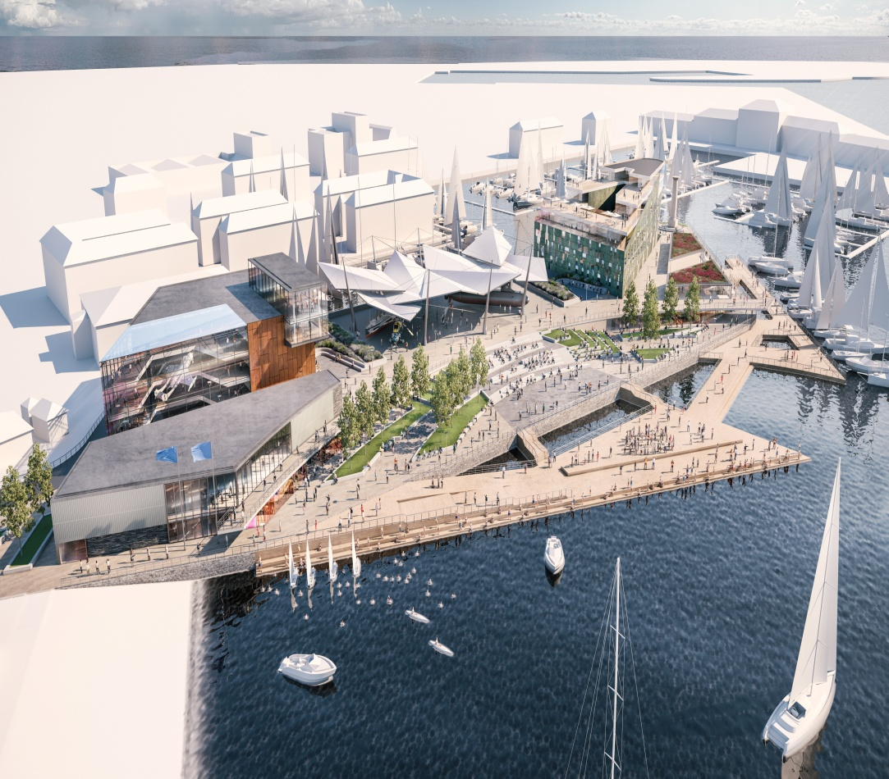
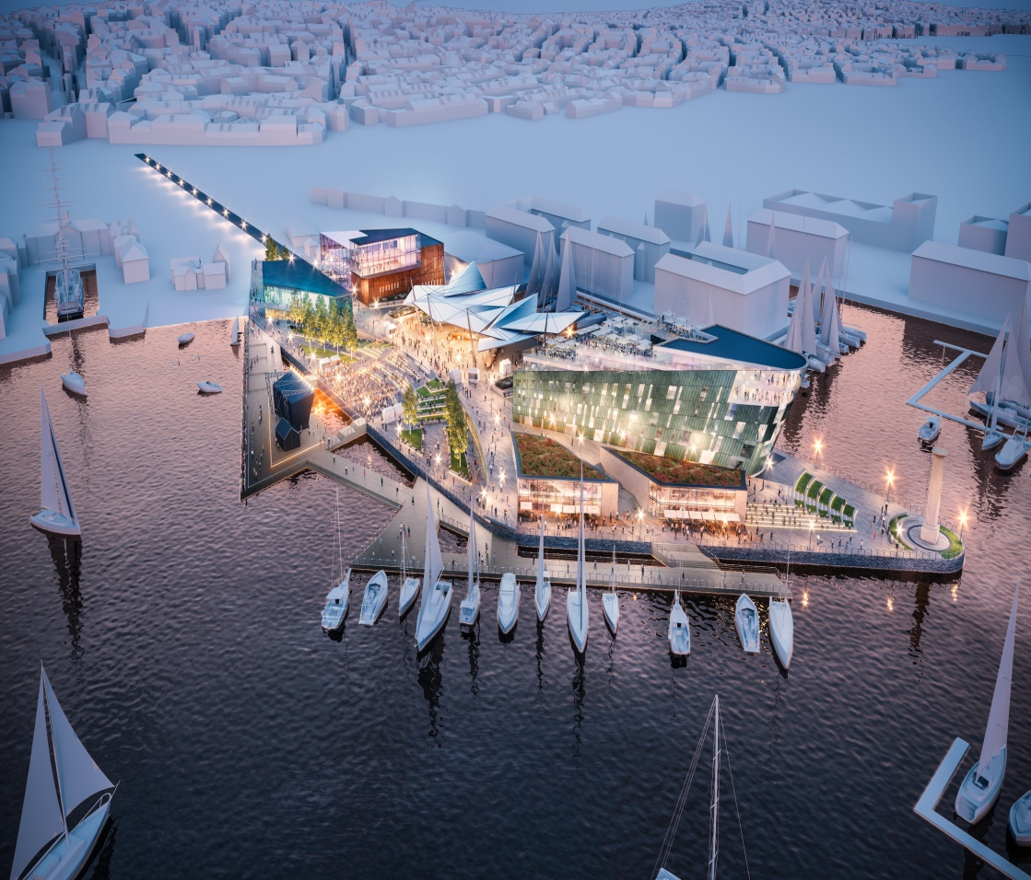
THE WATERFRONT – 5 ACRE REGENERATION SITE – CONCEPT MASTERPLAN FOR A MIXED USE TOURISM LED DEVELOPMENT WITH A NEW HOTEL, EVENTS SPACE AND VISITOR ATTRACTION

Slide 14
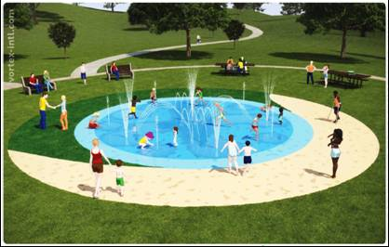
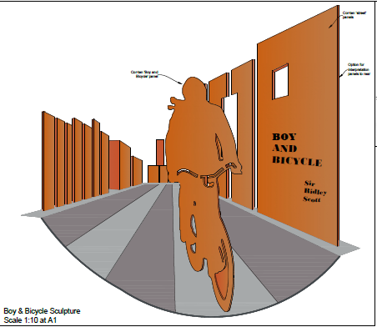
Hartlepool Coastal Transformation Project – Coastal Communities Fund Round 4
£1.3m Project
£600k requested from CCF R4
Major seafront improvements at Seaton Carew
Includes for an outdoor leisure park, new public realm, and public artworks linking the waterfront

Slide 15
Buzz Groups – Task 1
Groups of 4
10 minutes
Discuss your experience of developing & delivering large projects
Agree on top 3 barriers to overcome in delivering such projects
Discuss how you have overcome the barriers and lessons learnt
Brief feedback from selected groups

Slide 16
Coastal Community Teams
Little Projects
In 2015 Hartlepool successfully established two Coastal Community Teams:
Seaton Carew
Headland & Harbour
Each Team received £10K from the Government (via DCLG).
The Teams agreed to pool the £20,000 funding from the DCLG.
The Teams decided to focus on promoting the visitor economy.
Each Team has a mix of local Councillors, Council Officers, community and business representatives.
Referrals to join the CCTs is carried out by the Hartlepool Economic Forum.

Slide 17
Coastal Community Teams – Economic Plans
Both teams produced an Economic Plan setting out:
Their ambitions for local community regeneration.
Priority goals and activities.
Outcomes envisaged.
It was jointly agreed to commit the £20K funding on the “Coast” project to promote Hartlepool as a visitor destination.
Future projects were also identified to form the basis of funding submissions to the Coastal Communities Fund.

Slide 18
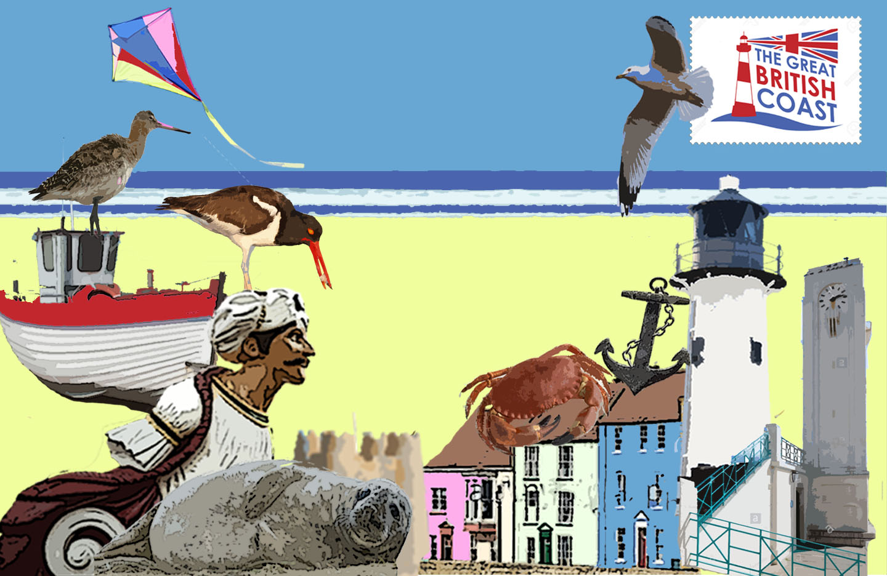

Slide 19
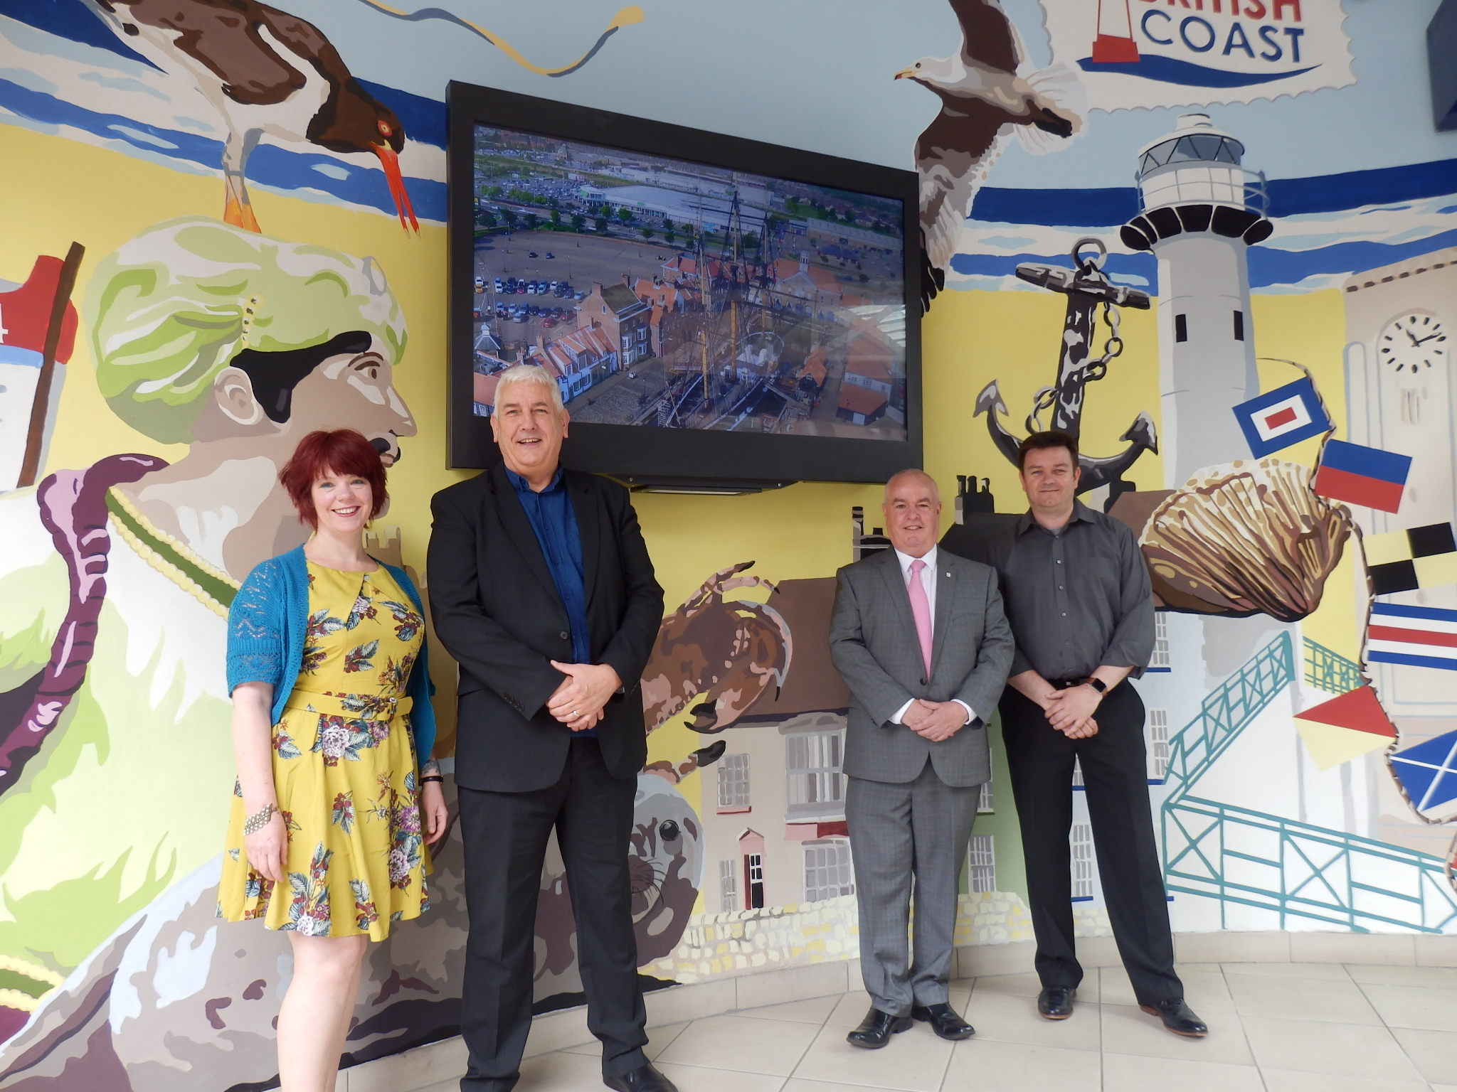

Slide 20
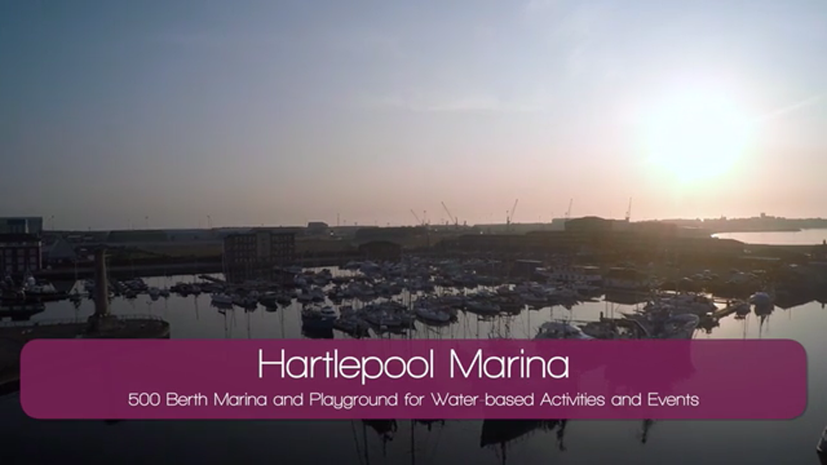
www.hartlepoolcoast.com

Slide 21
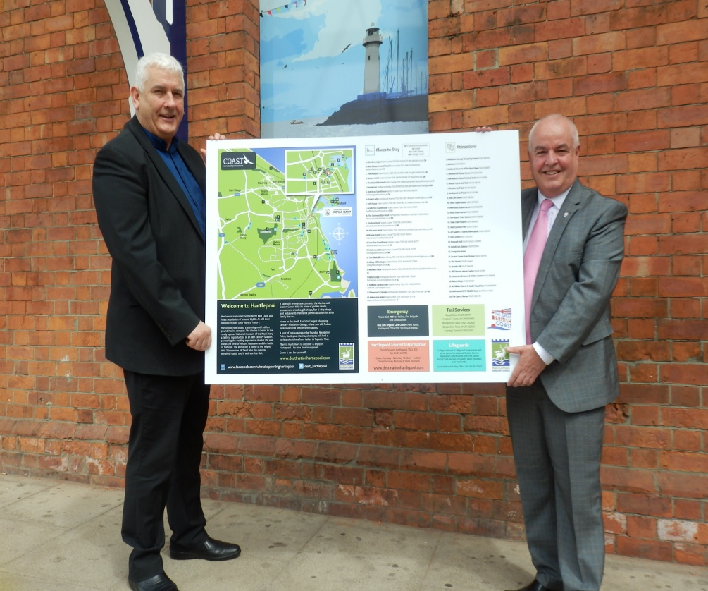
Notes:
!

Slide 22
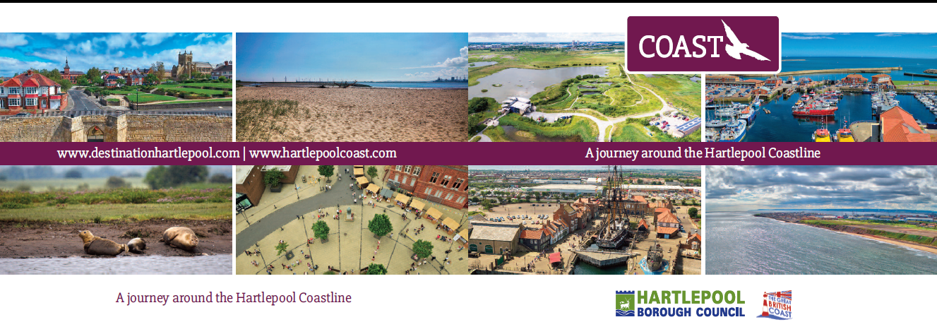

Slide 23
Coastal Community Teams – Key Lessons
If goals are shared and agreed then private & public sector partners can collaborate to deliver community projects in an effective way.
Key to success is using the positive and proactive involvement of local people with their knowledge and passion for their area.
Take advantage of the natural assets and promote them in innovative ways such as via drone footage.
Tap into the history of the area to unlock local community pride.

Slide 24
Regenerating Coastal Communities Seminar 27th January 2017
Institute for Local Governance organised the free to attend event in Hartlepool.
The ILG wanted to see what defines a coastal town and what needs to be done to secure their positive futures.
Delegates were invited who were interested in making change in coastal communities from different points of interest.
There is some really good work going on in coastal towns in the North East of England and projects using funding in creative ways.

Slide 25
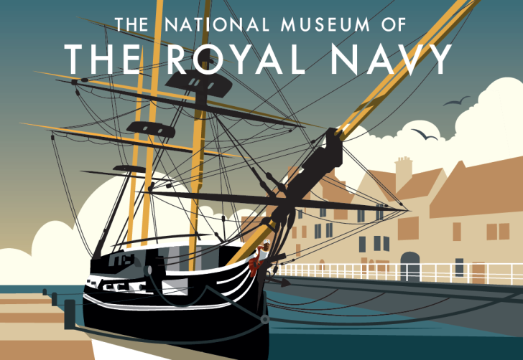
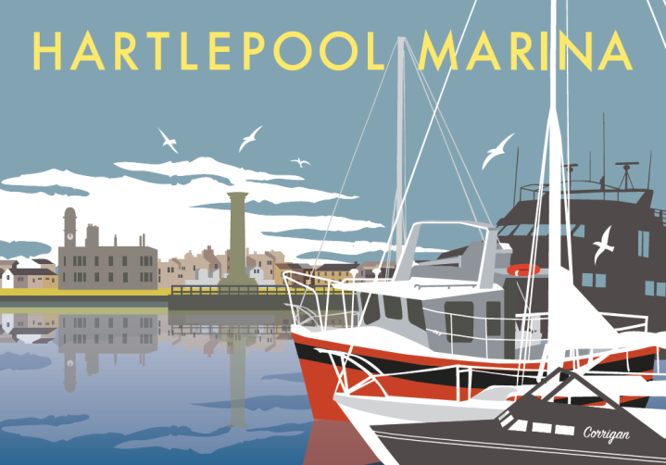
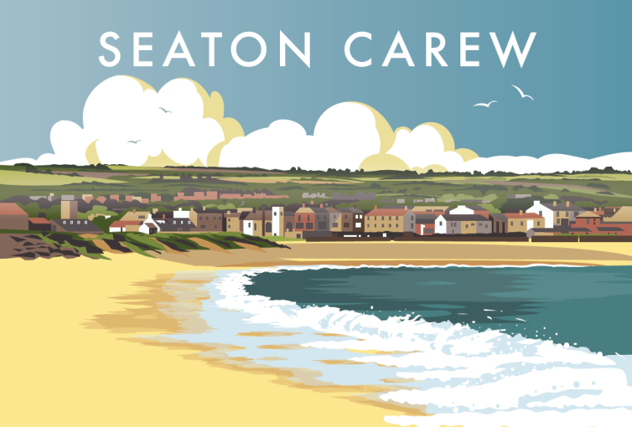
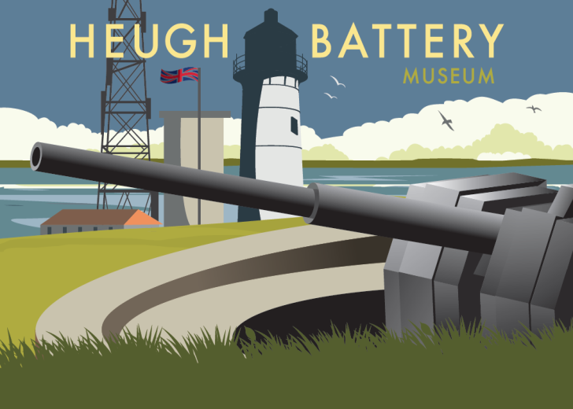
Railway Station Artwork

Slide 26
Coastal Regeneration - Summary
Major investment is planned for key areas of Hartlepool with external funding such as the Coastal Communities Fund essential to rejuvenate the town.
Hartlepool is becoming a regional & national destination for visitors and there is great opportunities for the local area to build upon the location of the major attraction of National Museum of the Royal Navy (Hartlepool).

Slide 27
Buzz Groups – Task 2
Groups of 4
10 minutes
With the challenges facing coastal communities what is your top realistic requests for the DCLG in order to see further progress made in your area?
Brief feedback from selected groups

