Slide 1
Moving Regeneration Forward Through Brexit
Helen Thompson
Inward Investment Manager
North East Lincolnshire Council
CoastNEL
21 April 2017

Slide 2
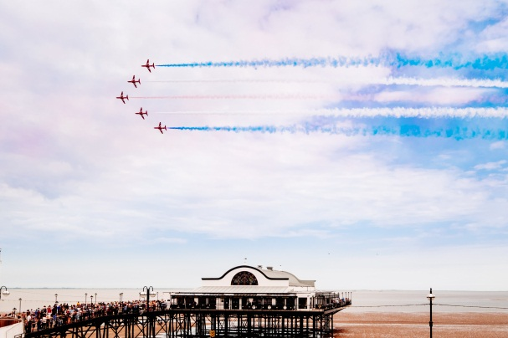
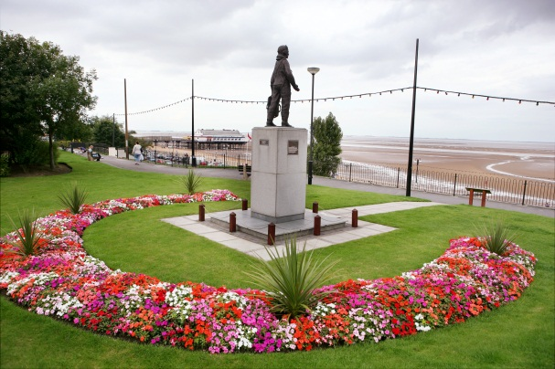
Presentation Content
Opportunities
The Action Plan for Tourism
A Coastal Community: North East Lincolnshire
Moving Regeneration Forward
Discussion

Slide 3
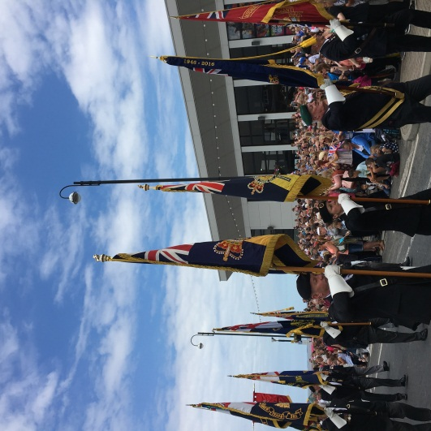
Opportunities
Tourism is key to economic growth in the UK - 1.6 million jobs;
2% increase in overseas visitors to the UK, year on year - 3.8 million in Aug 2016;
In 2016, tourism generated over
£62 billion in GVA revenue to the
UK economy.

Slide 4
The Tourism Action Plan, 2016
The Government’s end goal is, “a Britain that is even more attractive, accessible and welcoming to visitors.“
In August 2016 the ‘Tourism Action Plan’ was published

Slide 5
A Coastal Community: North East Lincolnshire
Public Sector Private Sector
Nothing appears different Underlying uncertainty
Increase in investment enquiries SMEs make local decisions
£11m for regeneration projects So what?
A ‘step change’ is needed through a wider regeneration plan

Slide 6
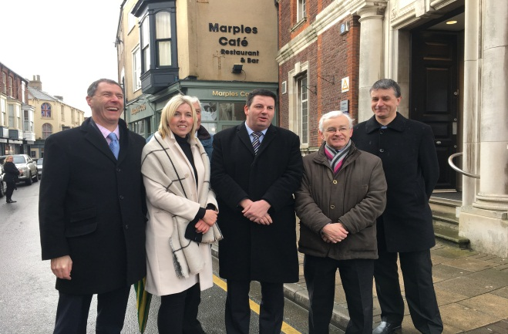
Moving Regeneration Forward...
Communication & Clarity:
Dialogue with public, private and 3rd sector partners
Cohesion and Collaboration:
Public/private sector partnership approach
Care and Consideration:
Focus on small businesses
Creating Confidence to Change:
The right environment for growth

Slide 7
Moving Regeneration Forward...
COMMUNICATION / CLARITY
BETTER LEVEL OF ENGAGEMENT & TRUST
UNDERSTANDING – RISK / BENEFITS
POSITIVITY
CONFIDENCE
INVESTMENT
WIDER REGENERATION & ‘A SENSE OF PLACE’

Slide 8
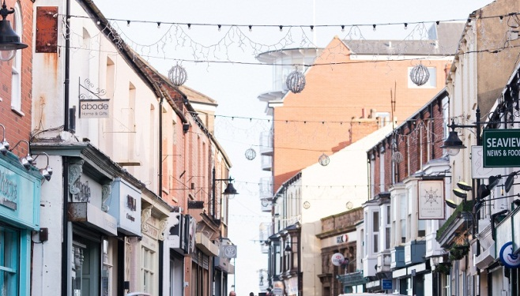
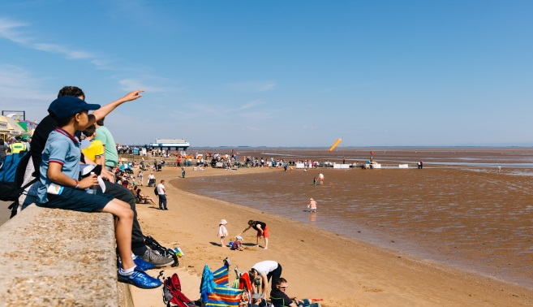
Discussion
What can Coastal Community Teams do to help ensure sustainable growth and regeneration?

